Slide 1
Team 05: Calvin Bolt 3.0

Slide 2
Team Members
Nathan Swaim
ME
Bernice Portugal
ME
Samuel Hanover
ME
Phillip Kim
ME

Slide 3
Presentation Outline
Project Overview
Accomplishments
Version Control Software
Braking System
Steering System
Design Norms
Ideas for Future Groups

Slide 4
Project Overview: Calvin Bolt 3.0
Overall Focus:
Create a platform of continuous improvement for future students in hopes of providing a visual representation of Calvin Engineering.
Improving certain systems rather than entire vehicle
Braking System
Steering System
Improve documentation through version control software
Project Overview
Version Control Software
Braking System
Steering System
Future Groups
Design Norms

Slide 5
Version Control Software
Tracks CAD Revisions
Adaptable to any CAD software
Store Microsoft Office Documents (i.e. Excel, Word)
http://www.autodesk.com/products/vault-family/overview
Project Overview
Braking System
Steering System
Future Groups
Design Norms
Version Control Software

Slide 6
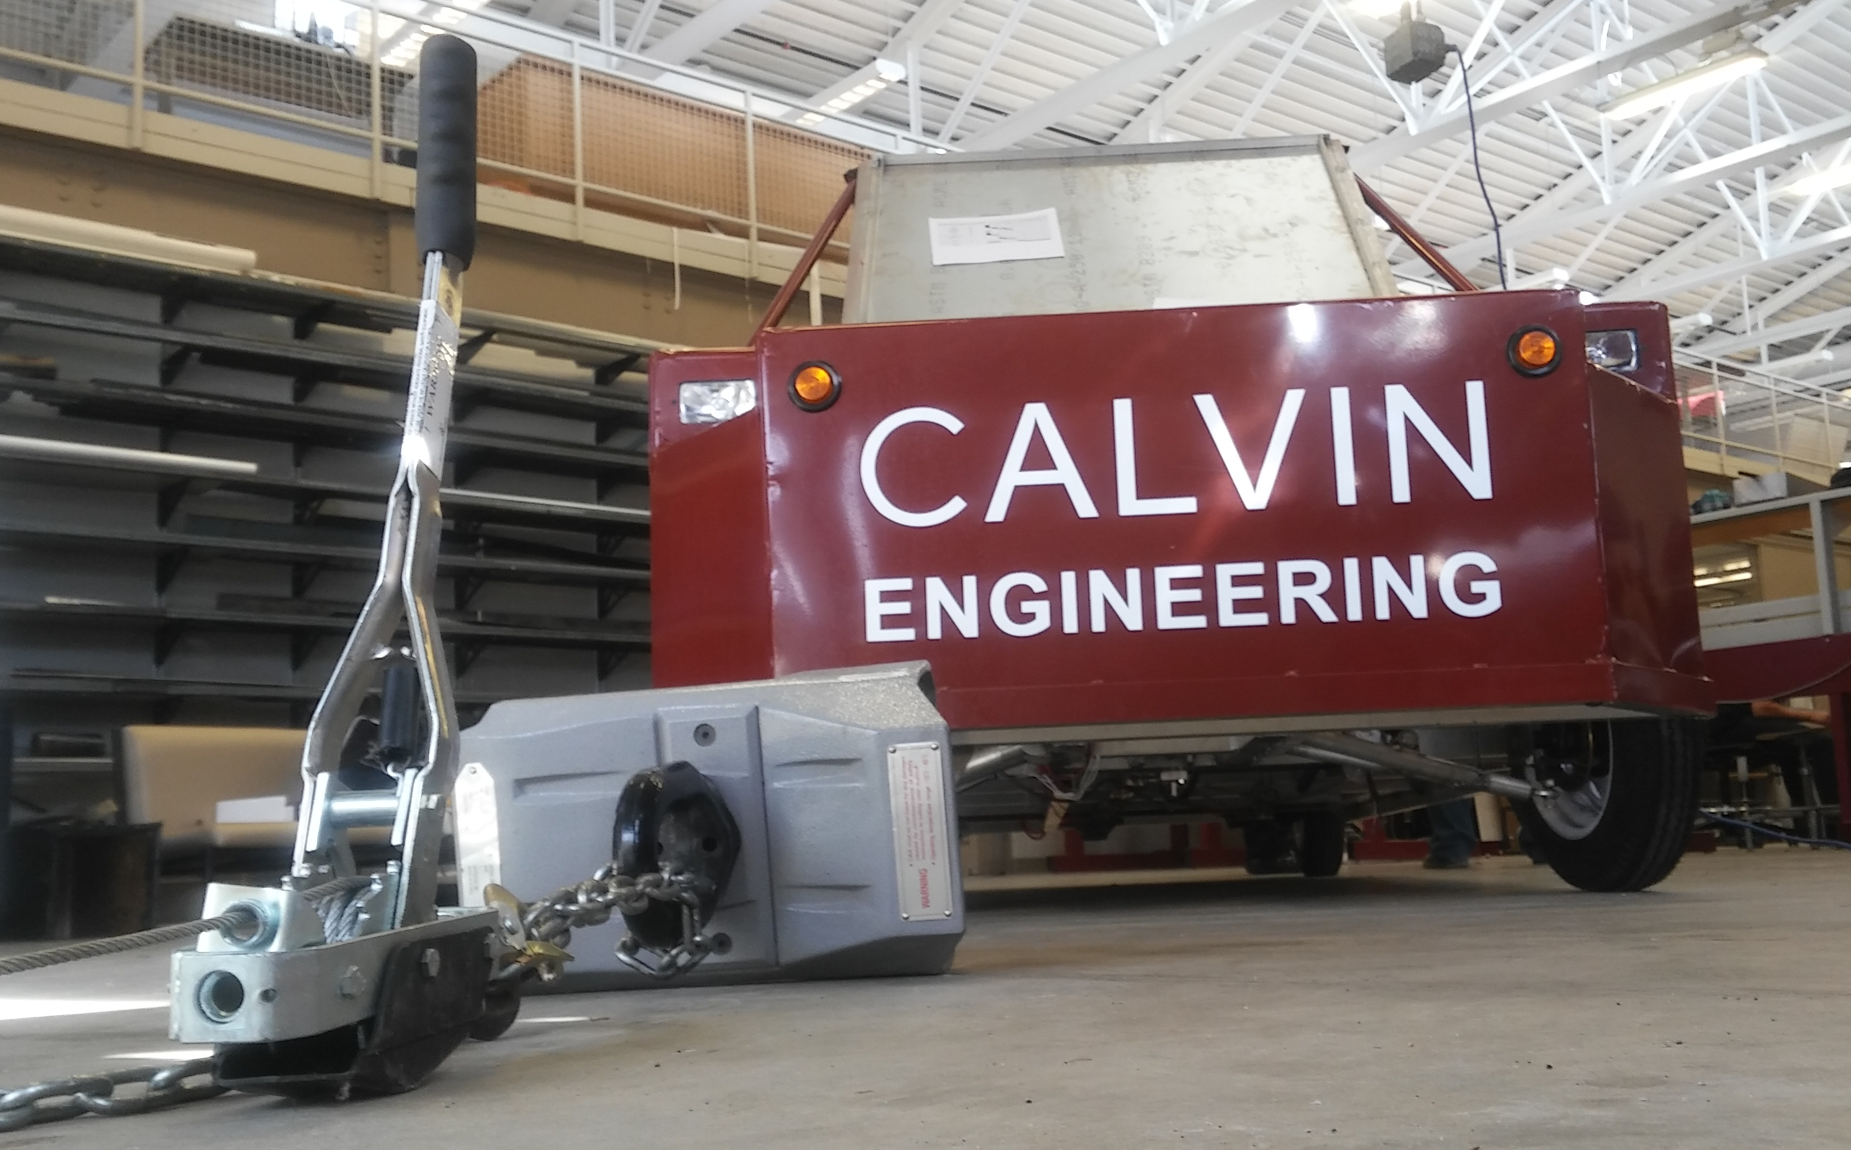
Braking System
The Goal:
Be able to provide a pulling force greater than 300 lbf. when applying 45 lbf. to the pedal.
µ = 0.3
µ = 0.7
Project Overview
Version Control Software
Braking System
Steering System
Future Groups
Design Norms

Slide 7
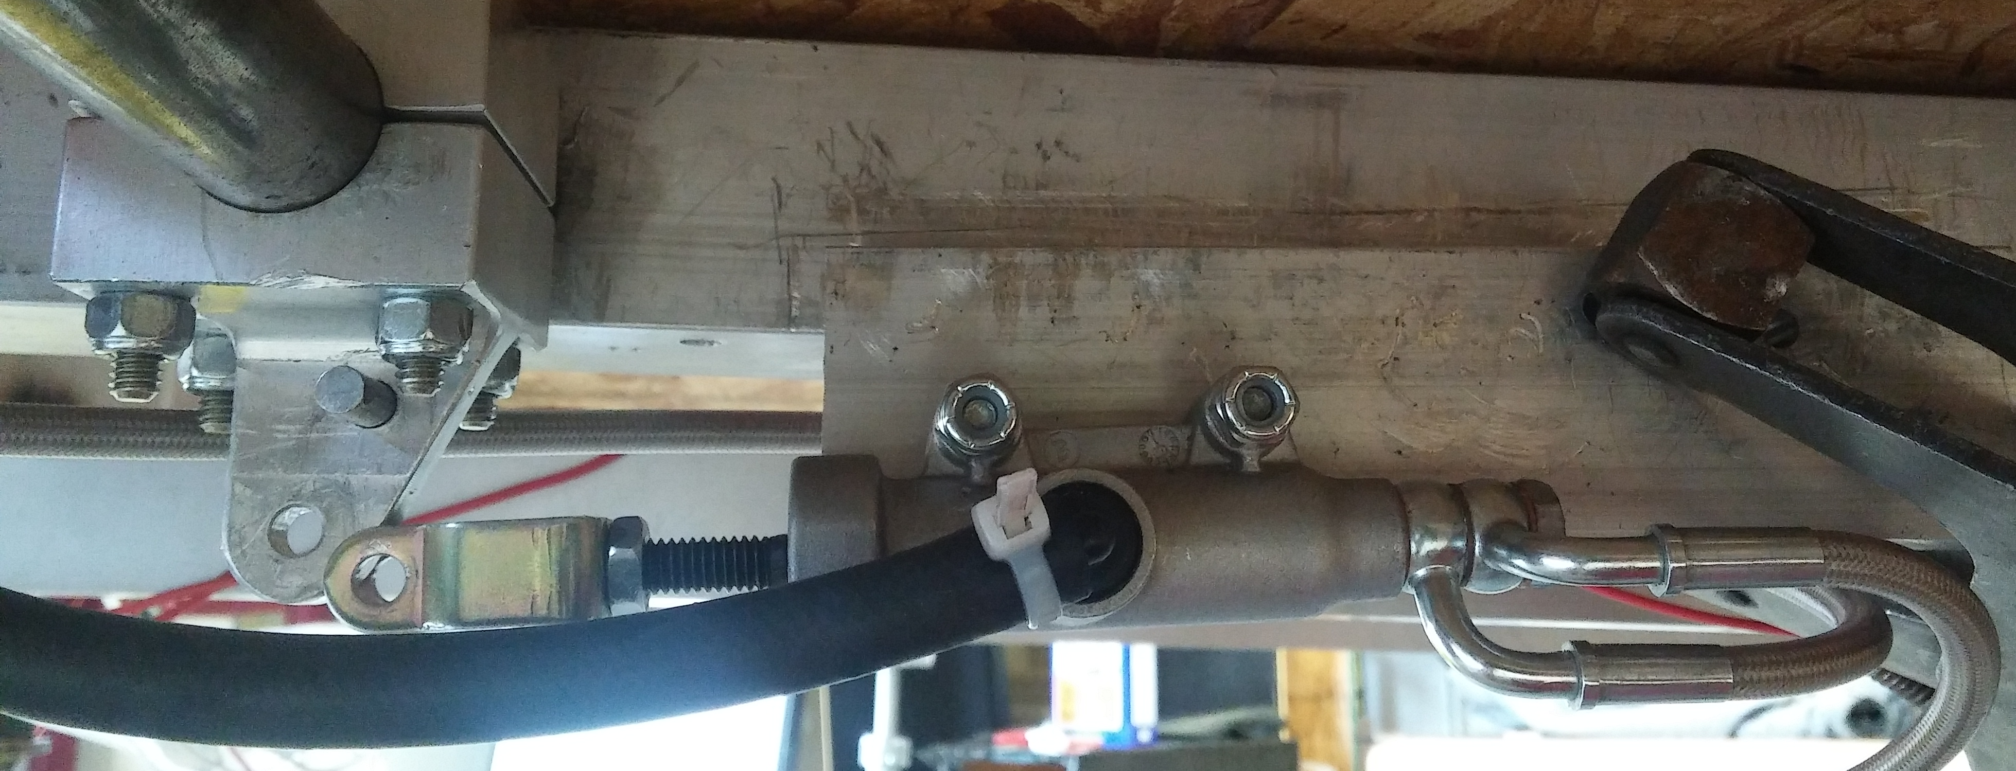
Braking System
The Original Plan:
Use a master cylinder with a smaller diameter and a higher pivot point. The closer the distances of “D” and “d” are, the higher the provided force by the master cylinder is.
Pedal
D
Shaft
Fixed
d
Shaft
d
Flexible
Pivot Point
Project Overview
Version Control Software
Braking System
Steering System
Future Groups
Design Norms

Slide 8
Braking System
Issues:
Issues | Solution | Did it work?
Piston Rod Broke | Create new rod | Improved, but no
Fluid Leakage from Caliper | Purchased new caliper | Improved, but no
Losing Pressure | Pressure Check | No, pressure was working fine
Project Overview
Version Control Software
Braking System
Steering System
Future Groups
Design Norms

Slide 9
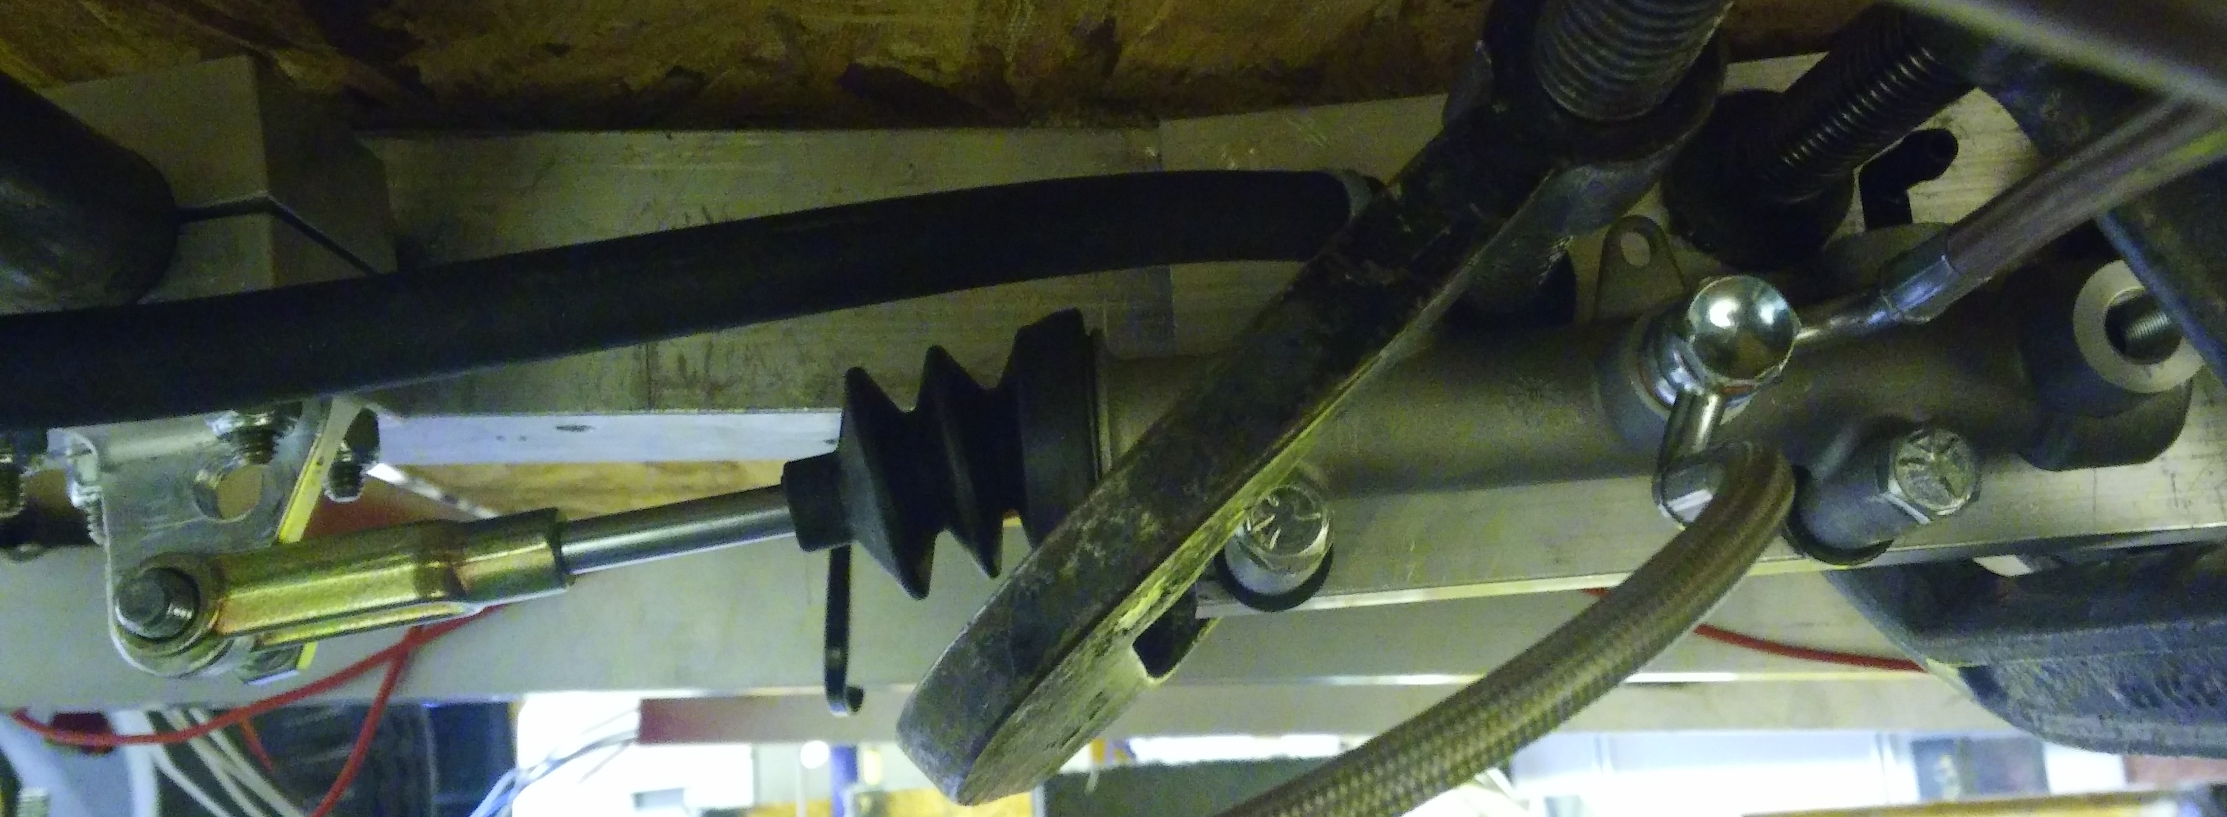
Braking System
The Revised Plan:
Use the 5/8” master cylinder with a higher pivot point and an increase in leverage from the geometry of the pedal to make up for the loss force in having a larger master cylinder.
Project Overview
Version Control Software
Braking System
Steering System
Future Groups
Design Norms

Slide 10
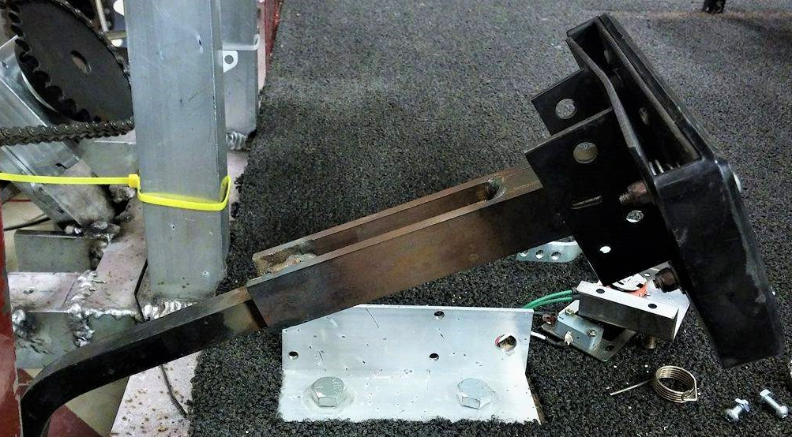
Braking System
The Final Plan:
Increase the length of the brake pedal by 3”
This number was calculated from our theoretical model.
Project Overview
Version Control Software
Braking System
Steering System
Future Groups
Design Norms

Slide 11
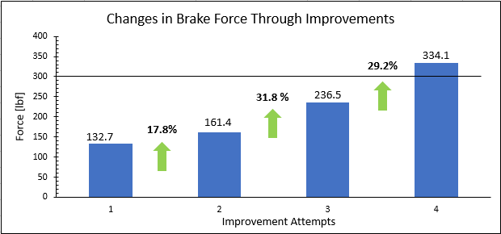
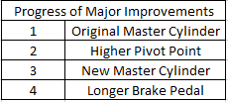
Braking System
The Results:
Project Overview
Version Control Software
Braking System
Steering System
Future Groups
Design Norms

Slide 12
Steering System
Ackermann Steering
Bump Steering
Steering degree Ratio
Shaft Supports
Project Overview
Version Control Software
Braking System
Steering System
Future Groups
Design Norms

Slide 13
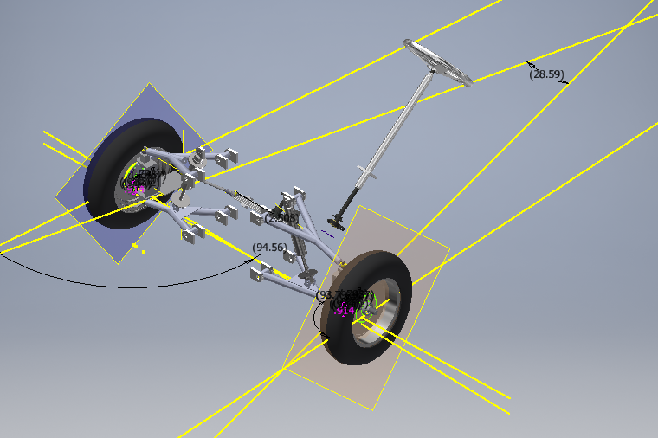
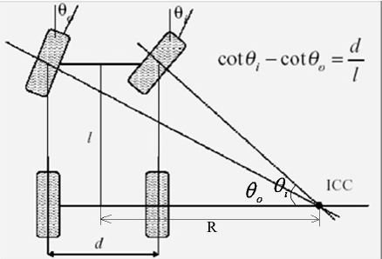
Ackermann Steering
www.slideshare.net
Project Overview
Version Control Software
Braking System
Steering System
Future Groups
Design Norms

Slide 14
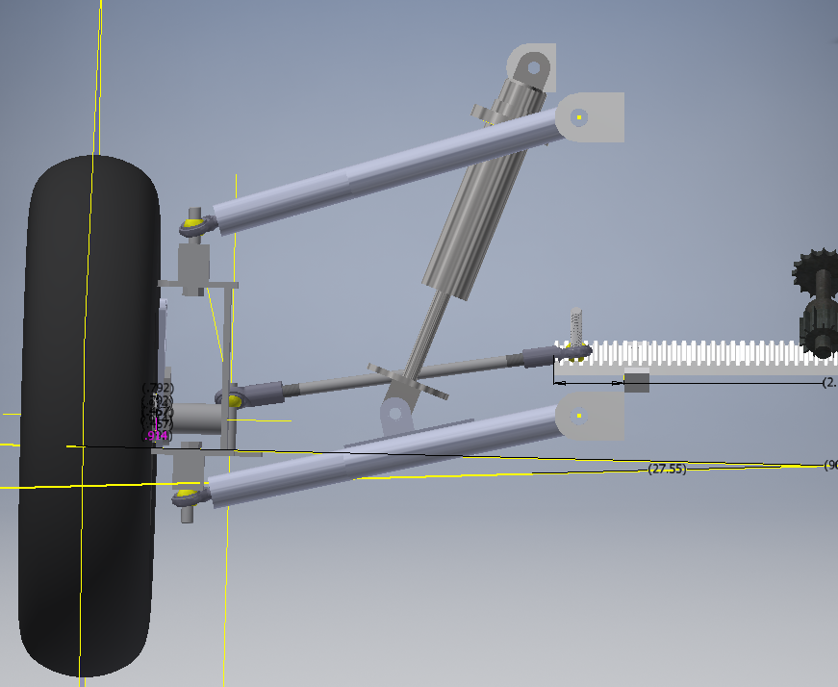
Bump Steering
Project Overview
Version Control Software
Braking System
Steering System
Future Groups
Design Norms

Slide 15
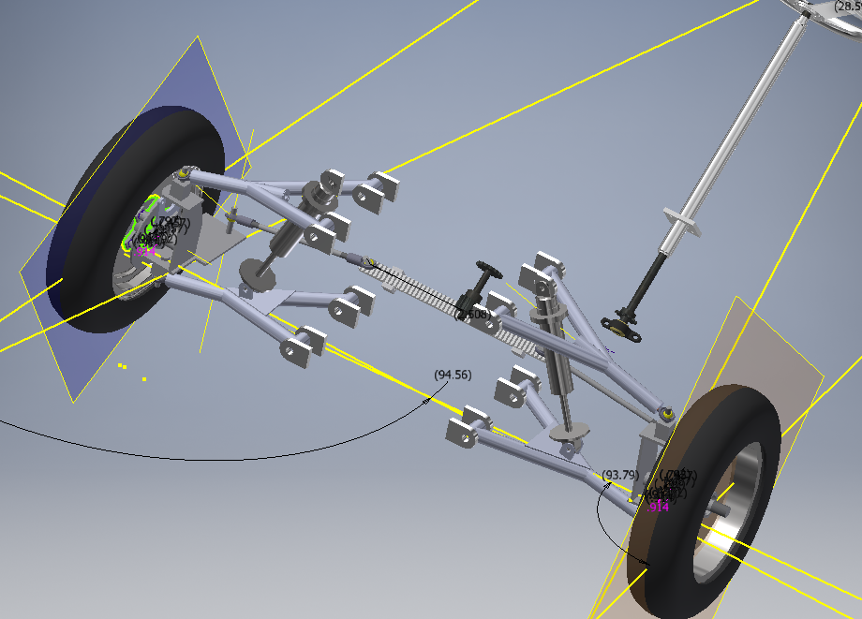
Steering Degree Ratio
Standard Ratio: 12:1 to 20:1
Previous Ratio: 11:1
Current Ratio: 25:1
Version Control Software
Braking System
Steering System
Future Groups
Design Norms
Project Overview

Slide 16
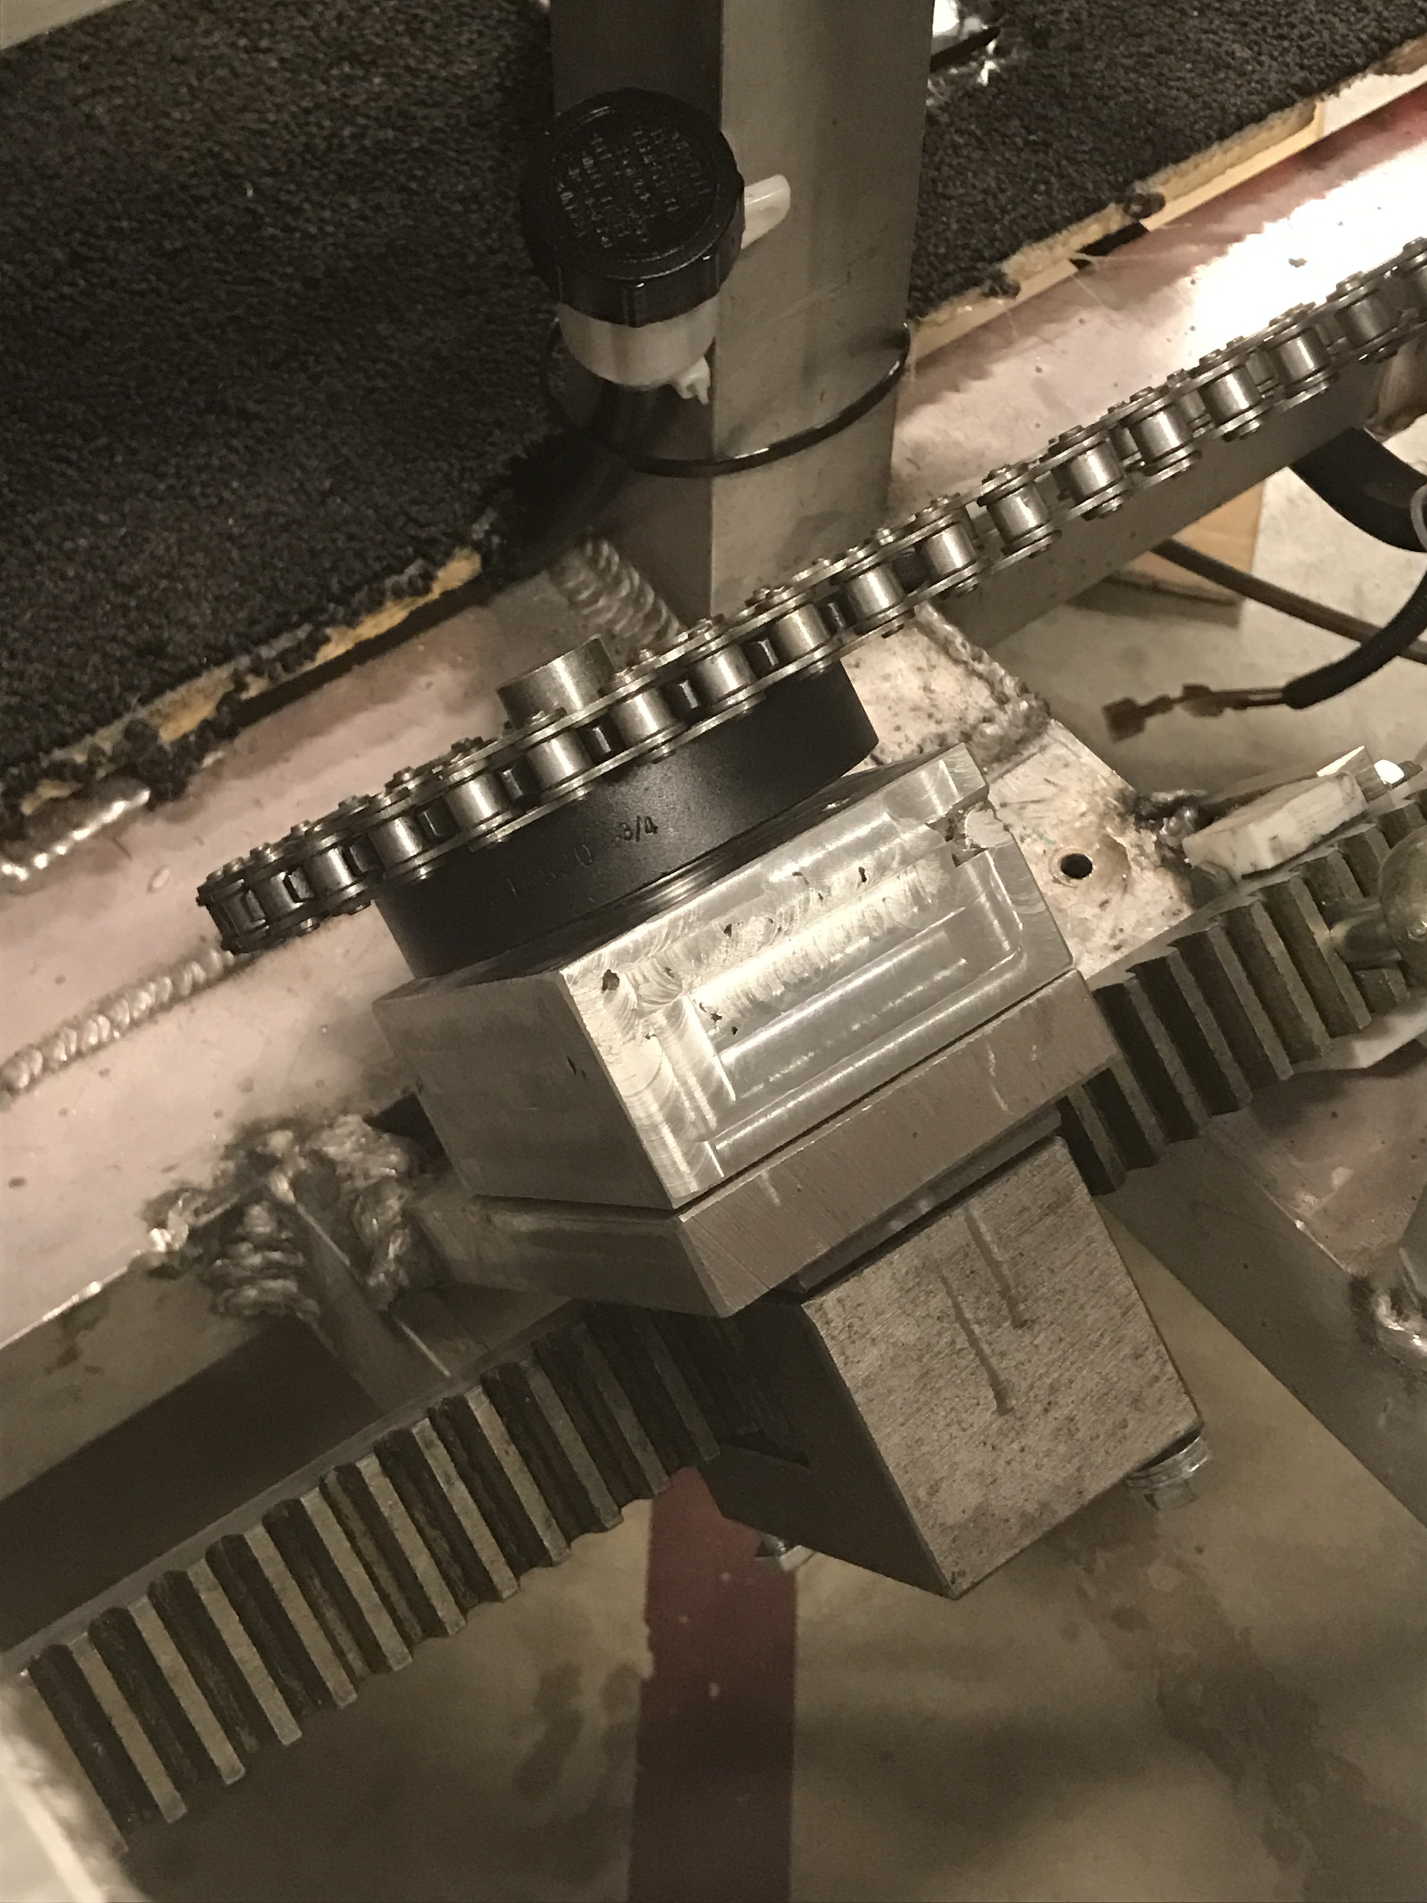
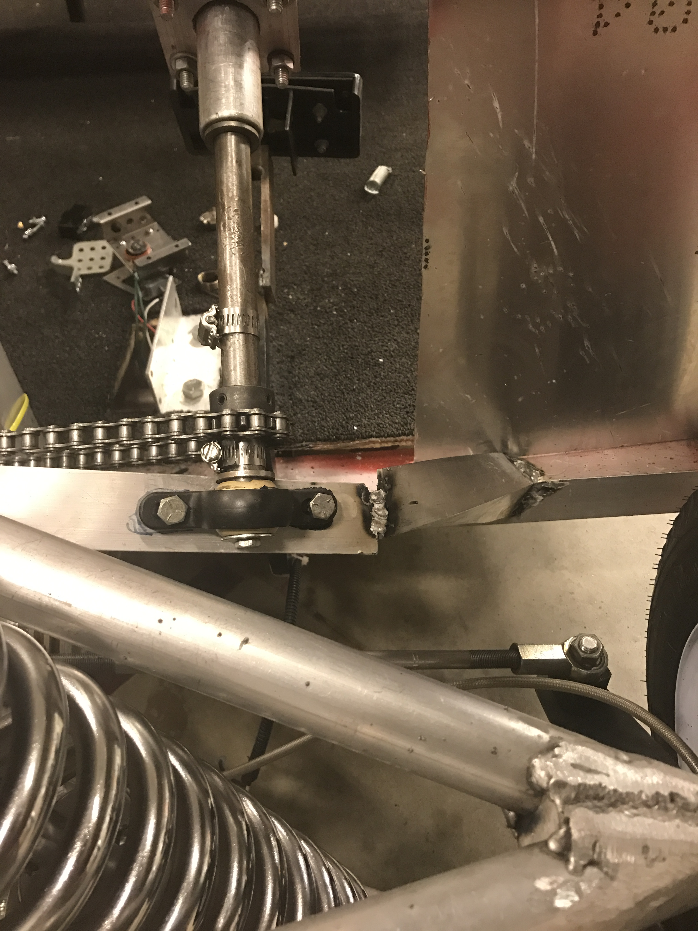
Shaft Supports
Version Control Software
Braking System
Steering System
Future Groups
Design Norms
Project Overview

Slide 17
Design Norms
Trust
Stewardship
Integrity
www.linkedin.com
Project Overview
Version Control Software
Braking System
Steering System
Future Groups
Design Norms

Slide 18
Idea for Future Groups
Implementing ABS
Aesthetic Appeal
Frame
Higher Efficient Batteries
Higher Seating Capacity
Lighting
And more…
Project Overview
Version Control Software
Braking System
Steering System
Future Groups
Design Norms

Slide 19
Questions?

