Slide 1
The Perfect Stormwater
Team 07 – Anna Camilleri, Travis Hanko, Ryan Roggie, Ha Ram Kang
Advisor: Professor DeRooy

Slide 2
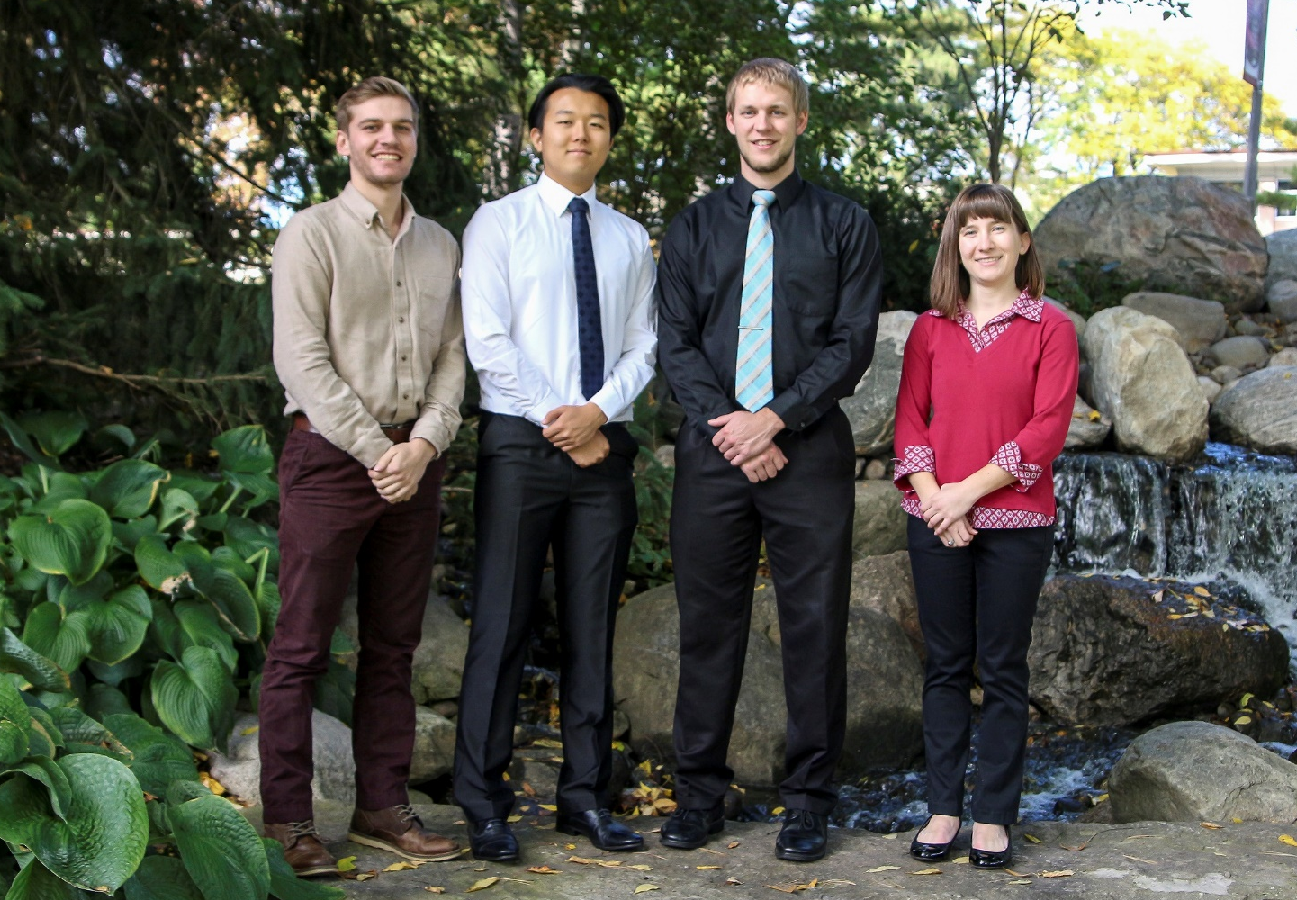
Introduction
Ryan Roggie (CE), Ha Ram Kang(CE), Travis Hanko(CE), Anna Camilleri (CE)
Introduction
Computations & Modeling
Project Description
Design Decisions
Obstacles
Final Design
Design Performance

Slide 3
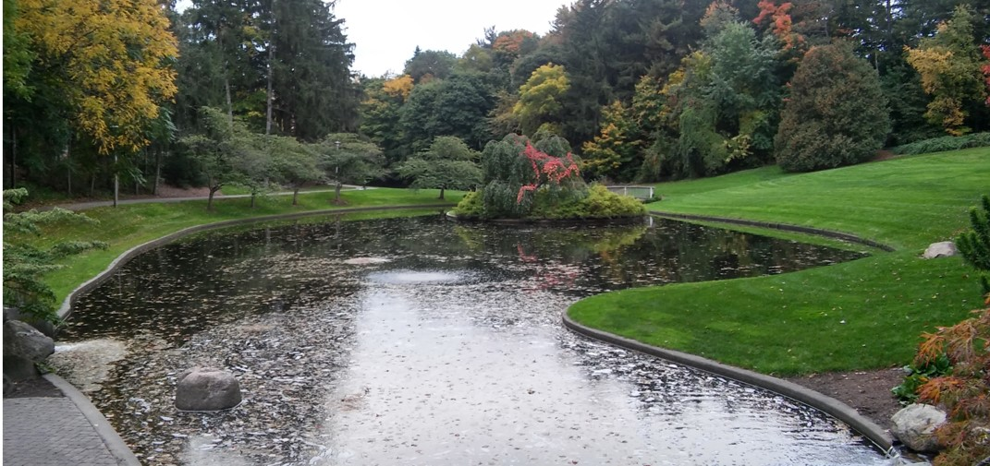
Outline
Project Description
Design Decisions
Computations & Modeling
Obstacles
Final Design
Design Performance
Introduction
Computations & Modeling
Project Description
Design Decisions
Obstacles
Final Design
Design Performance

Slide 4
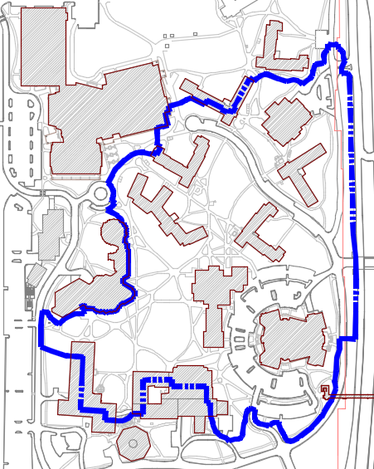
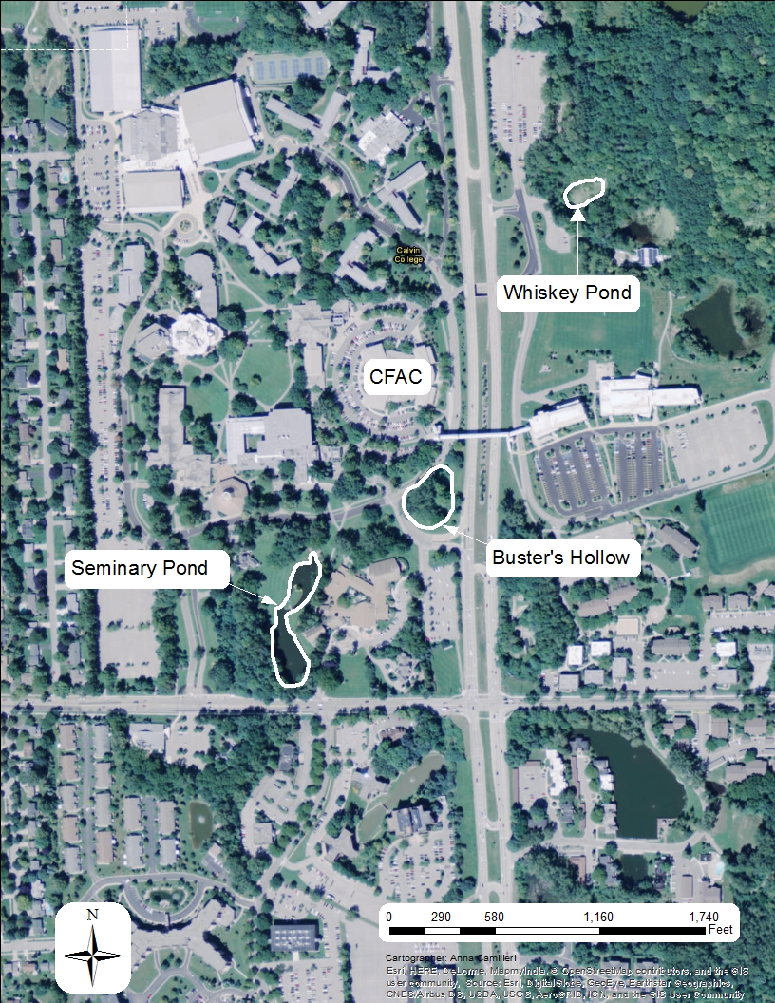
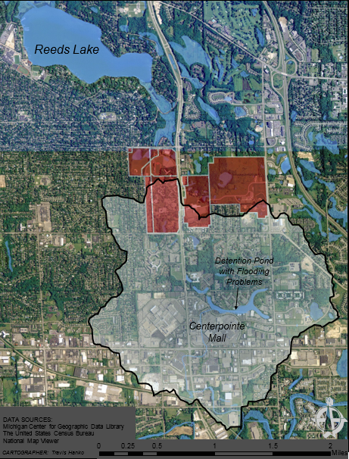
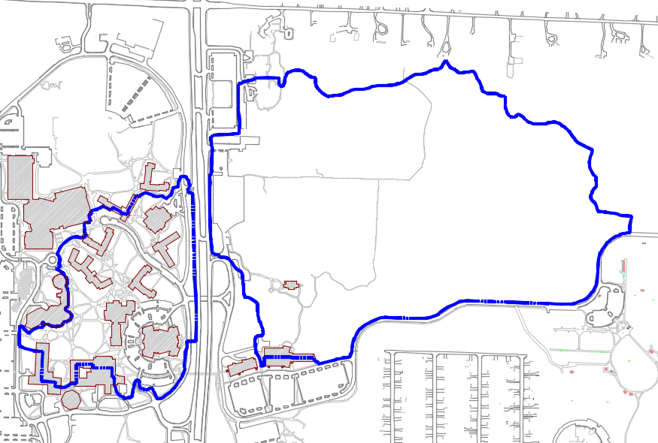
Project Description
Calvin College
Daylight Whiskey Creek to improve storm water quality & increase detention.
Whiskey Creek Watershed
Commons
Commons Annex
CFAC
Hekman Library
Introduction
Computations & Modeling
Project Description
Design Decisions
Obstacles
Final Design
Design Performance
Notes:
-We decided to daylight whiskey creek at the beginning of last semester, to improve the overall aesthetics of Calvin’s campus core, as well as to improve the storm water quality that enters the sem pond
-Later on, after meeting with the KCDC, the team added another goal of increasing detention for Calvin’s campus
-Calvin is in the Whiskey Creek watershed. The main stream for this watershed is whiskey creek, which starts on Calvin’s nature preserve.
-It then is immediately captured by storm sewers
-and transported via concrete piping to Busters Hollow, and the Sem Pond
-Contributing watershed for this project was calculated to be just under 150 acres, including the area East of the East Beltline
-only 48 acres on the West of Campus

Slide 5
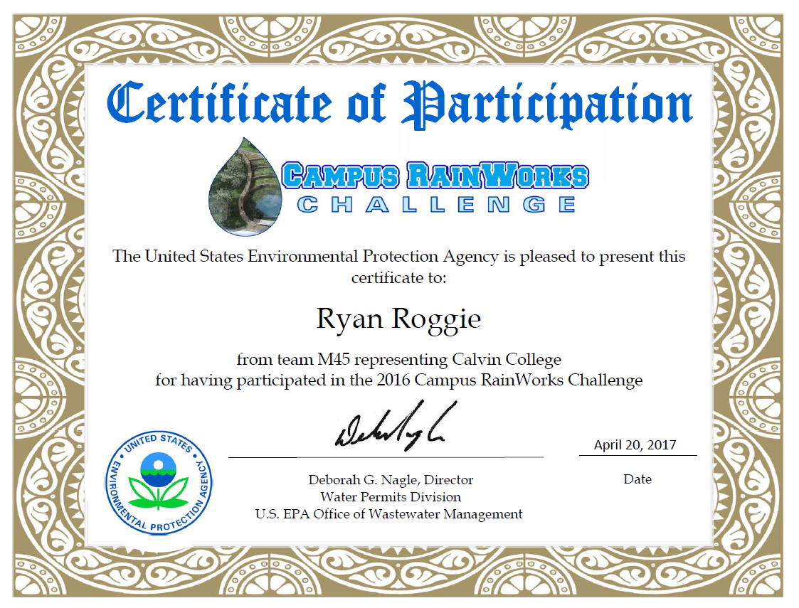
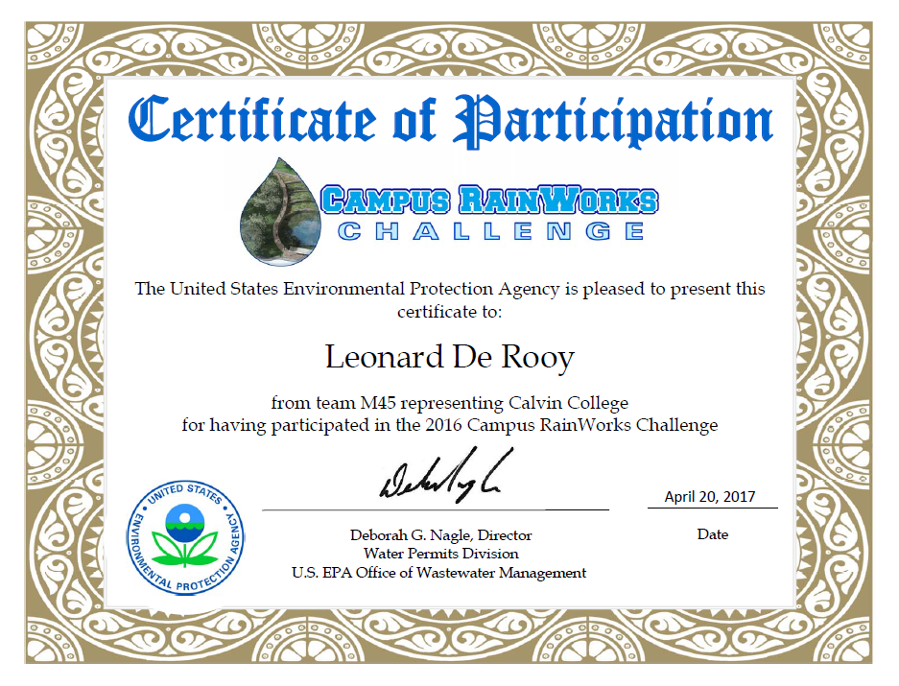
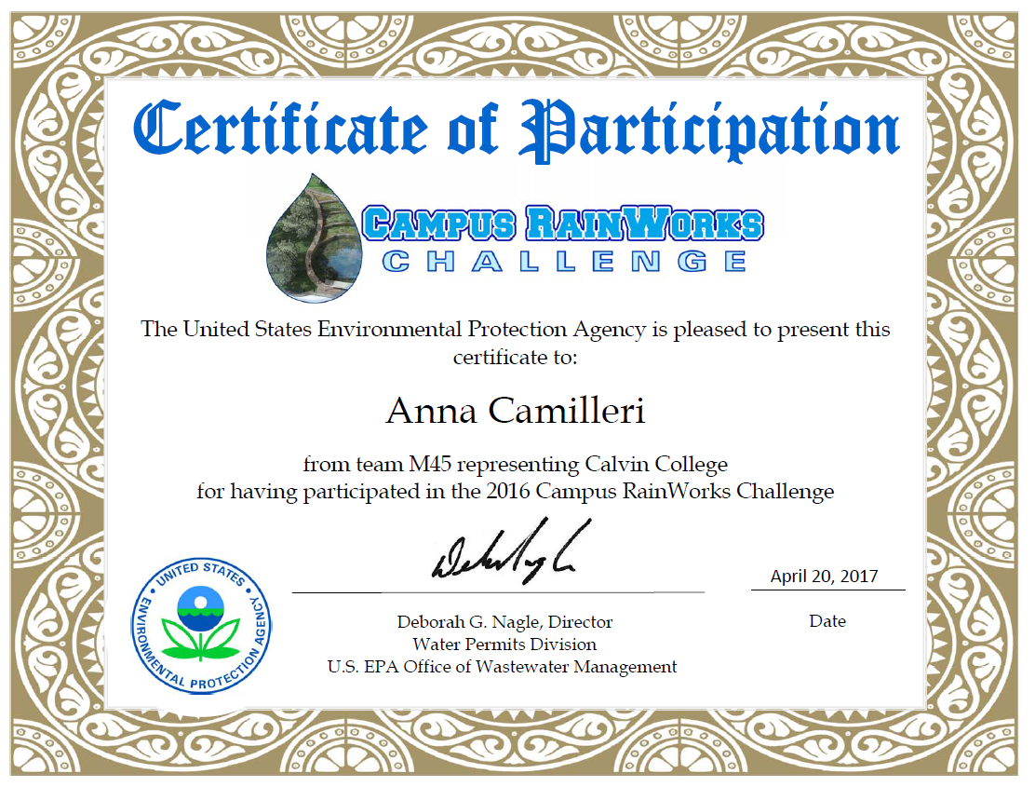
Project Description
EPA's National Campus RainWorks Challenge
Introduction
Computations & Modeling
Project Description
Design Decisions
Obstacles
Final Design
Design Performance
Notes:
-We also entered into EPA’s 5th annual National Campus RainWorks Challenge.
-”design an innovative green infrastructure project for their campus that effectively manages stormwater runoff while benefitting the campus community and the environment”
-Entered a preliminary model analysis on December 16th of last year.
-Winners announced this April, and we didn’t win anything, but it was a good experience to enter into this competition
-Set an example for future teams, that this competition is possible

Slide 6
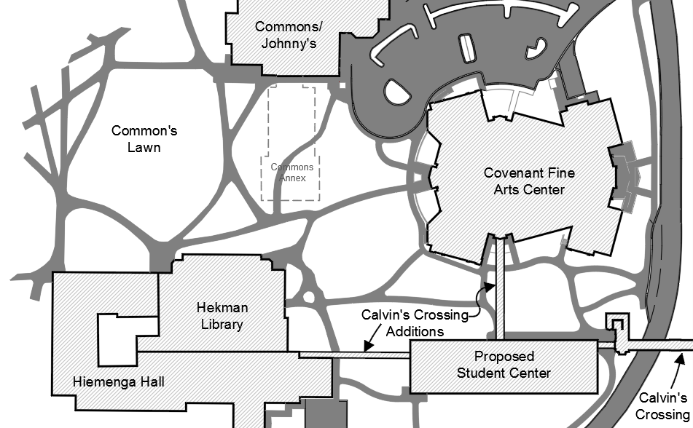
Design Decisions
Stream Path
Inlet/Outlet Locations
Initial Stream Width and Floodplains
100-year
25-year
Introduction
Computations & Modeling
Project Description
Design Decisions
Obstacles
Final Design
Design Performance
Notes:
Stream Path
-Depended on the existing buildings and utilities in the area
-constricted by the CFAC, Proposed Student Center, Hekman Library, and roads
-constricted by existing sanitary sewers in the area
-Eventually, the team decided on the locations seen here. Ryan will talk about the actual dimensions and channel properties later on
Ideal Depth of Flow
-The team struggled with a very minimal amount of flow. The team also had to consider the velocity of the water in the channel to make sure there isn’t enough force to uproot plants or move rocks in the channel
-depth of flow is about 0.5 feet deep
Initial Stream Width and Floodplains
-Initially, we just picked these numbers from what we thought looked good
-These were later refined
-Determined based on the SWMM calculations and a MathCAD spreadsheet.
Detention Pond size
-This was chosen using the minimal amount of retaining walls as possible and trying to stay away from the existing sidewalks as much as possible.
-Wanted to provide as much detention as possible, but the goal was to completely detain a 25-year storm
-Storm that drops a certain amount of water that has a probability of happening once every 25 years – 4.7 inches (24-hours)
-This proved to be not enough detention, so another retaining wall was added, and the size was about doubled

Slide 7
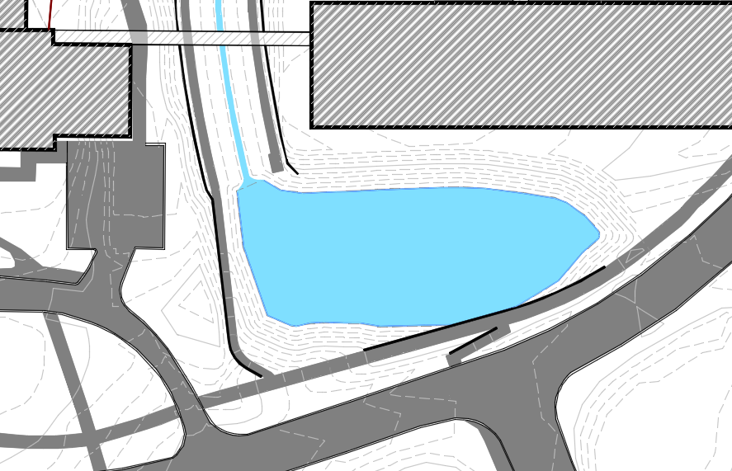
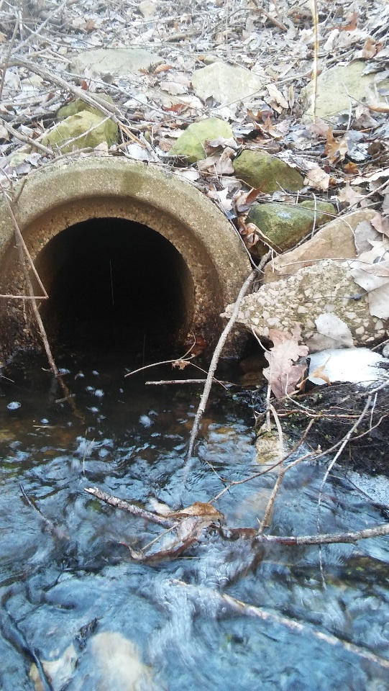
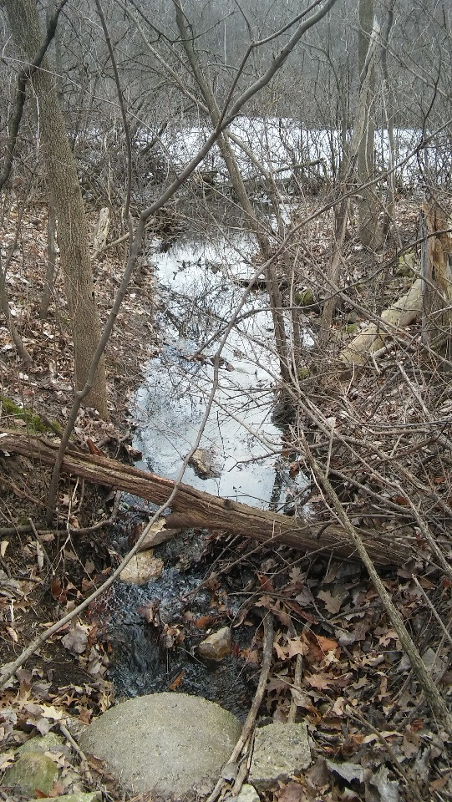
Design Decisions
Ideal Depth of Flow
Water velocity
Erosion
Detention Pond Size
Introduction
Computations & Modeling
Project Description
Design Decisions
Obstacles
Final Design
Design Performance

Slide 8
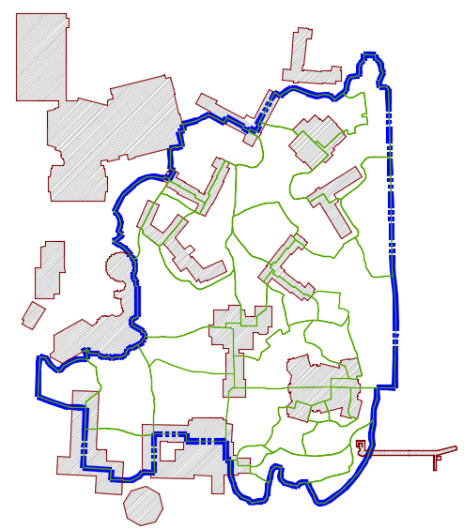
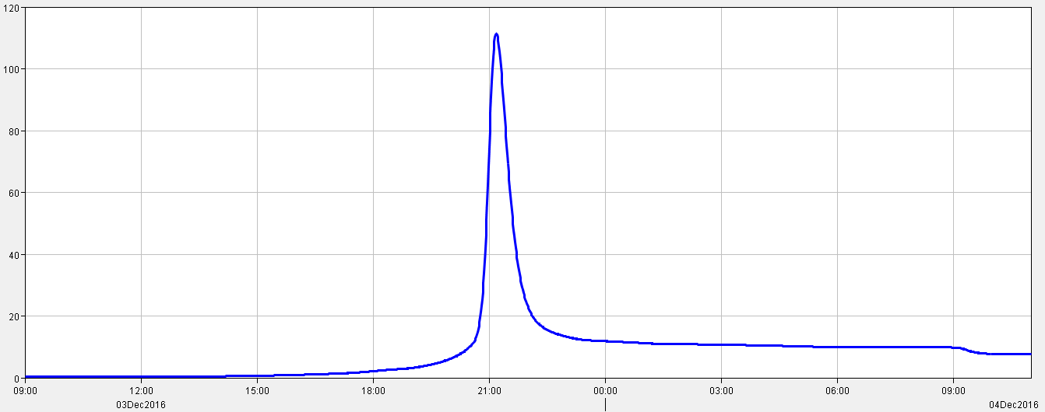
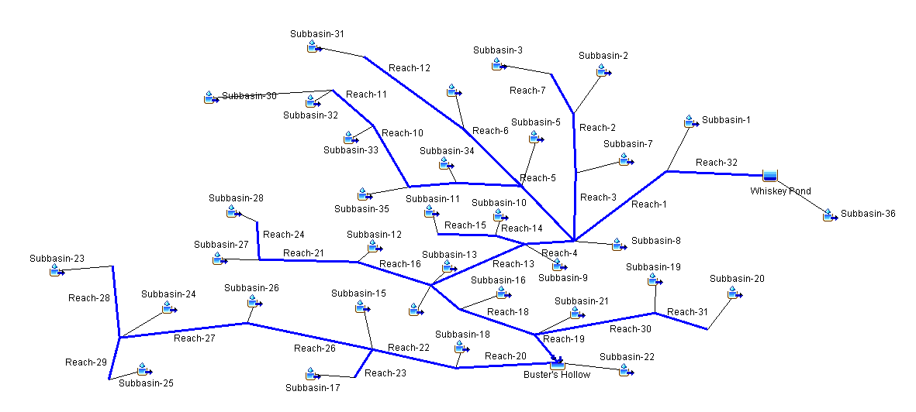
Computations & Modeling
Civil 3D
Individual Catchment Areas
HEC-HMS
Existing Runoff Calculations
EPA SWMM
Proposed flow conditions
Surcharging Manholes
Fieldhouse
Dorms
Commons
CFAC
Hekman Library
Introduction
Computations & Modeling
Project Description
Design Decisions
Obstacles
Final Design
Design Performance
Notes:
As-builts: utilities underground
Pollutant Data: Honors chem students take data ‘book ends’ from whiskey pond and seminary pond
Survey Equipment: connection through Travis, used total station manhole picks and tape measure to measure the water elevations of the storm sewers and get gps data for our autocad drawings
Flow meters: can get (not in possession yet) but will use to gather velocity of whiskey creek and can use that to find the volumetric flow for sizing creek bed and culverts.

Slide 9
Dimensions of Daylighted Stream

Slide 10
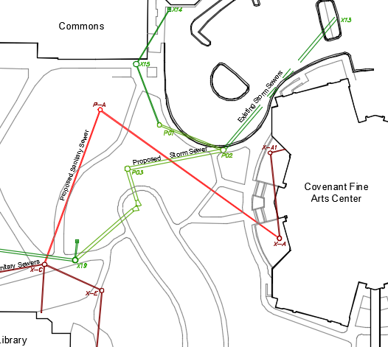
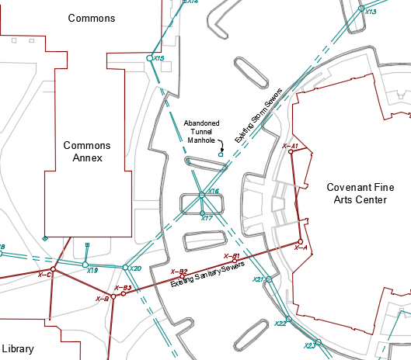
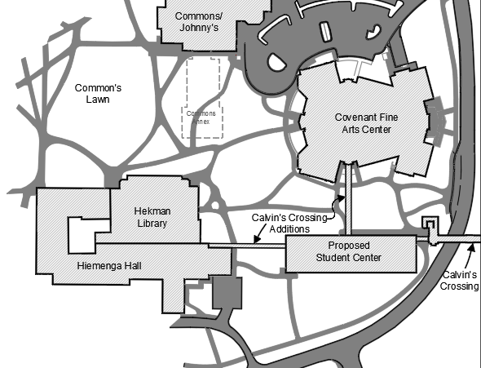
Obstacles Overcome
Existing Utility Lines
Master Plan Development
Very small base flow
Introduction
Computations & Modeling
Project Description
Design Decisions
Obstacles
Final Design
Design Performance
Notes:
One alternative is to outlet the stream to be significantly above the invert of the pipe. This means a lot of the upstream piping could be permanently underwater during flow conditions. However, this could induce surcharging upstream manholes.
-During a storm event, pressure surges can occur within the sewer system. This could raise the upstream water level, and with the already increased hydraulic grade line, this could force water through the upstream manholes and catch basins causing flooding under the overpass.
There are also some existing utilities in the area that need to be worked around. Watermain, Sanitary Sewer, Maintenance Tunnel.

Slide 11
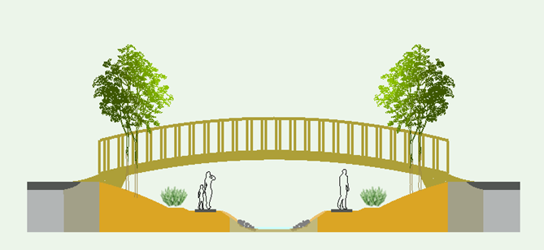
Final Design
Channel Design
Length: 318 ft
Average Width: 77.5 ft
Average Depth: 7.5 ft
Side Slope: 3:1 (H:V)
Channel Slope: 0.1%
Vegetation
Introduction
Computations & Modeling
Project Description
Design Decisions
Obstacles
Final Design
Design Performance

Slide 12
Weir Design
Broad Crested Weir
4’ Long
0.5’ High
6’ Wide (Top width)
0.5’
Introduction
Computations & Modeling
Project Description
Design Decisions
Obstacles
Final Design
Design Performance

Slide 13
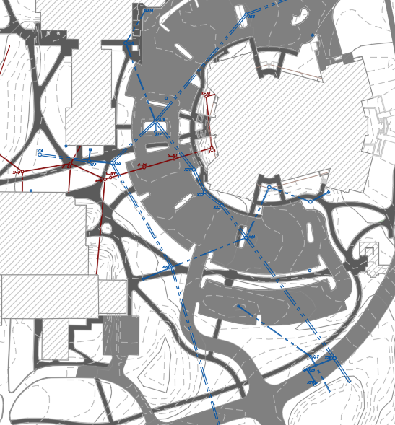
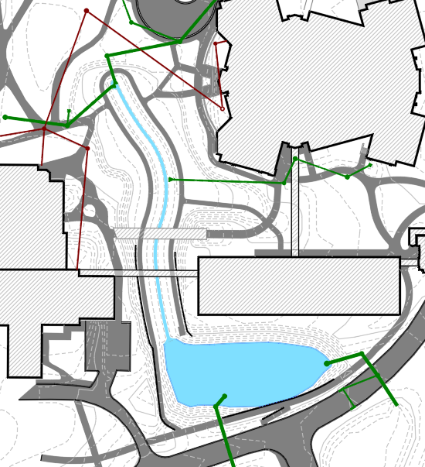
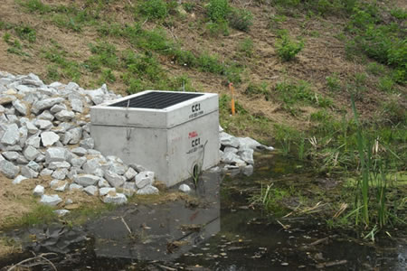
Existing Conditions
Proposed Design
Outlet Structure
http://baigroupinc.net/natural-resources-management/stormwater-evaluation-and-design/
Introduction
Computations & Modeling
Project Description
Design Decisions
Obstacles
Final Design
Design Performance

Slide 14
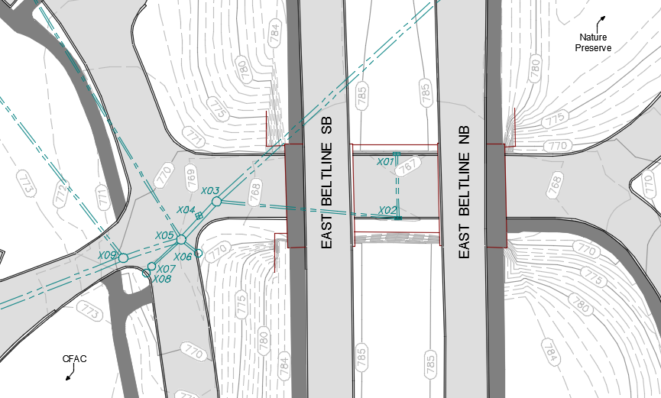
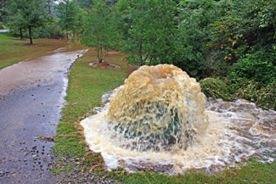
Flood Analysis
Existing: 5.52 cubic feet per sec
Proposed: 4.25 cubic feet per sec
https://www.como.gov/PublicWorks/StormWater/InflowandInfiltrationReductionProgram.php

Slide 15
Design Performance
Detention
Sedimentation Removal:
Coarse silt to very fine clay
Contaminant Removal
Phosphates: 189 lb/yr (61%)
Nitrates: 383 lb/yr (45%)
Introduction
Computations & Modeling
Project Description
Design Decisions
Obstacles
Final Design
Design Performance
Notes:
Sediment Removal:
The detention pond under baseflow conditions settles out particles up to a particle diameter of 2 thousandths of an inch. The design contaminant removal is 61% removal of phosphorous and 45% removal of nitrates.

Slide 16
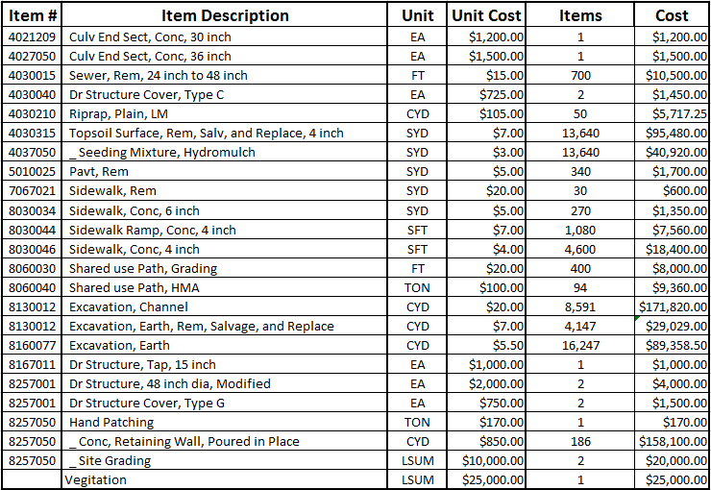
Cost Overview
Total Cost: $975,000
Majority of Cost:
Excavation: 29,000 cubic yards
Utility removal: 1100 feet
Utility placed: 750 feet

Slide 17
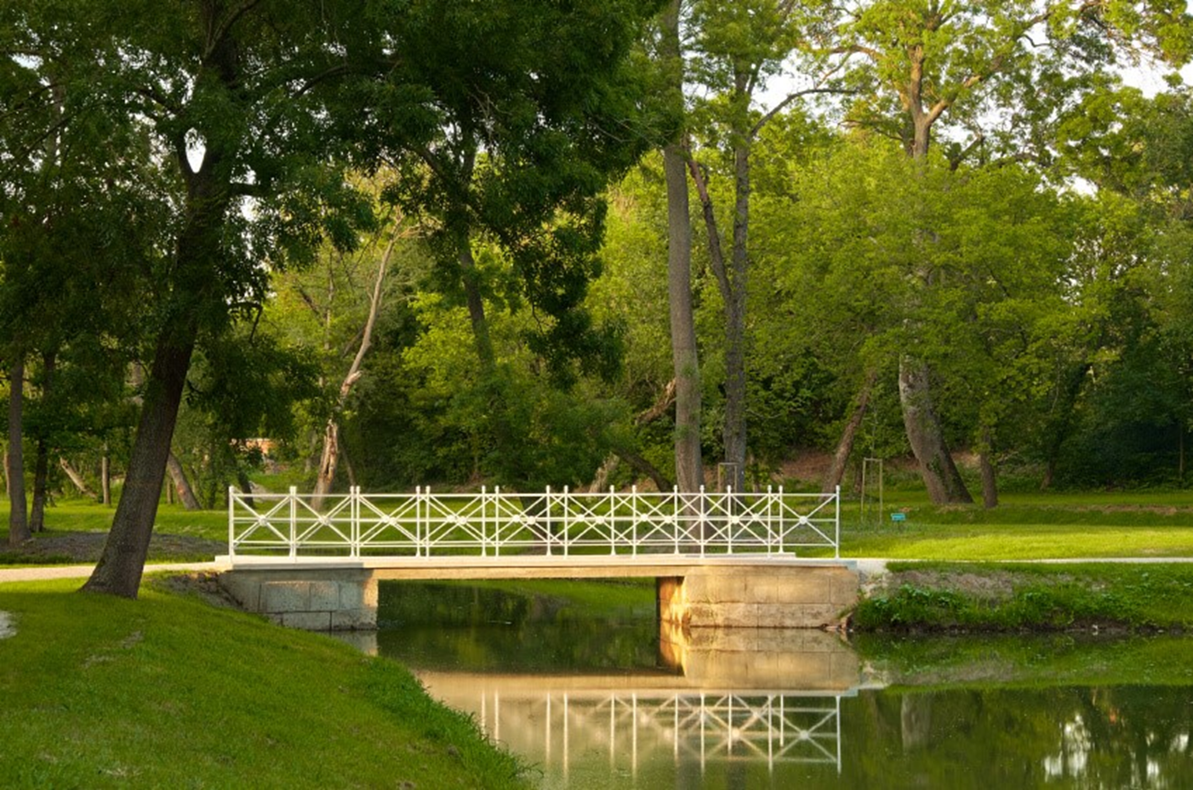
Future Work
Bridge Design
Retaining Wall Design
Vegetation
http://www.homestratosphere.com/backyard-garden-bridge-ideas/

Slide 18
Acknowledgements
Professor Robert Hoeksema
Professor Mark Muyskens
Professor Deanna VanDijk
Advisor: Leonard De Rooy
Feenestra & Associates Civil Engineers and Surveyors
Calvin College Engineering Department
& Emily (for the Ducks)

Slide 19
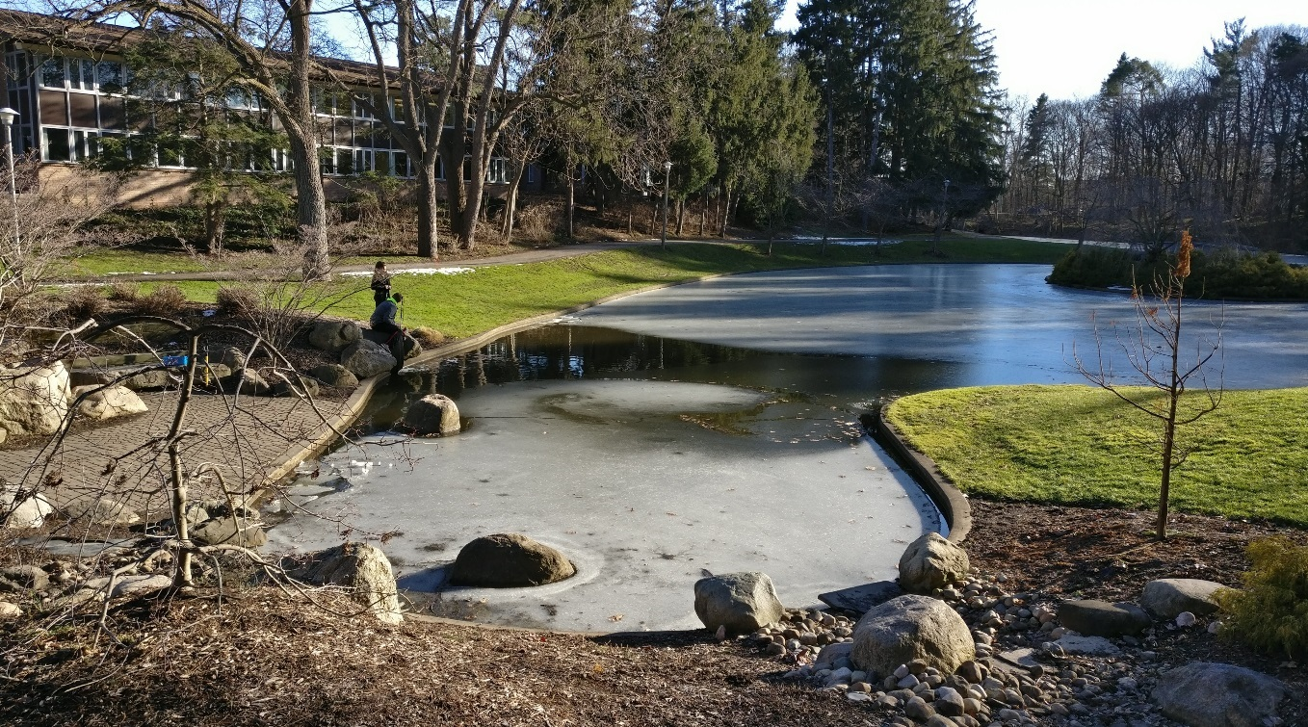
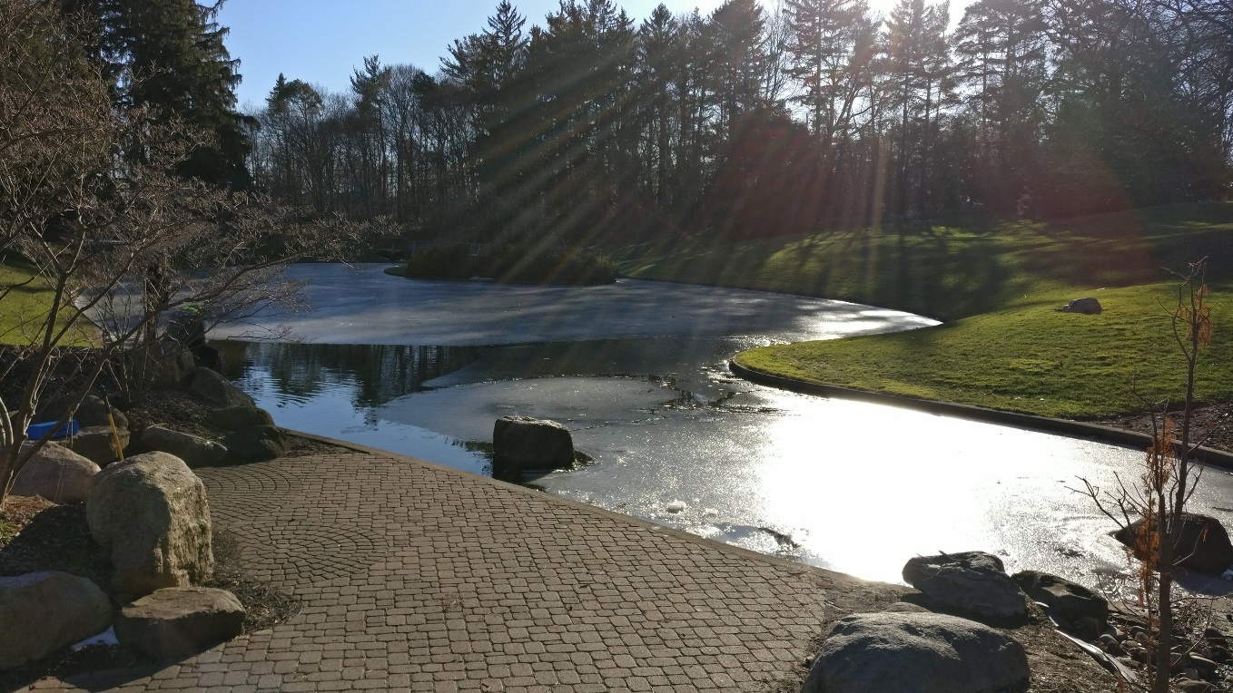
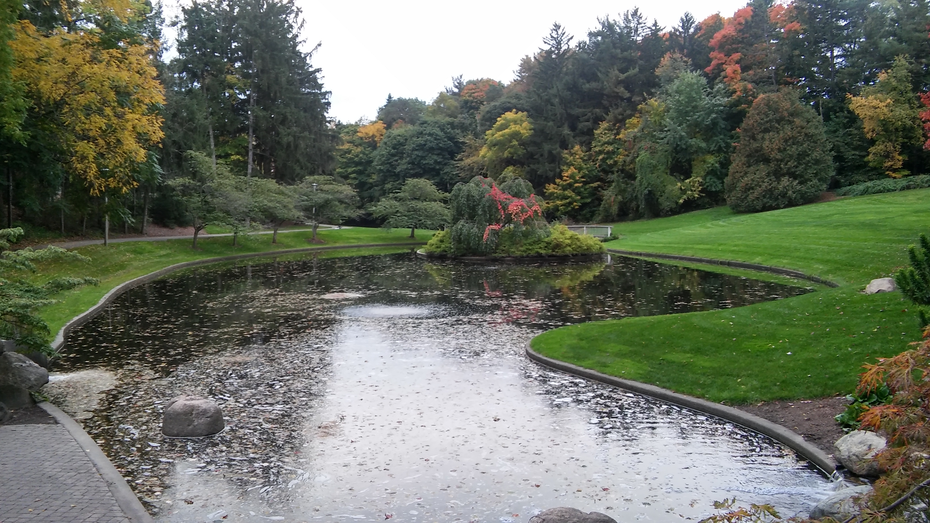
Questions?

