Slide 1
IdentiKey
Team 10
CEAC Presentation
April 21, 2017

Slide 2
Jonathan Engle (ECE) | Brian DeVries (ECE) | Drew Davis (ECE) | Jared Haan (ECE)
Team 10
2/19

Slide 3
Outline
Problem
Solution
Accomplishments
Future Work
3/19

Slide 4
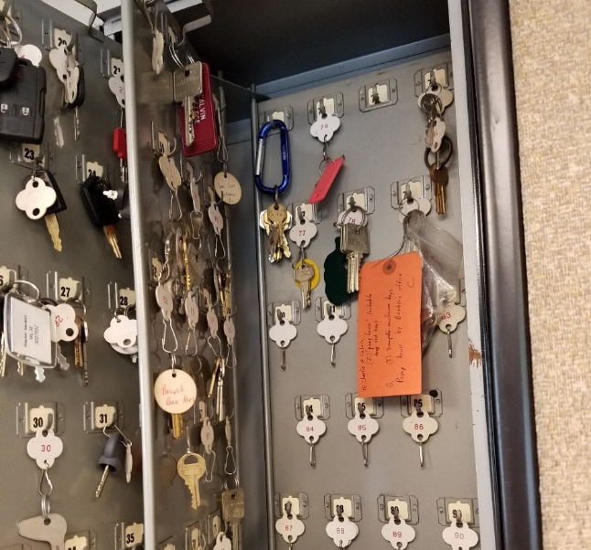
Problem
Retrieving keys
Returning keys
Security
4/19

Slide 5
Outline
Problem
Solution
Accomplishments
Future Work
5/19

Slide 6
Solution
Trust
Delightful Harmony
IdentiKey
Caring
Automated
Eliminate human error
Easy to use
Secure
Expandable
6/19

Slide 7
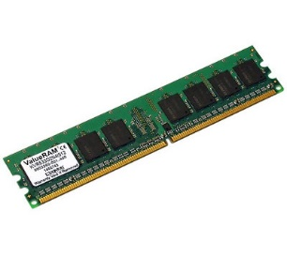
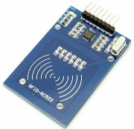
Basic Process Flow Diagram
Key Storage:
Key
RFID
Microprocessor
Memory
Key Retrieval:
User Interface
Microprocessor
Key
7/19

Slide 8
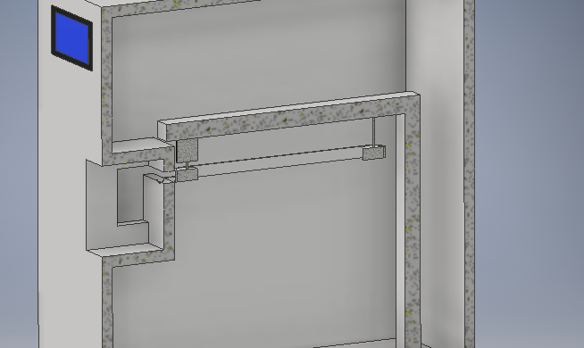
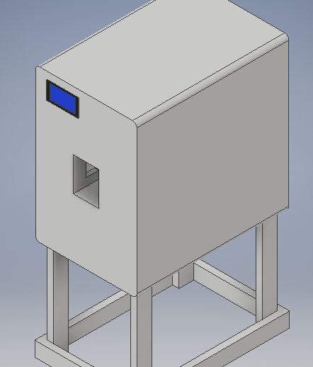
Prototype Initial Concept
8/19

Slide 9
Outline
Problem
Solution
Accomplishments
Future Work
9/19

Slide 10
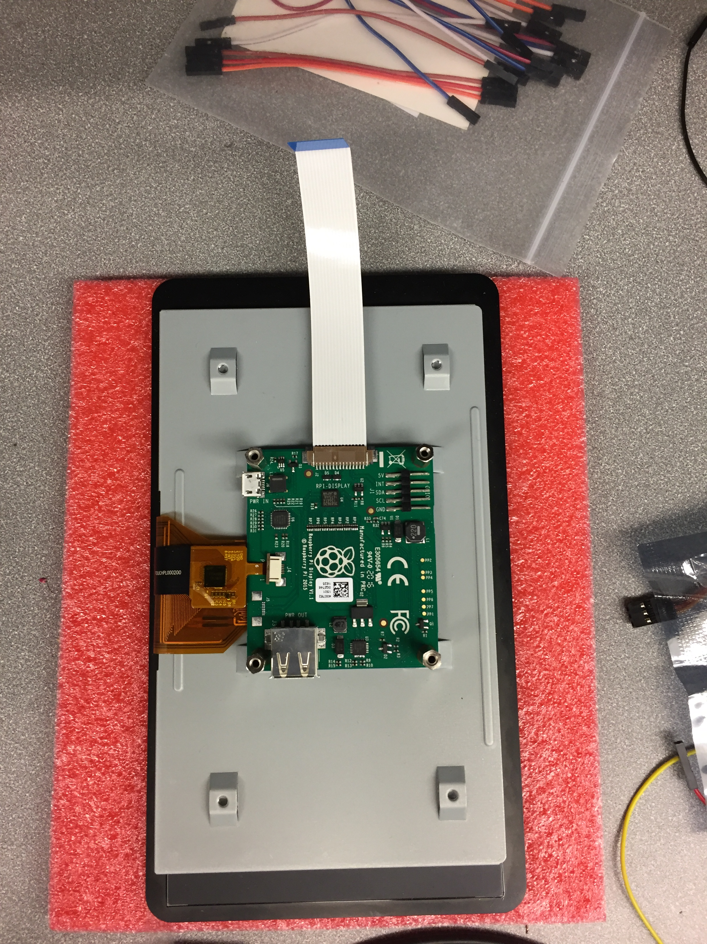
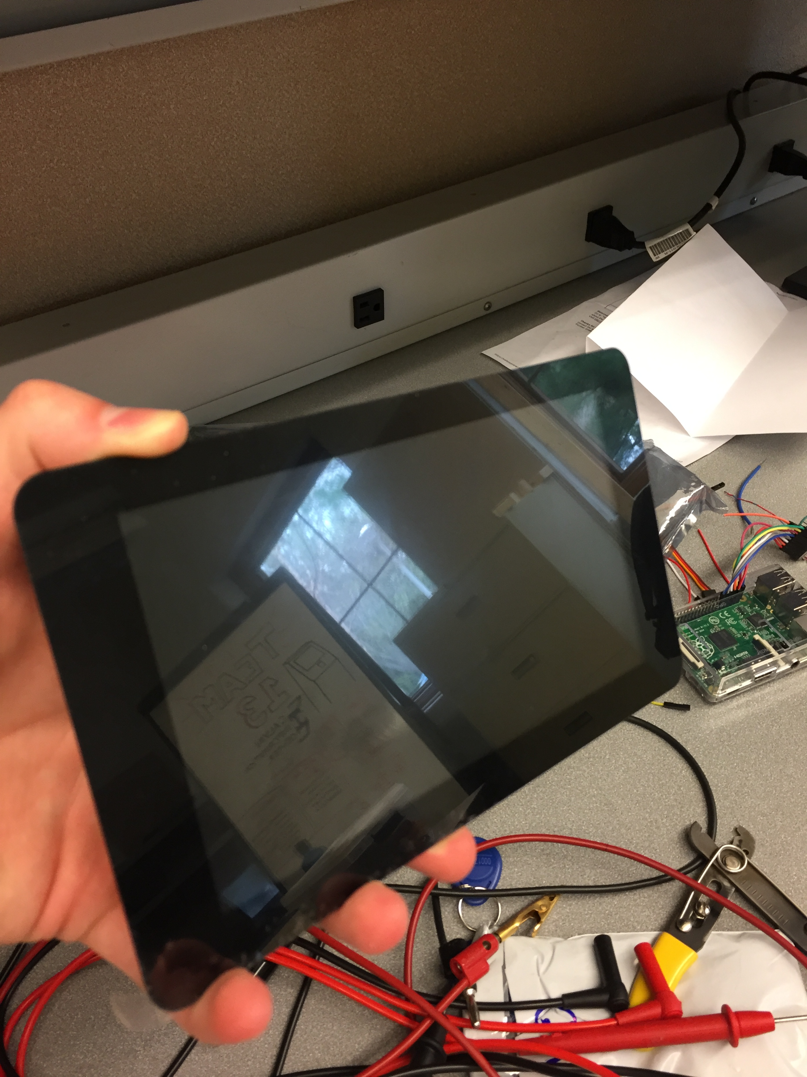
Touchscreen
11/19

Slide 11
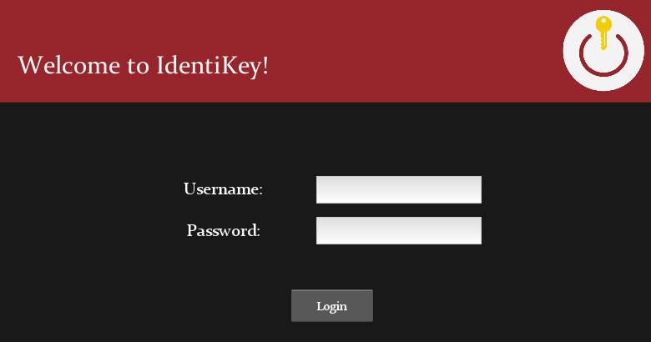
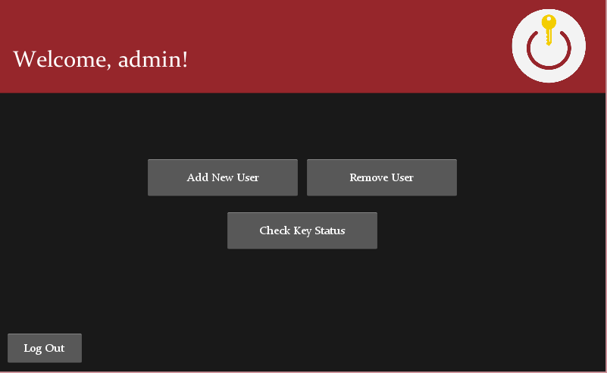
Graphical User Interface
10/19
Kivy Logo Source: <https://kivy.org/logos/kivy-logo-black-256.png>

Slide 12
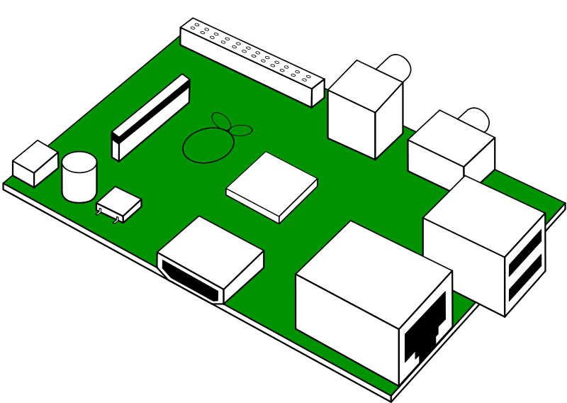
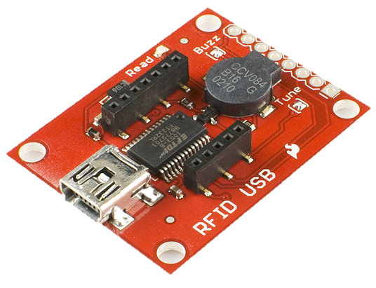
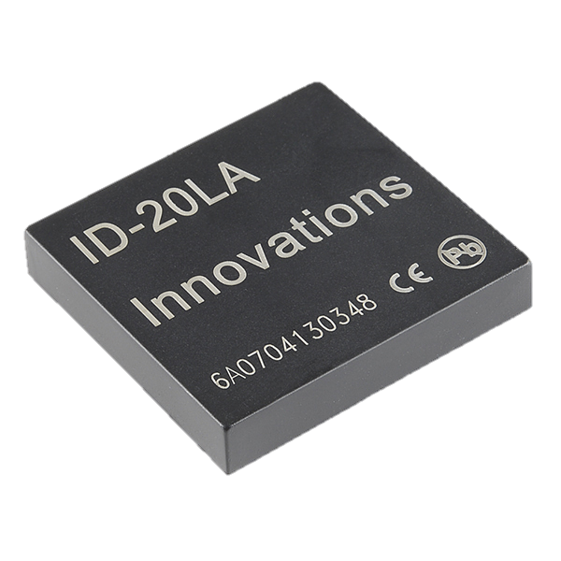
Radio Frequency Identification (RFID)
<https://img.clipartfest.com/2780a30729c87451d8487358a3df86f8_free-looks-like-raspberry-pi-raspberry-pi-clipart_800-568.png>
<https://cdn.sparkfun.com//assets/parts/4/0/9/5/09963-01.jpg>
<https://www.sparkfun.com/products/11828>
12/19

Slide 13
RFID Demo
13/19

Slide 14
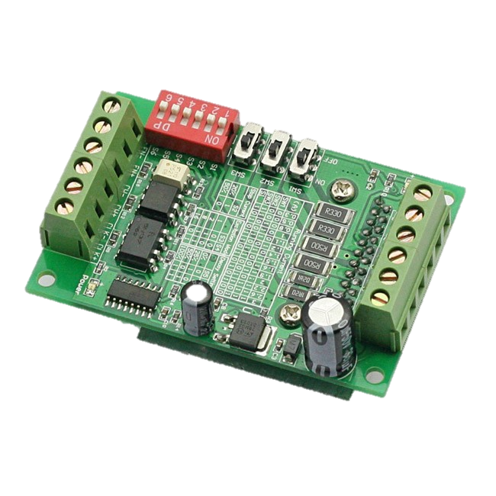
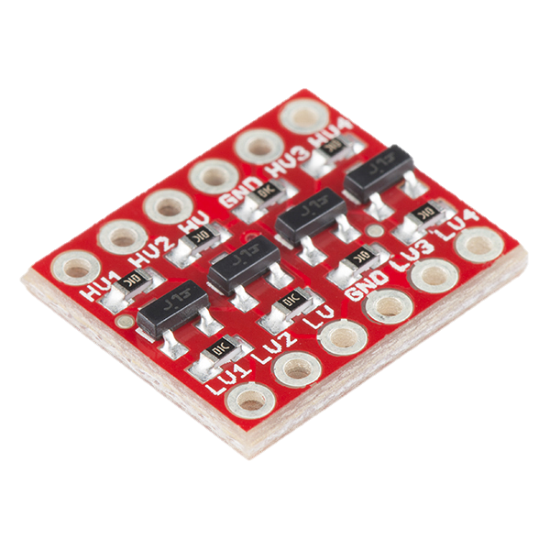
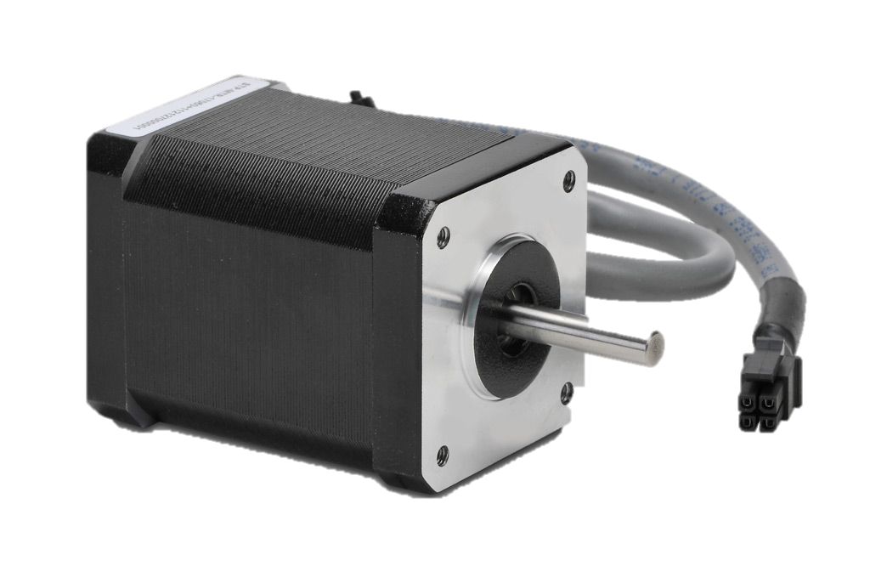
Motor Control
x2
<https://img.clipartfest.com/2780a30729c87451d8487358a3df86f8_free-looks-like-raspberry-pi-raspberry-pi-clipart_800-568.png>
<https://www.sainsmart.com/new-cnc-router-single-axis-3a-tb6560-stepper-motor-drivers-board-for-axiscontrol.html>
<https://www.automationdirect.com/adc/Shopping/Catalog/Motion_Control/Stepper_Systems/Stepper_Motors_-z-_Cables/STP-MTR-17060>
<https://www.sparkfun.com/products/12009>
14/19

Slide 15
Motor Control Testing
External power supply
24 V DC
Max 4.2 A
Motor Driver
Rated up to 3 A
Motor
Bipolar stepper
2 A
15/19

Slide 16
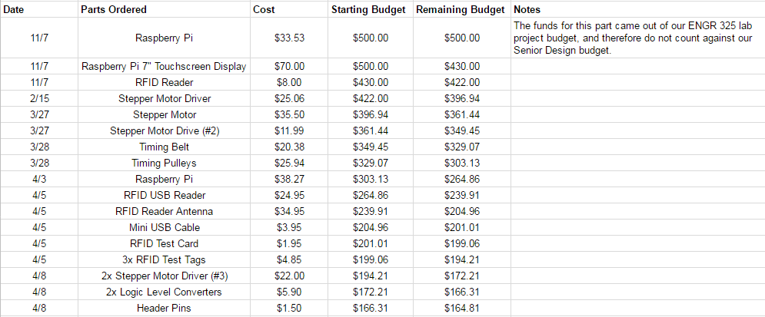
Budget
16/19

Slide 17
Outline
Problem
Solution
Accomplishments
Future Work
17/19

Slide 18
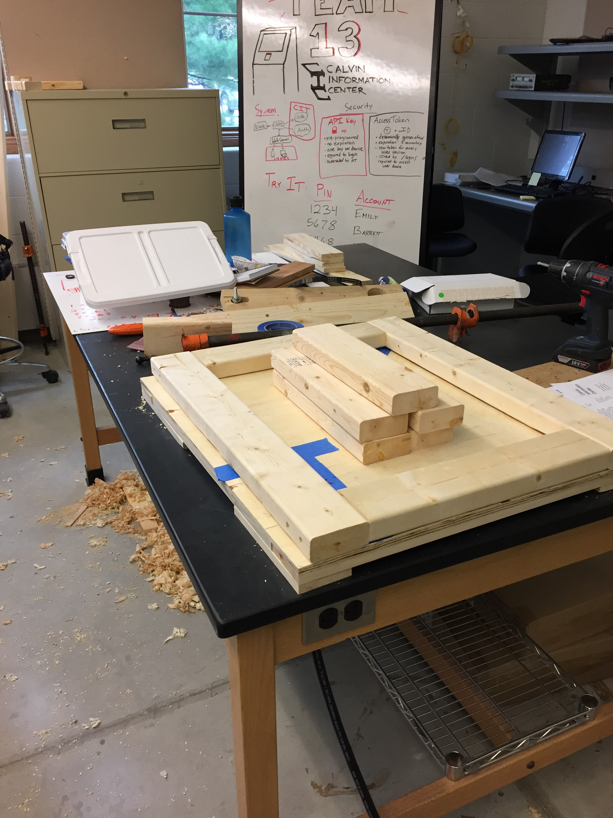
Future Work
Complete prototype construction
System integration
18/19

Slide 19
Questions?
“Wisdom is the offspring of suffering and time…”
19/19

