Slide 1
IdentiKey
Team 10
Presentation 4
April 28, 2017

Slide 2
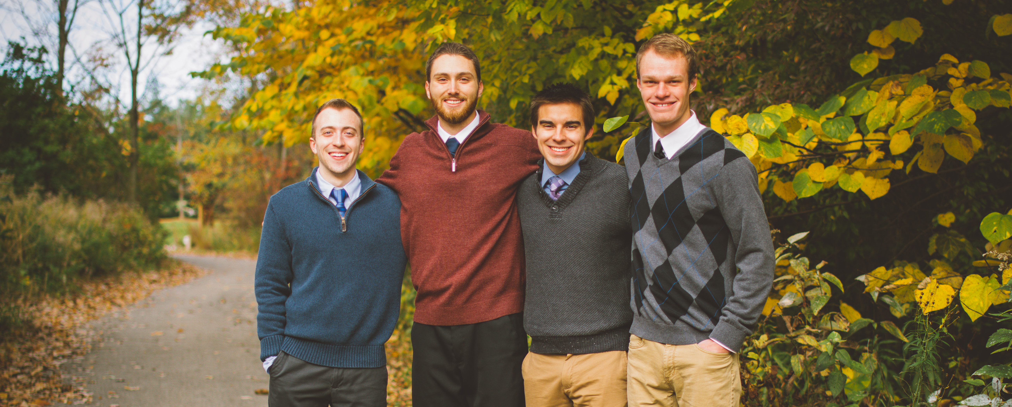
Jonathan Engle (ECE) | Brian DeVries (ECE) | Drew Davis (ECE) | Jared Haan (ECE)
Team 10
2/24

Slide 3
Outline
Project Review
Design Choices
Obstacles
Prototype
Reflections
3/24

Slide 4
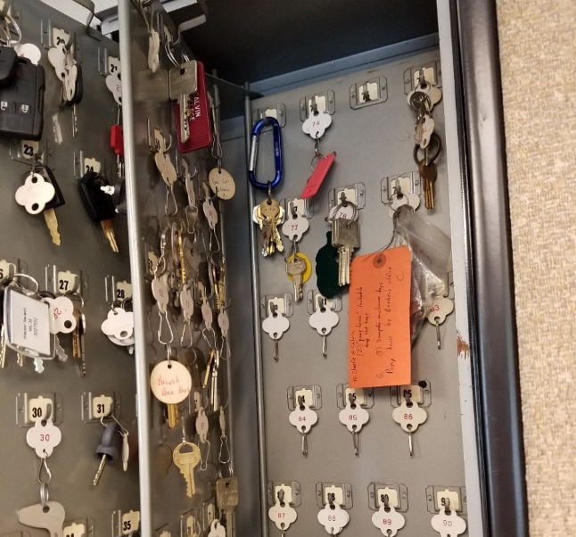
Problem
Retrieving keys
Returning keys
Security
Solution
Automated
Eliminate human error
Easy to use
Secure
Expandable
4/24

Slide 5
Outline
Project Review
Design Choices
Obstacles
Prototype
Reflections
5/24

Slide 6
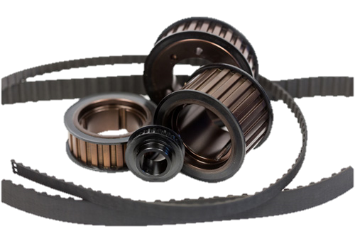
Automation – Conveyor
Belt and Pulley System
Two pulleys with one timing belt
Motor is driving one pulley
Keys are attached to hooks that are attached to timing belt
<http://www.bbman.com/assets/contentImages/precision/trapezoidal/imperialpulleys/imperialpitchpulleys-2.jpg>
6/24

Slide 7
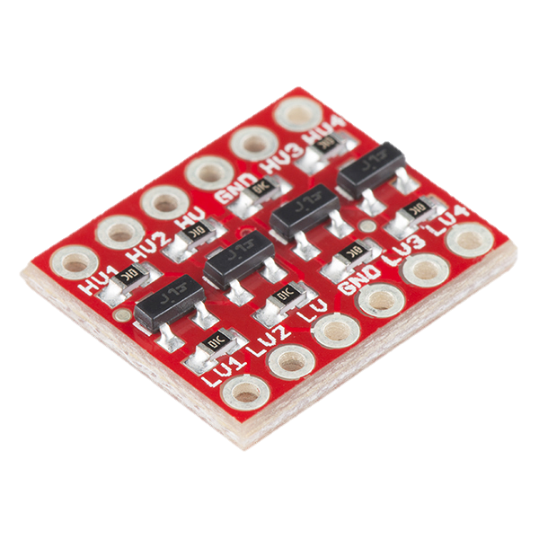
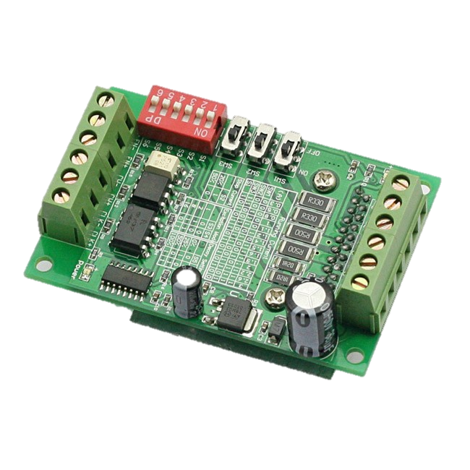
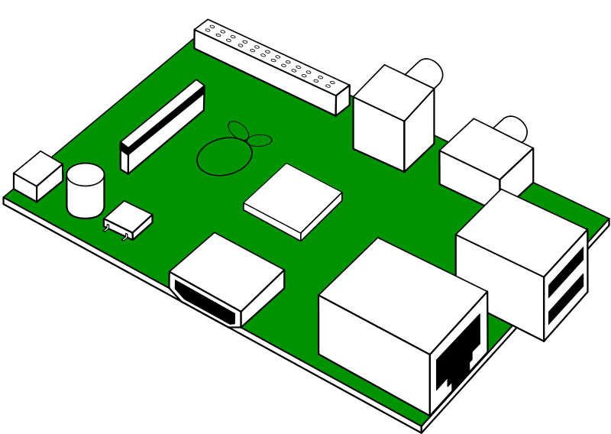
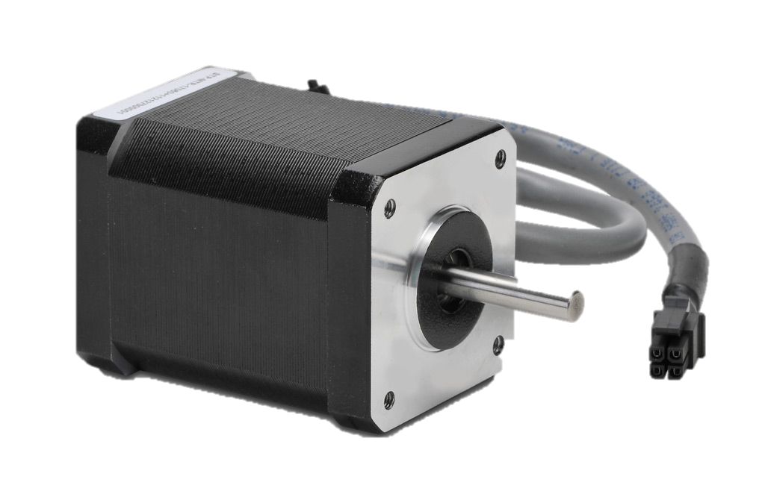
Automation – Motor
x2
24 V, 4.2 A
<https://img.clipartfest.com/2780a30729c87451d8487358a3df86f8_free-looks-like-raspberry-pi-raspberry-pi-clipart_800-568.png>
<https://www.sainsmart.com/new-cnc-router-single-axis-3a-tb6560-stepper-motor-drivers-board-for-axiscontrol.html>
<https://www.automationdirect.com/adc/Shopping/Catalog/Motion_Control/Stepper_Systems/Stepper_Motors_-z-_Cables/STP-MTR-17060>
<https://www.sparkfun.com/products/12009>
7/24

Slide 8
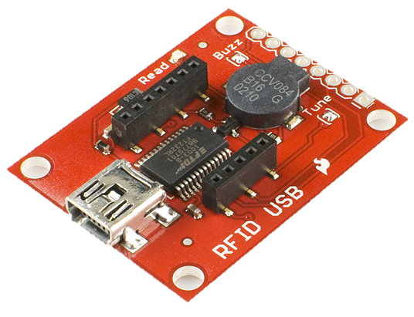
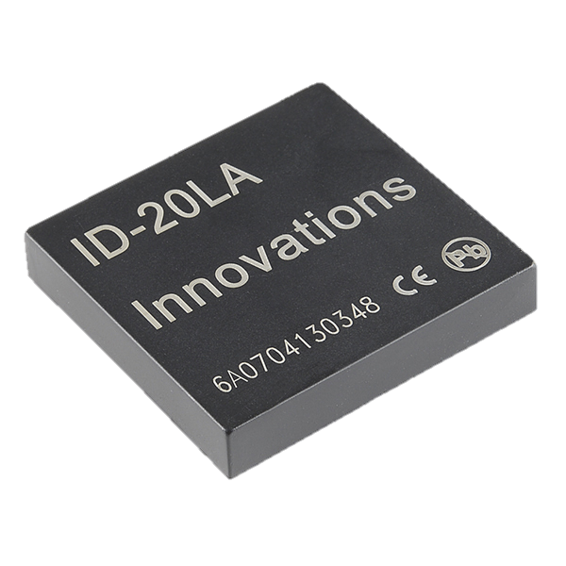
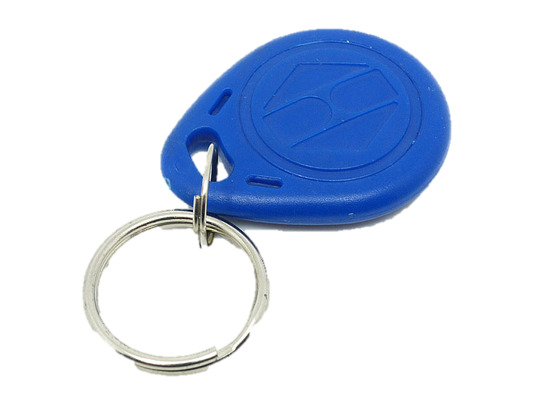
Identification – RFID
<https://img.clipartfest.com/2780a30729c87451d8487358a3df86f8_free-looks-like-raspberry-pi-raspberry-pi-clipart_800-568.png>
<https://cdn.sparkfun.com//assets/parts/4/0/9/5/09963-01.jpg>
<https://www.sparkfun.com/products/11828>
<https://statics3.seeedstudio.com/images/product/1356tag1.jpg>
8/24

Slide 9
User Interaction – Touch Screen
<https://files1.element14.com/community/themes/images/raspberrypi/pi7displayBG.png>
<https://img.clipartfest.com/2780a30729c87451d8487358a3df86f8_free-looks-like-raspberry-pi-raspberry-pi-clipart_800-568.png>
<https://cache.gawkerassets.com/assets/images/4/2011/11/c13e962bd220b94be5d3f0251c63154f.jpg>
9/24

Slide 10
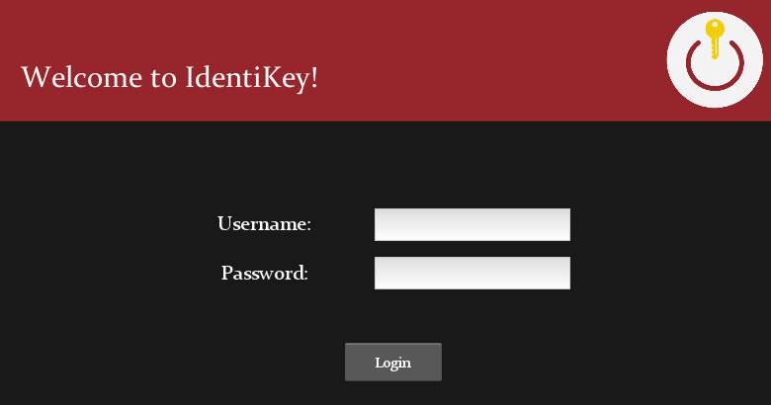
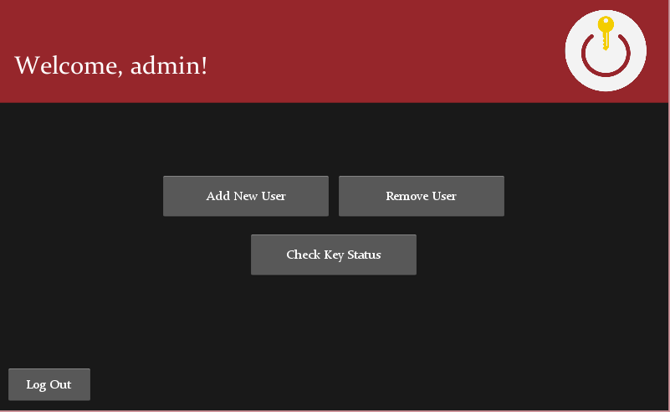
User Interaction – GUI
10/24
Kivy Logo Source: <https://kivy.org/logos/kivy-logo-black-256.png>

Slide 11
Outline
Project Review
Design Choices
Obstacles
Prototype
Reflections
11/24

Slide 12
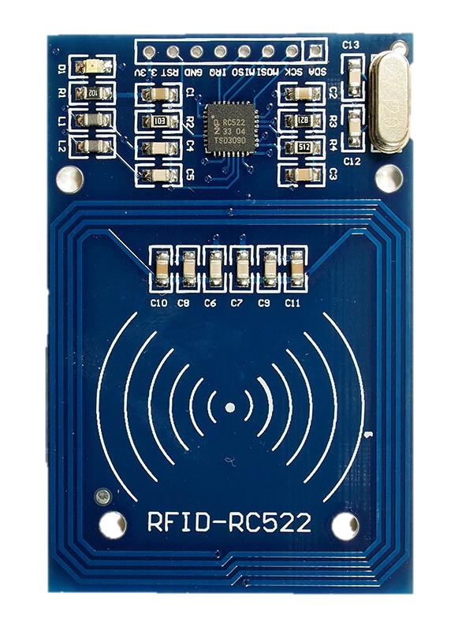
Obstacle #1: RFID Range
~ 1.75 inches
< 1 inch
http://www.haoyuelectronics.com/Attachment/MFRC-522/RC522_1.jpg
12/24

Slide 13
Obstacle #2: Motor Control
For and While Loops vs. Interrupts
Variable to Count Steps → “Edge Counter”
http://www.jameco.com/Jameco/workshop/circuitnotes/raspberry_pi_circuit_note_fig2a.jpg
http://www.learningaboutelectronics.com/images/Square-wave.png
13/24

Slide 14
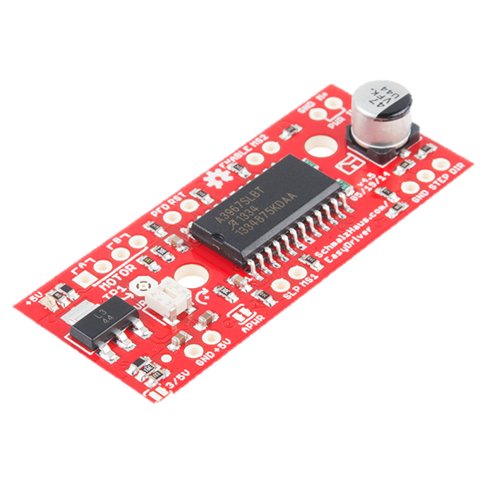
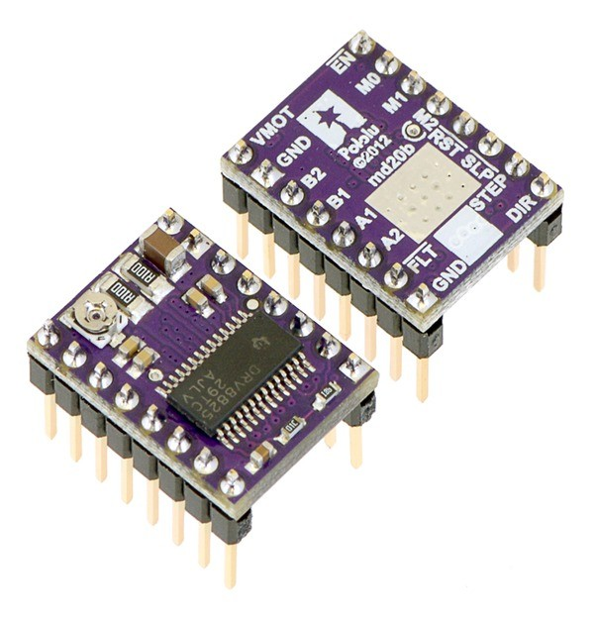
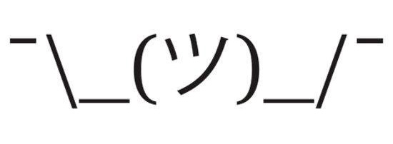
Obstacle #2.5: Motor Driver(s)
?
https://cdn.sparkfun.com//assets/parts/9/5/8/0/12779-01.jpg
http://www.exp-tech.de/media/catalog/product/cache/2/thumbnail/600x/17f82f742ffe127f42dca9de82fb58b1/0/j/0j4227.600_1706_3.jpg
14/24

Slide 15
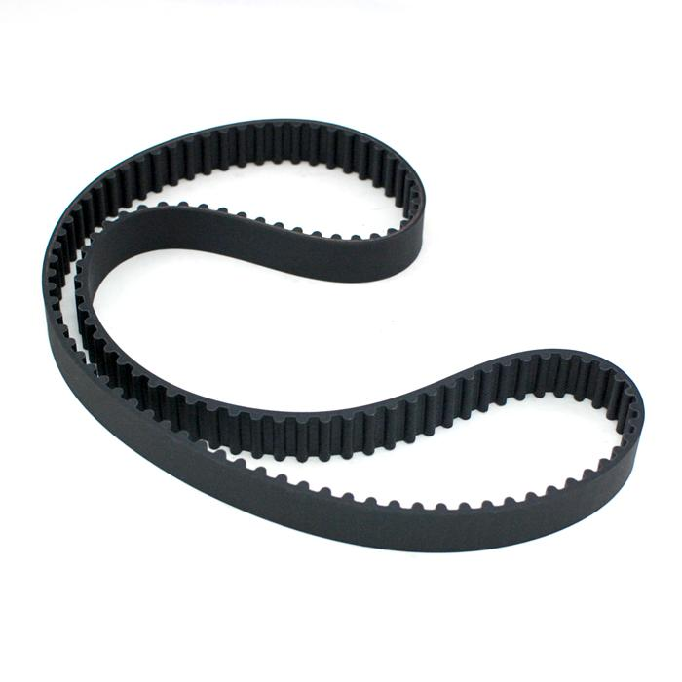
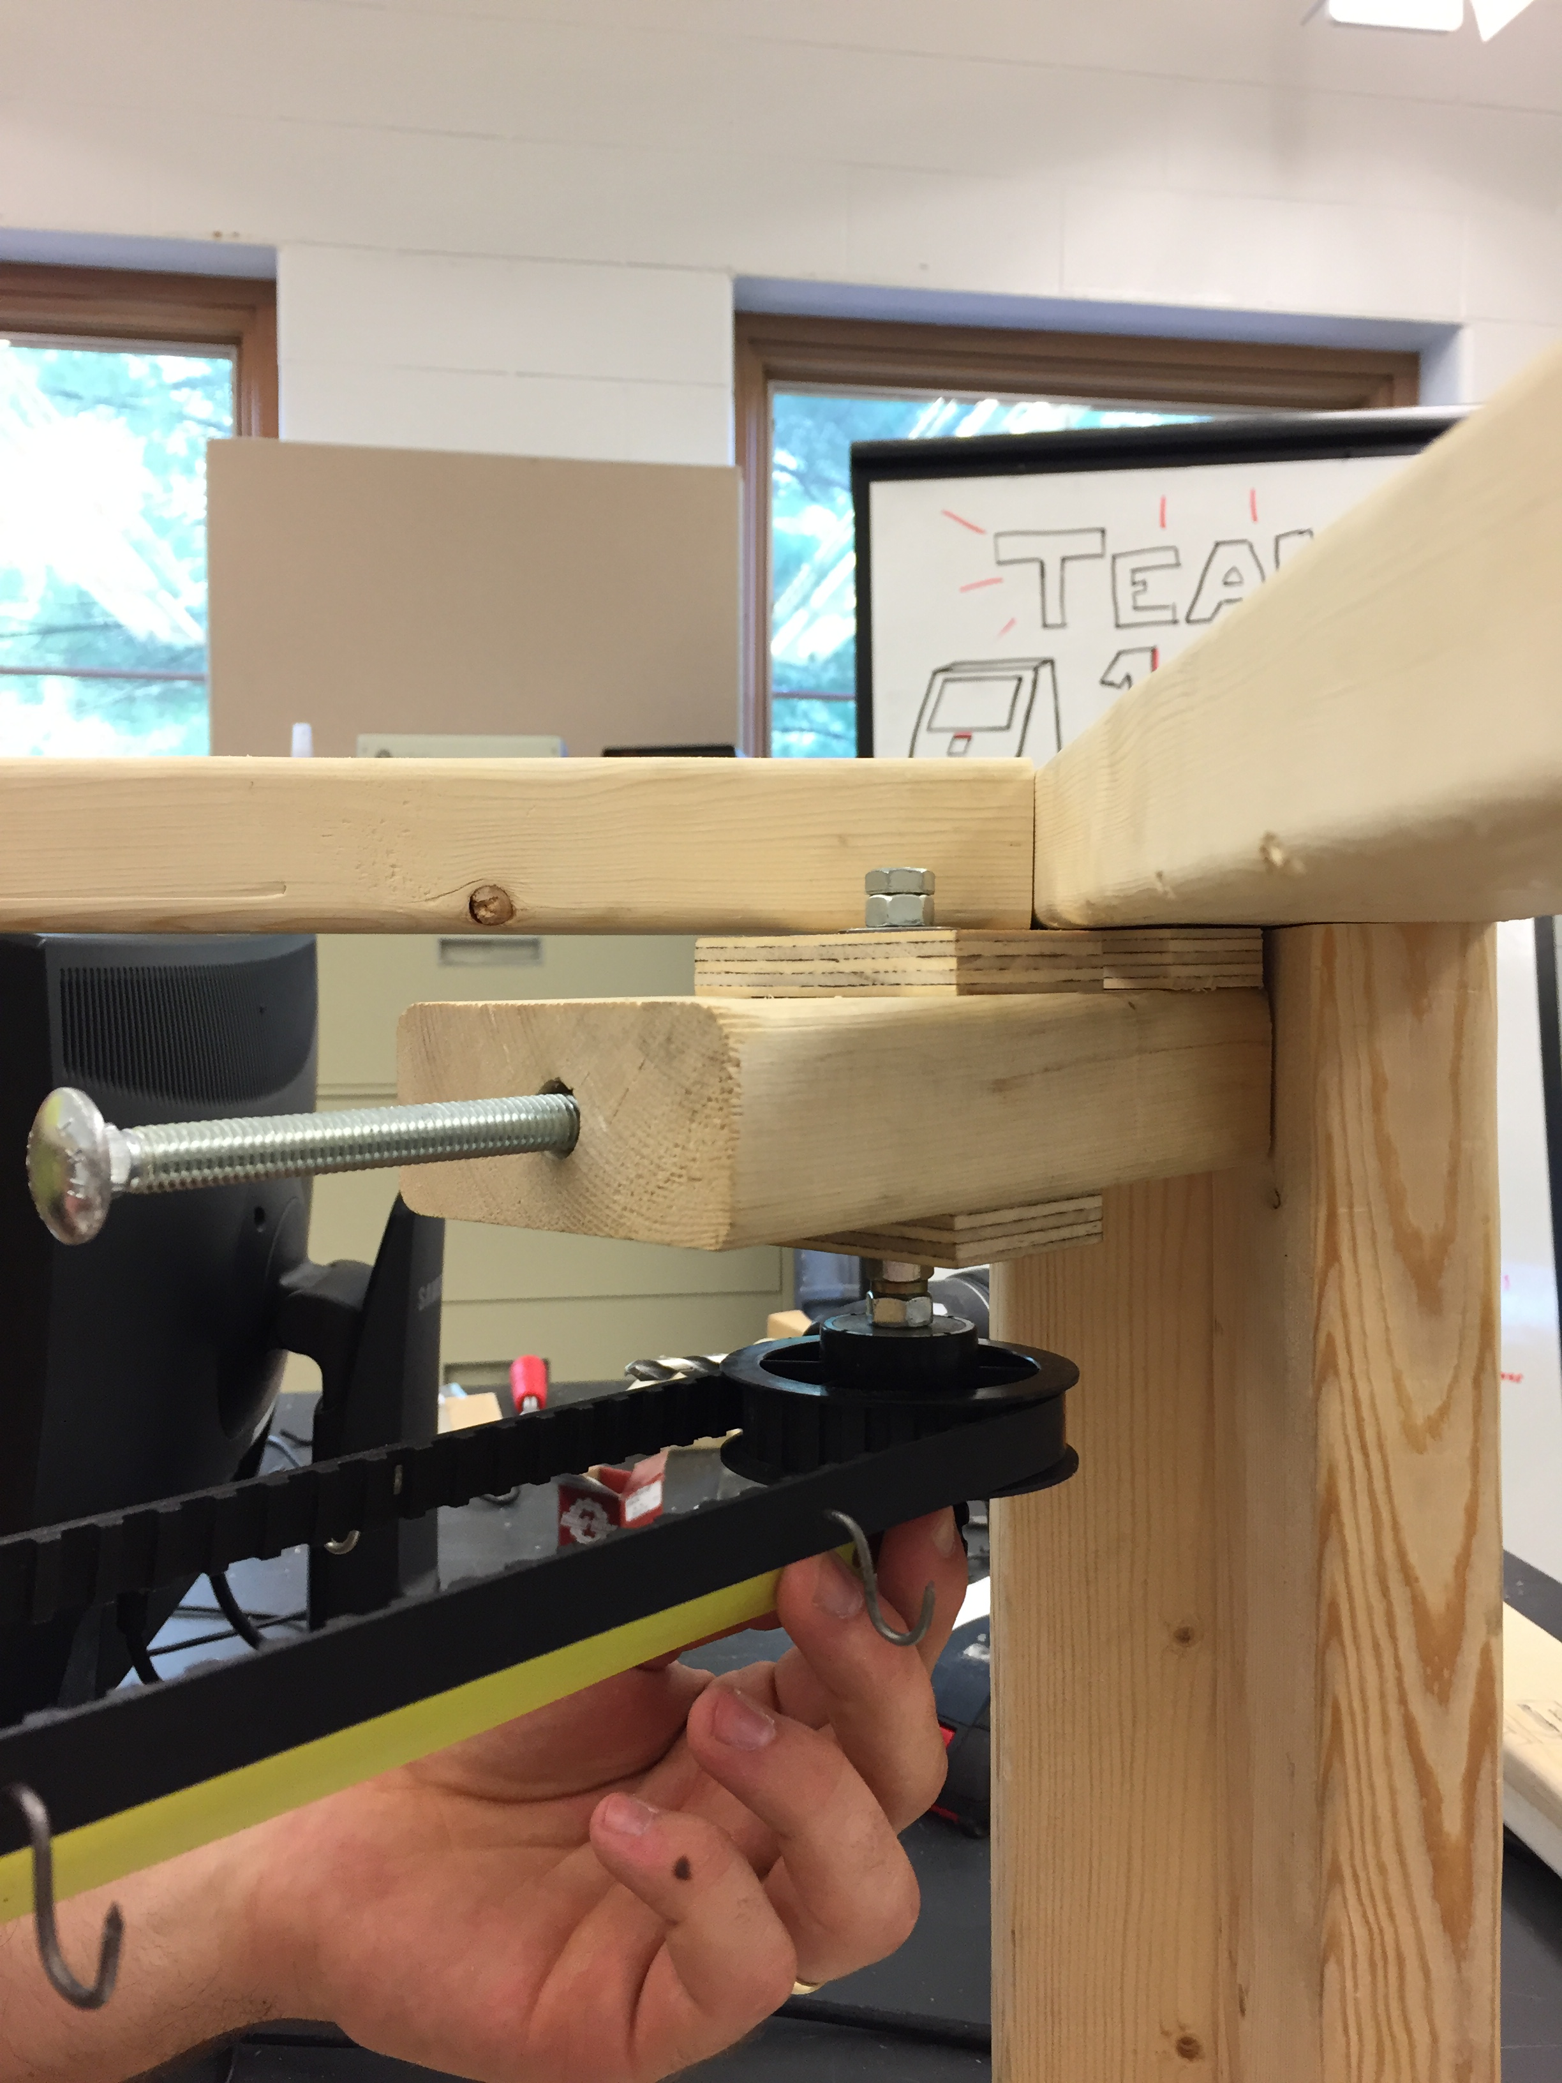
Obstacle #3: Timing Belt Tension
https://www.dashzracing.com/images/P/TB-91893.jpg
15/24

Slide 16
Outline
Project Review
Design Choices
Obstacles
Prototype
Reflections
16/24

Slide 17
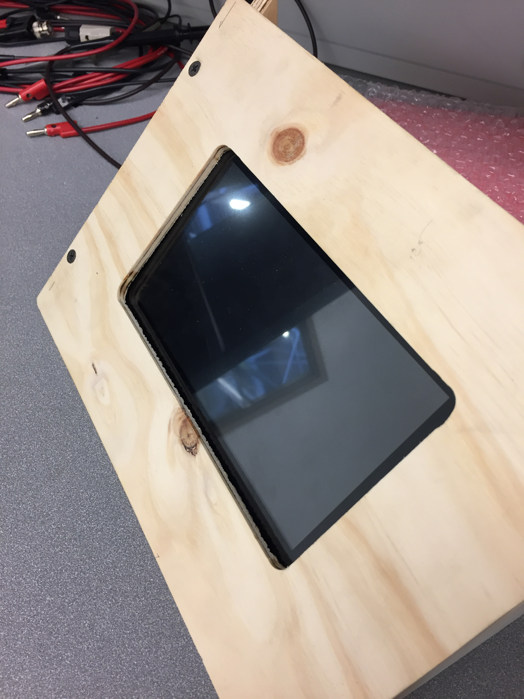
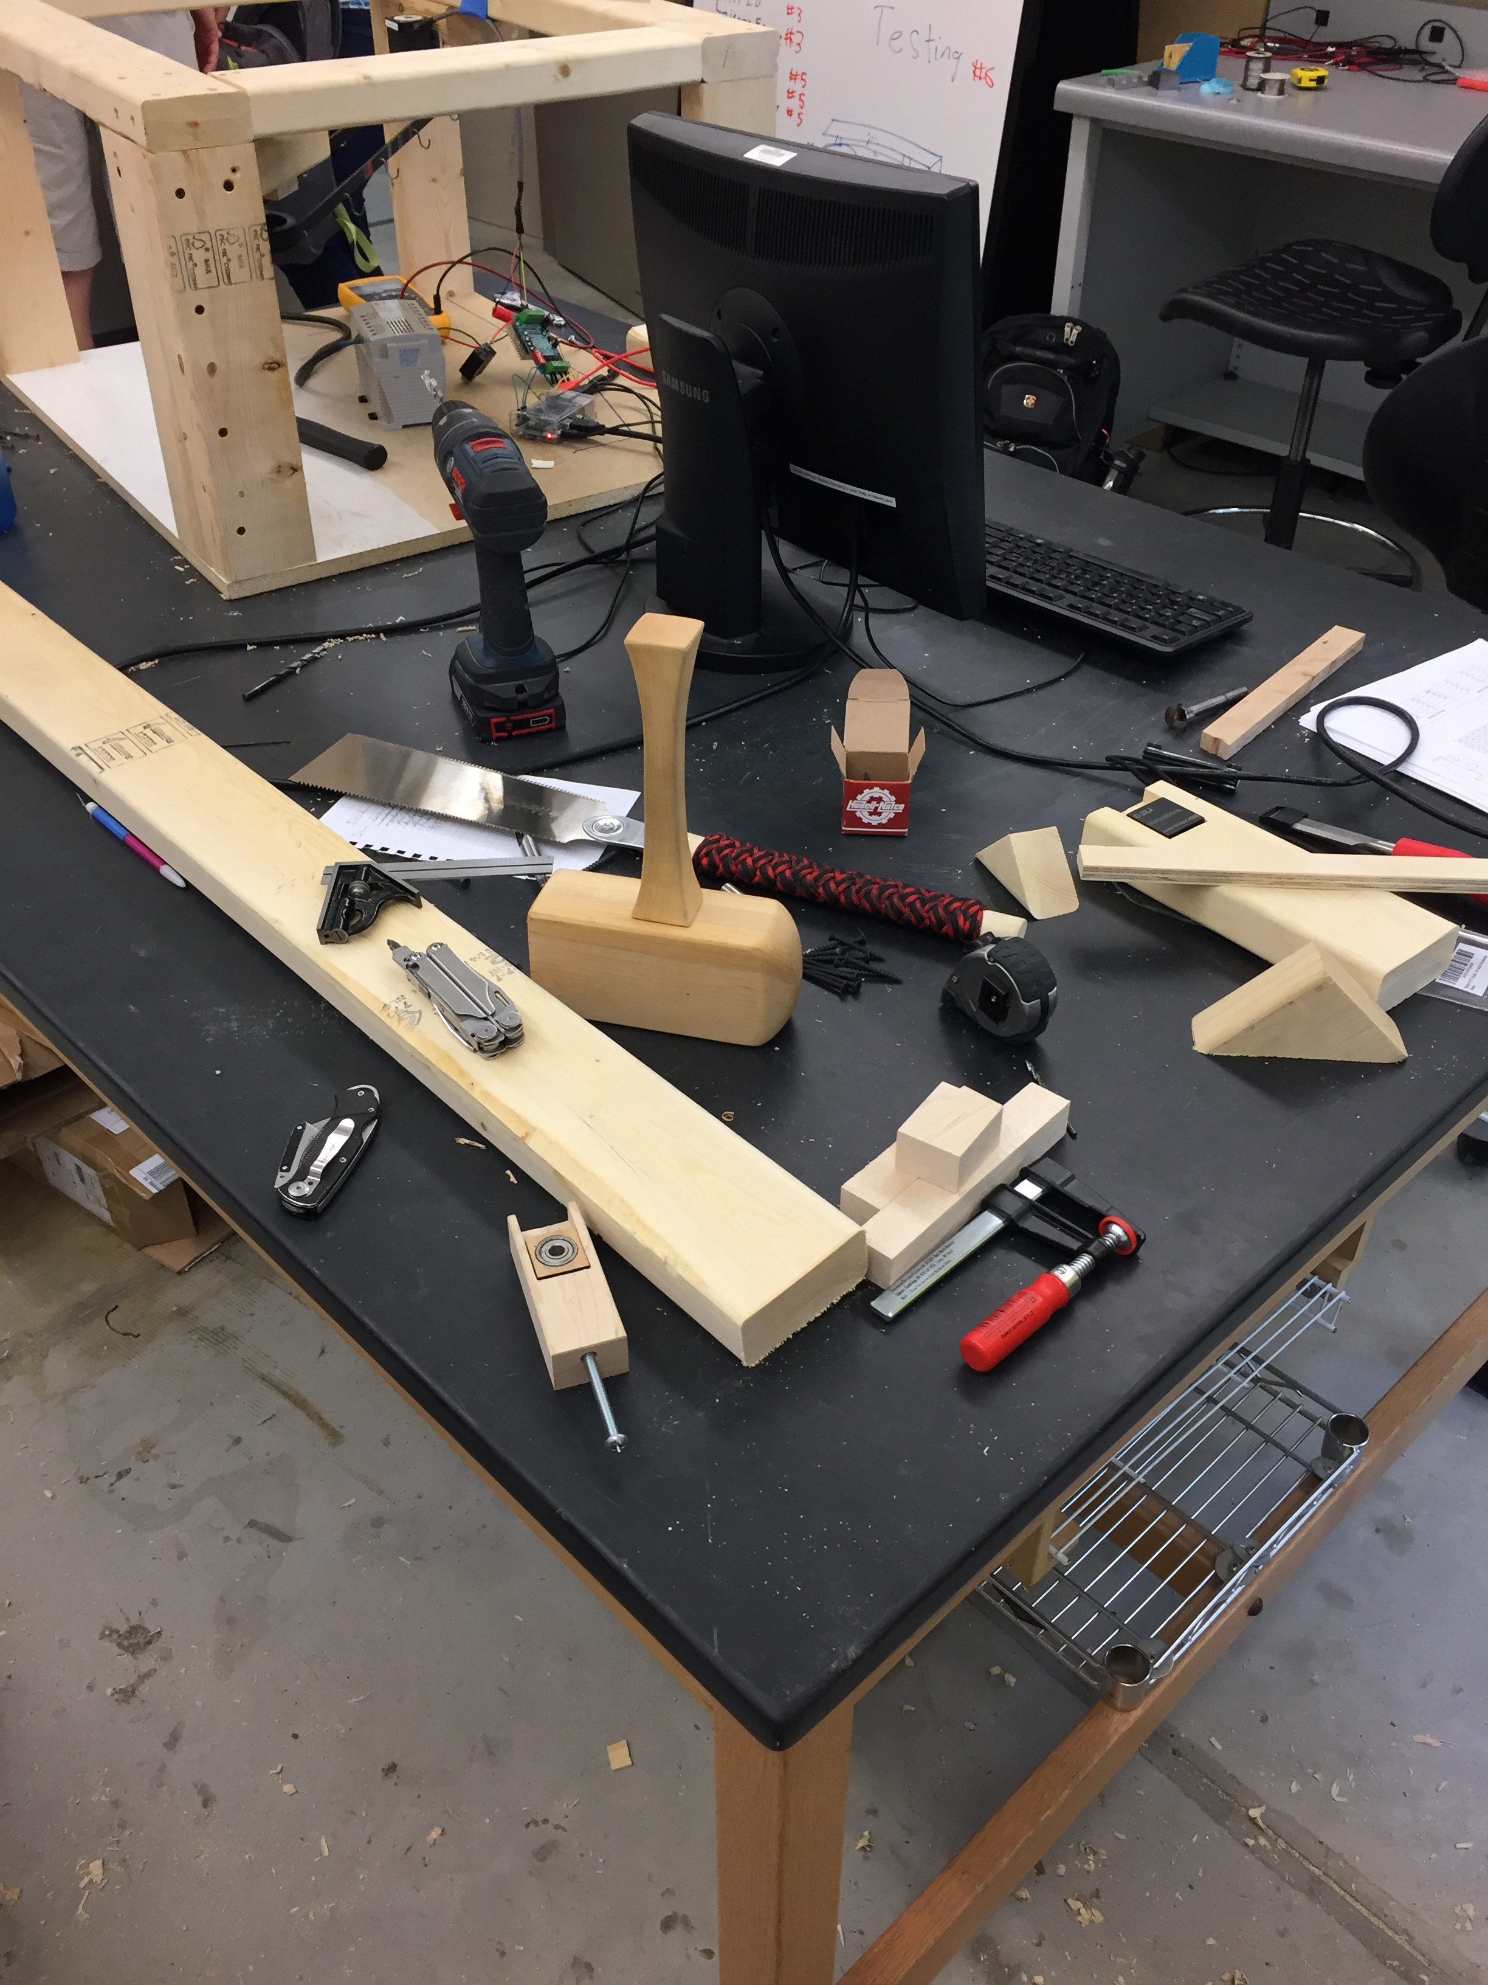
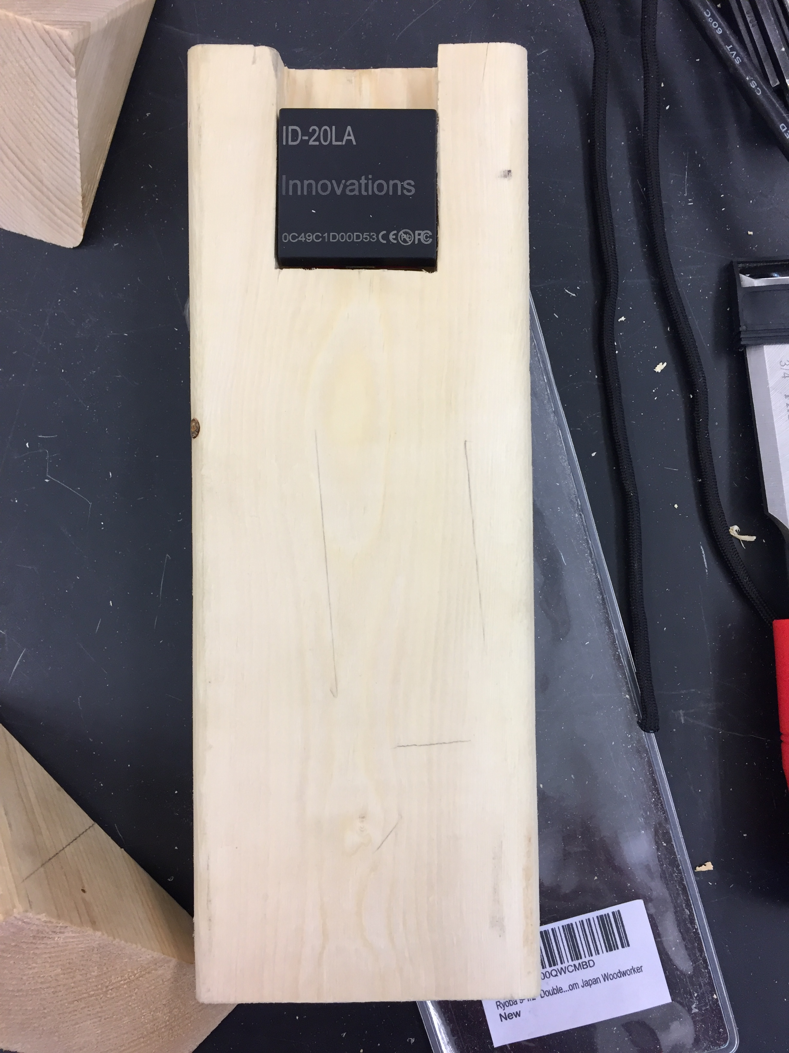
17/24

Slide 18
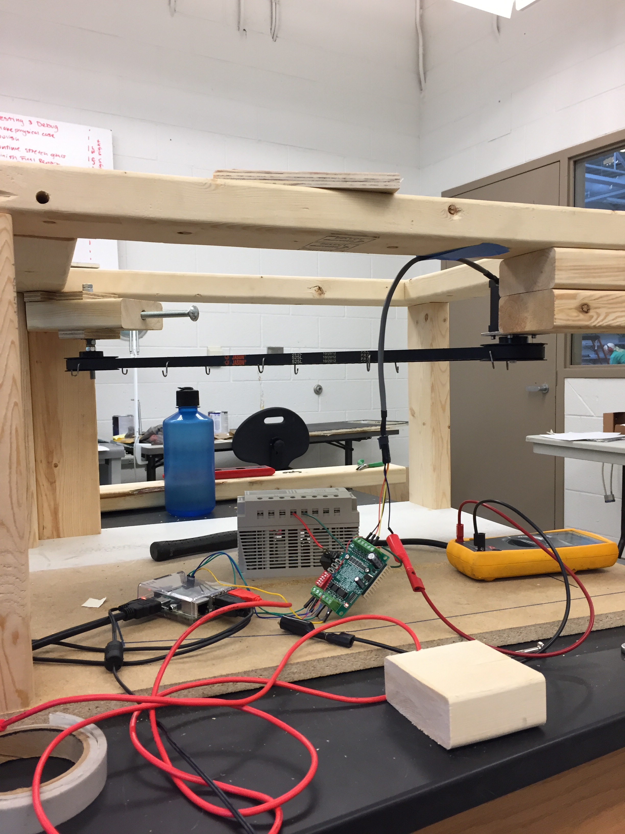
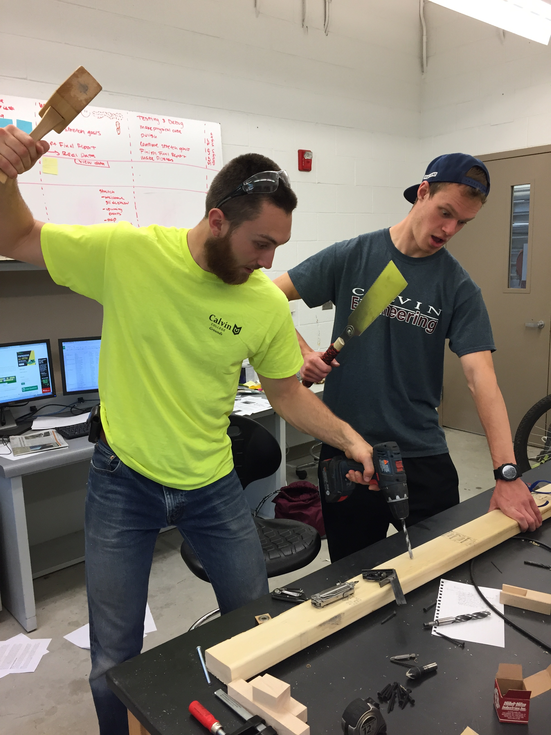
18/24

Slide 19
19/24

Slide 20
20/24

Slide 21
Outline
Project Review
Design Choices
Obstacles
Prototype
Reflections
21/24

Slide 22
Reflections
Communication is…
22/24
Key: http://www.clipartlord.com/wp-content/uploads/2014/03/key.png

Slide 23
Acknowledgements
Professor Michmerhuizen
Professor Kim
Mr. Eric Walstra
Mr. Bob DeKraker
The Internet
23/24

Slide 24
Questions?
“Wisdom is the offspring of suffering and time…”
24/24

