Slide 1
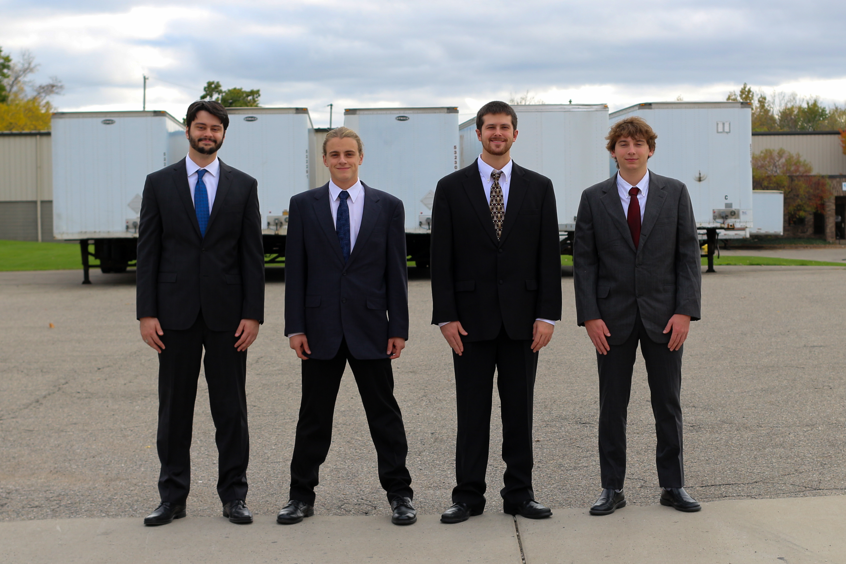

Team 16

Slide 2

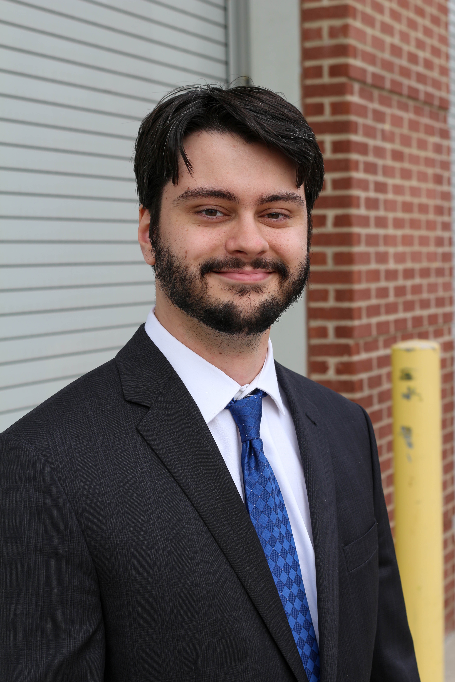
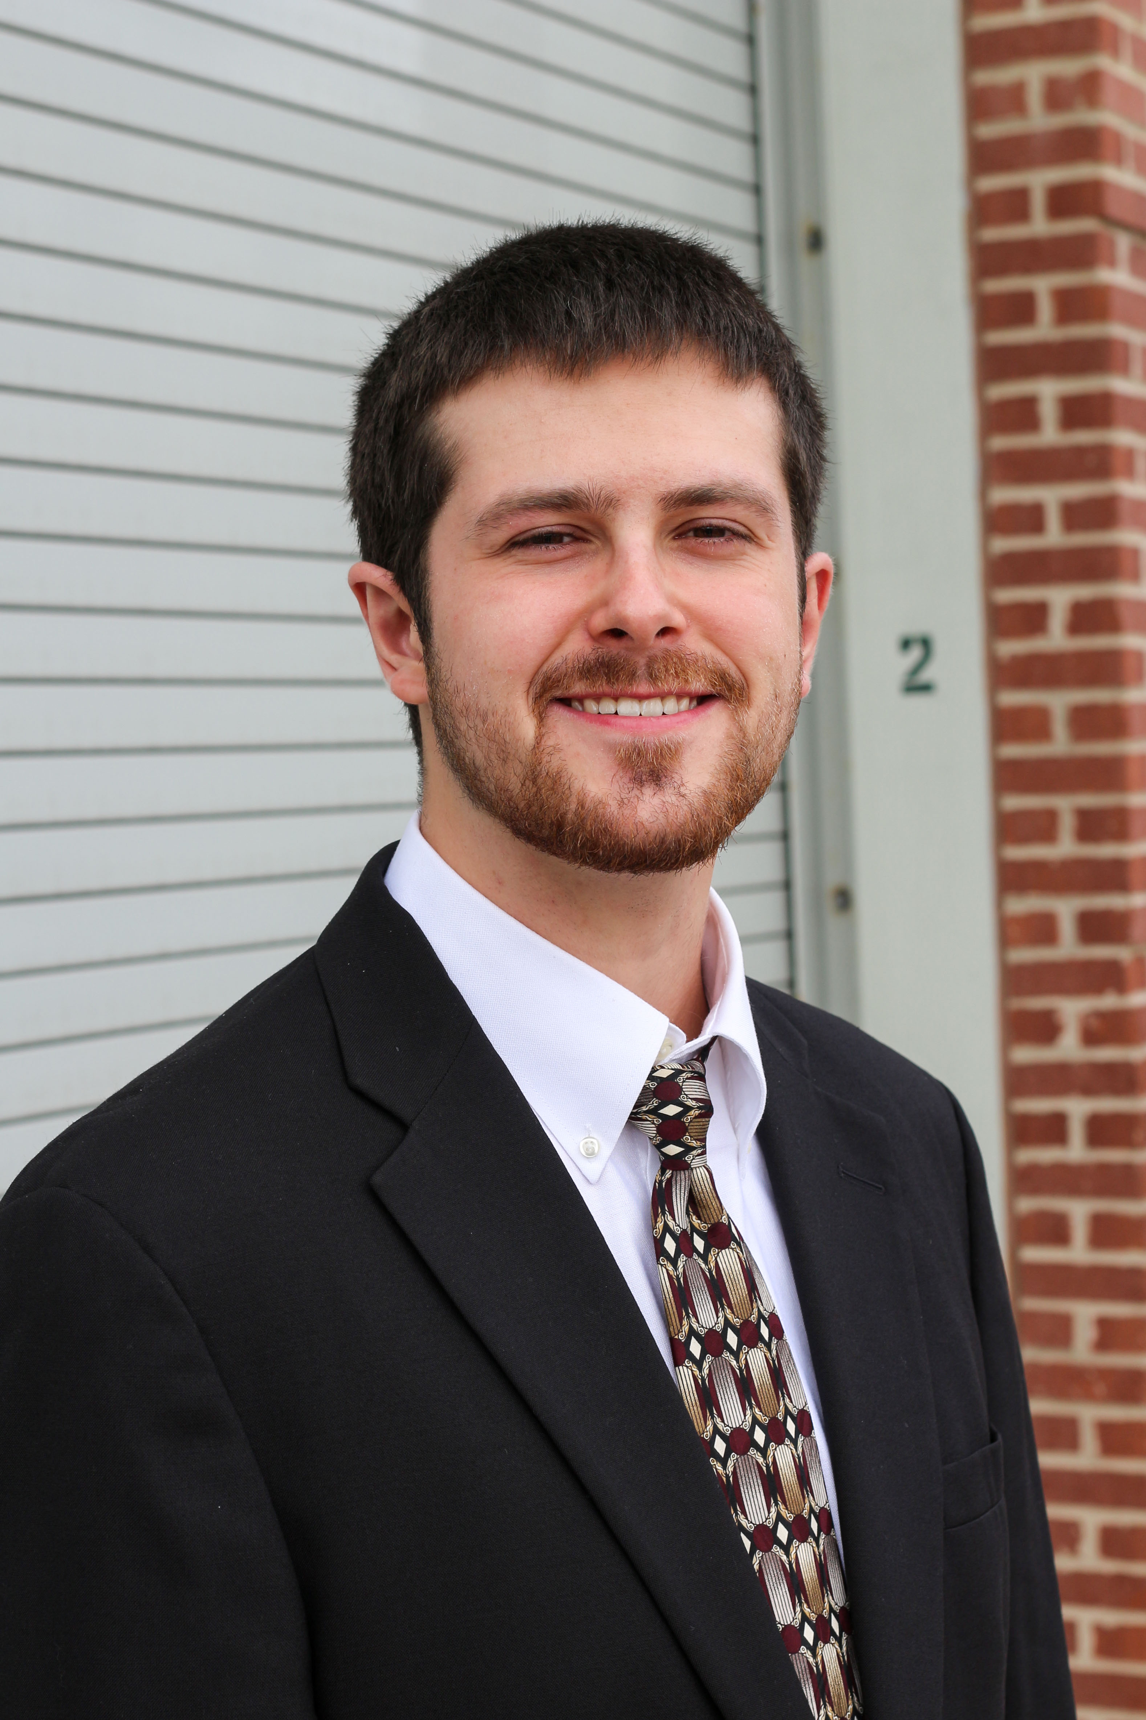

Team Semi-Pro
Taylor Mulder Electrical
Adam Christensen
Mechanical
Isaac Embertson
Electrical
Robert Lanser Mechanical

Slide 3
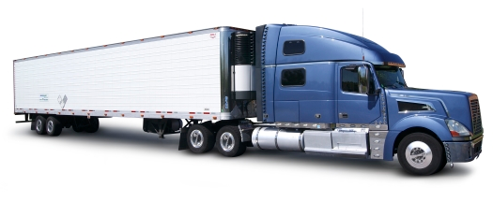
Outline
Project
Feasibility
Design
Progress
Future
Project Summary
Design Norms
System Architecture
Feasibility
Scope
Resources
Decision Made
To Do
logisticstationinc.com

Slide 4
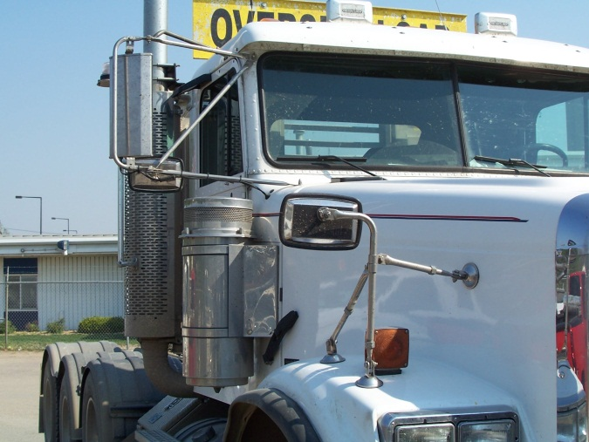
Project Summary
Project
Feasibility
Design
Progress
Future
Objectives
Enhance Visibility
Reduce Drag
Driver Accountability - DVR
Affordable
www.m-cna.com/construction_industry

Slide 5
Design Norms
Project
Feasibility
Design
Progress
Future
Integrity
Delightful Harmony
Transparency
Trust

Slide 6
System Architecture
Project
Feasibility
Design
Progress
Future
Rear Trailer
Front Truck

Slide 7
Feasibility
Project
Feasibility
Design
Progress
Future
Products on the market today
Present need
Complete system
Combined features that others don't have
Notes:
Isaac stops here

Slide 8
Scope
Project
Feasibility
Design
Progress
Future
Core of Project
Two Front Cameras
Rearview Camera
LCD Display
Raspberry Pi
First Set of Additions
WiFi Commications
Solar Panel
DVR Module
Optimistic Additions
Full Length WiFi
Multi-LCD
Removable Module

Slide 9
Resources Advisors
Project
Feasibility
Design
Progress
Future
Raspberry Pi
Analog Camera
USB Camera
Next to obtain
Ethernet Camera
Second Raspberry Pi
Professor Nielsen
Professor Michmerhuizen
Eric Walstra

Slide 10
Decision Made
Project
Feasibility
Design
Progress
Future
Bluetooth vs WiFi
Analog vs USB vs Ethernet Camera
LCD Location\Multiple Locations

Slide 11
To Do
Project
Feasibility
Design
Progress
Future
Air Resistance
Successful Base System
Rearview Camera Module Components

Slide 12
Questions?

