Slide 1
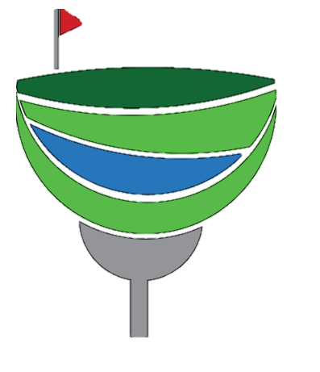
Team 01: Par-fect Stream
PAR-FECT STREAM
Presenting: Joe Jackson, Ben Vandyk, Heidi Boeve, and Kyle Van De Weert

Slide 2
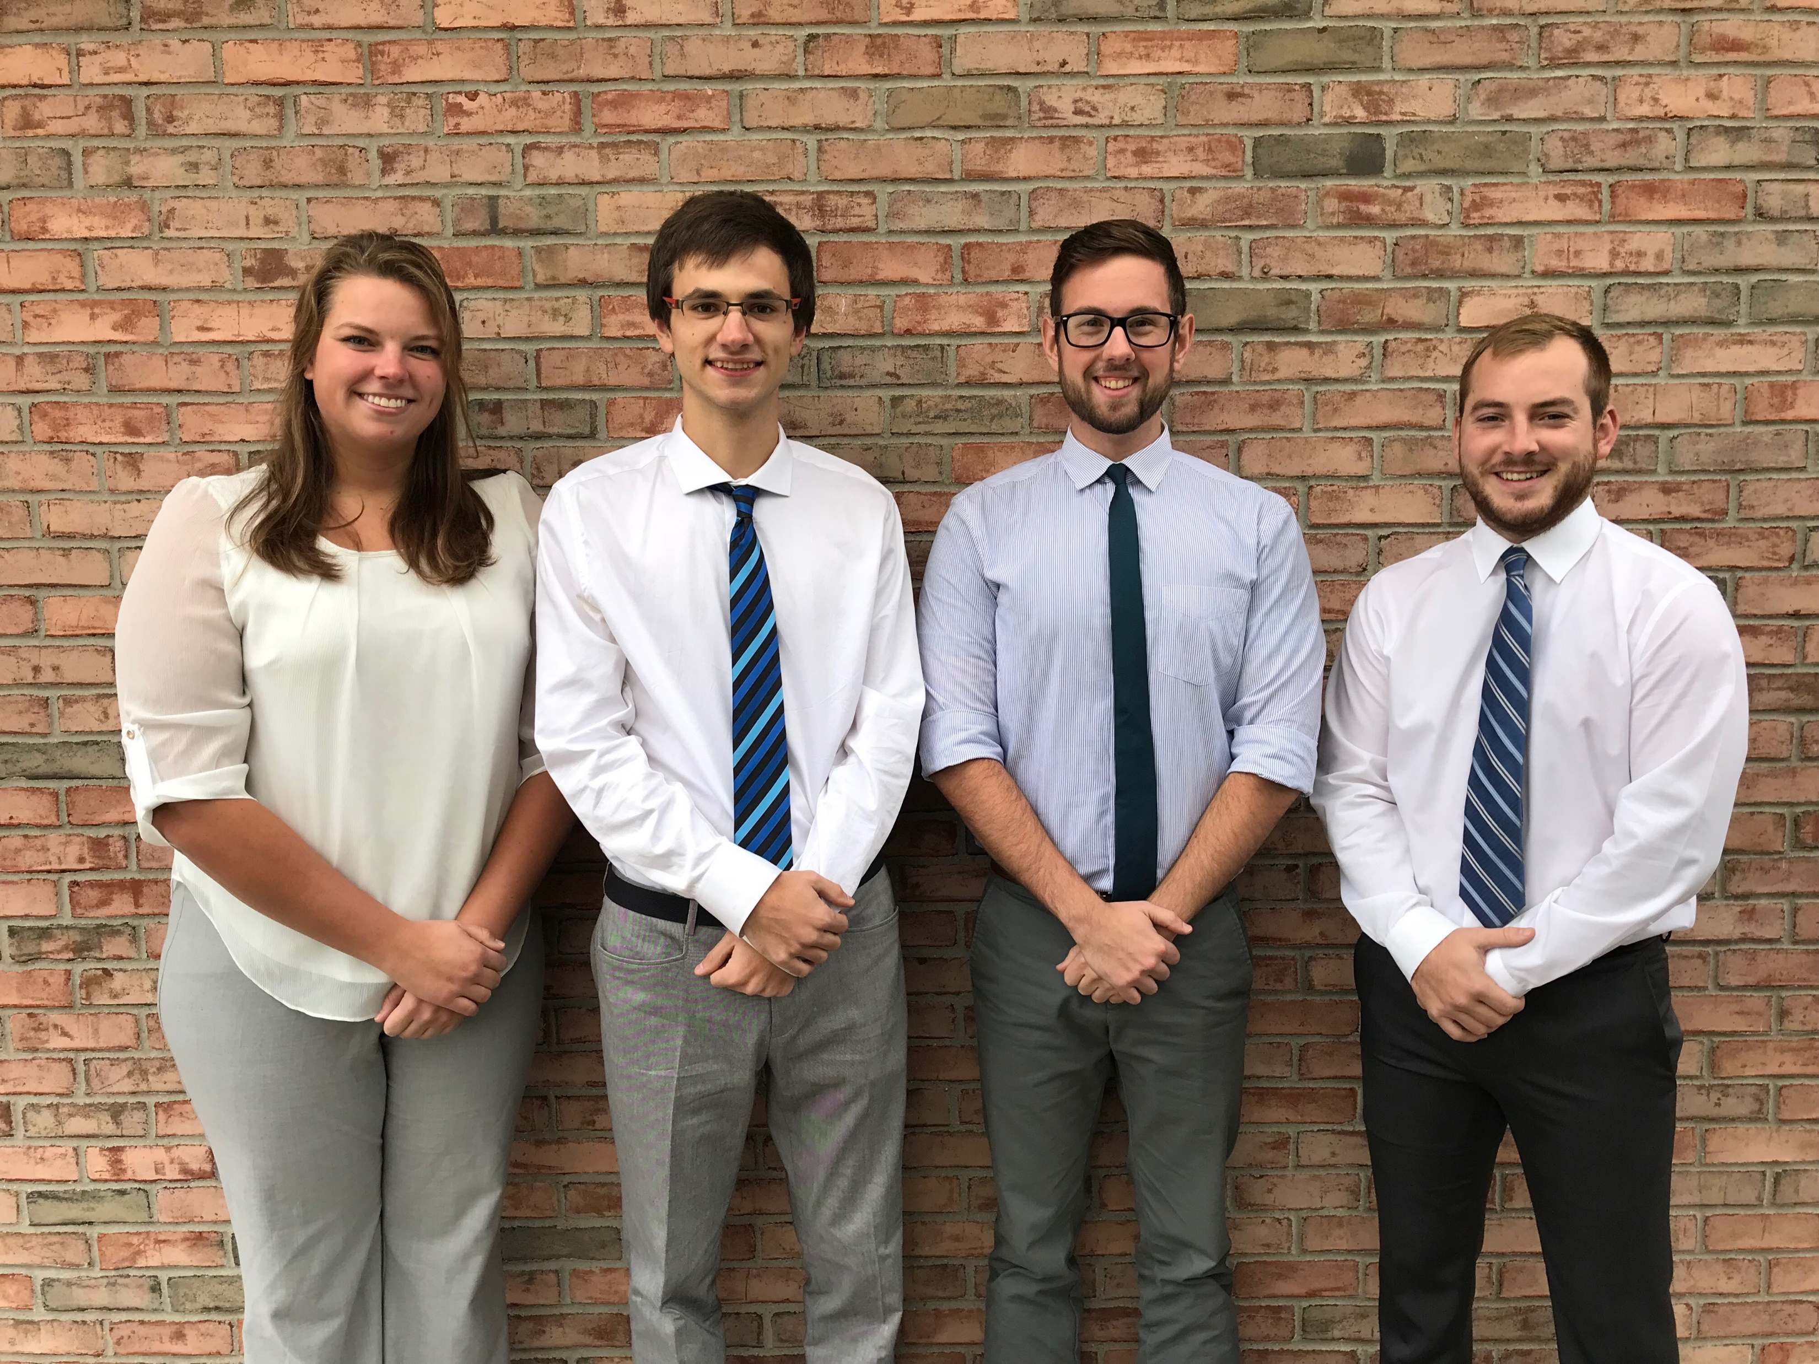
Team One
Heidi Boeve, CE
Ben Vandyk, CE
Joe Jackson, CE
Kyle Van De Weert, CE
Introduction
Design
HEC-RAS
Costs
HEC-HMS
Additional
Slide 1/22

Slide 3
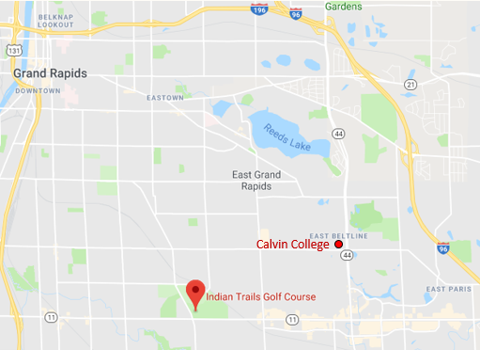
Location & Client
Indian Trails Golf Course
Plaster Creek Stewards
Introduction
Design
HEC-RAS
Costs
HEC-HMS
Additional
Slide 2/22

Slide 4
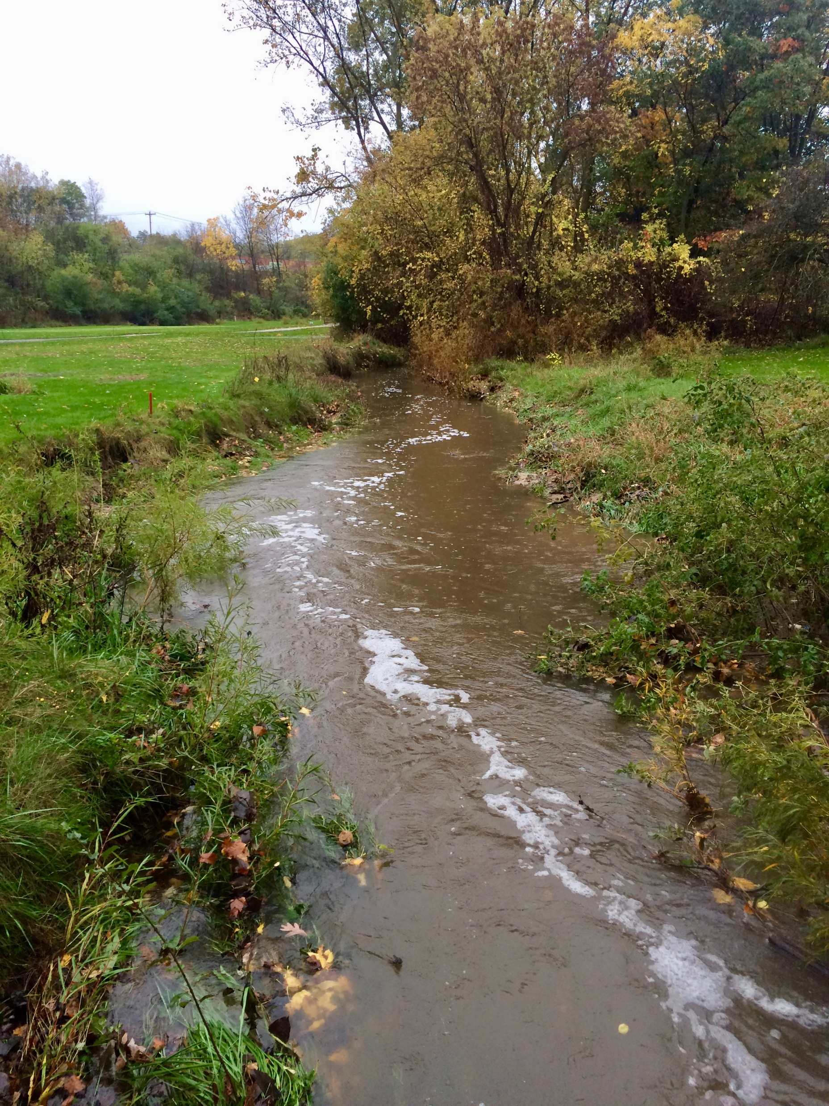
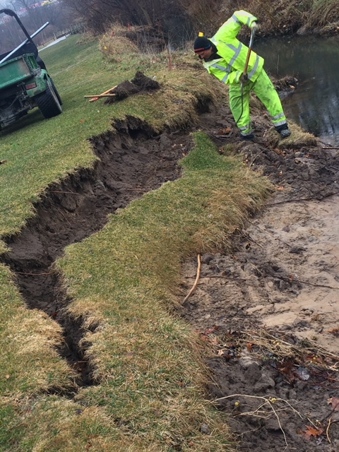
The Problem
Flooding
Erosion
Introduction
Design
HEC-RAS
Costs
HEC-HMS
Additional
Slide 3/22

Slide 5
Design Alternatives
Constraints
Land available
Reduce stormwater runoff
Aesthetically pleasing
Budget concerns
Introduction
Design
HEC-RAS
Costs
HEC-HMS
Additional
Slide 4/22

Slide 6
Design Alternatives
Constraints
Solutions
Land available
Reduce stormwater runoff
Aesthetically pleasing
Budget concerns
Rain gardens
Divergent structure
Expand wetlands
Two-stage ditch
Stream restoration
Introduction
Design
HEC-RAS
Costs
HEC-HMS
Additional
Slide 5/22

Slide 7
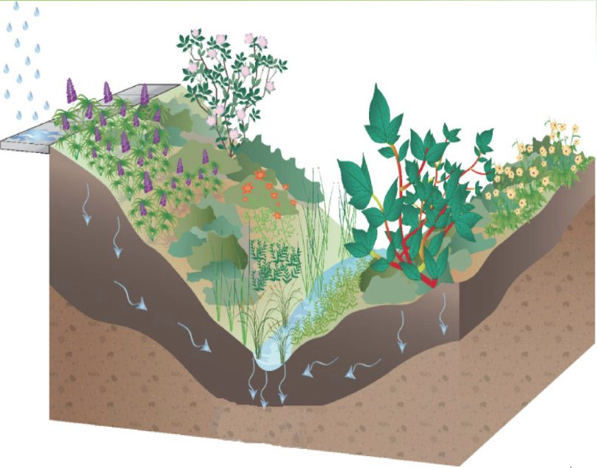
Rain Garden
Emphasis on infiltration
Heavily vegetated
Commonly mistaken for bioswale
Introduction
Design
HEC-RAS
Costs
HEC-HMS
Additional
Slide 6/22

Slide 8
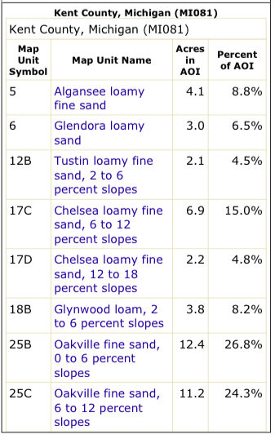
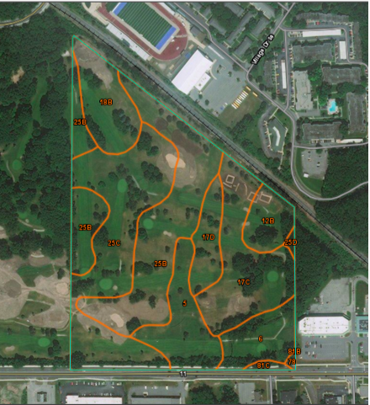

Slide 9
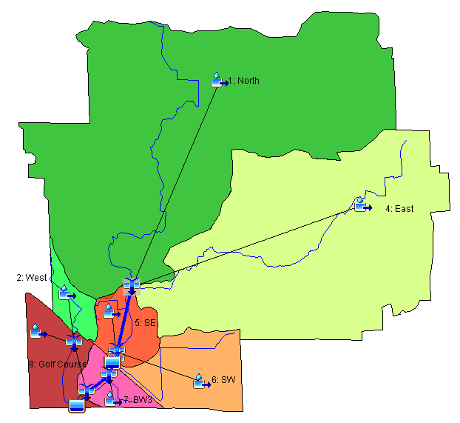
Initial Modeling and Calculations
Find inputs for HEC-HMS model
Watershed and Stream Geometry
Storm Events
SCS Method
Introduction
Design
HEC-RAS
Costs
HEC-HMS
Additional
Slide 7/22

Slide 10
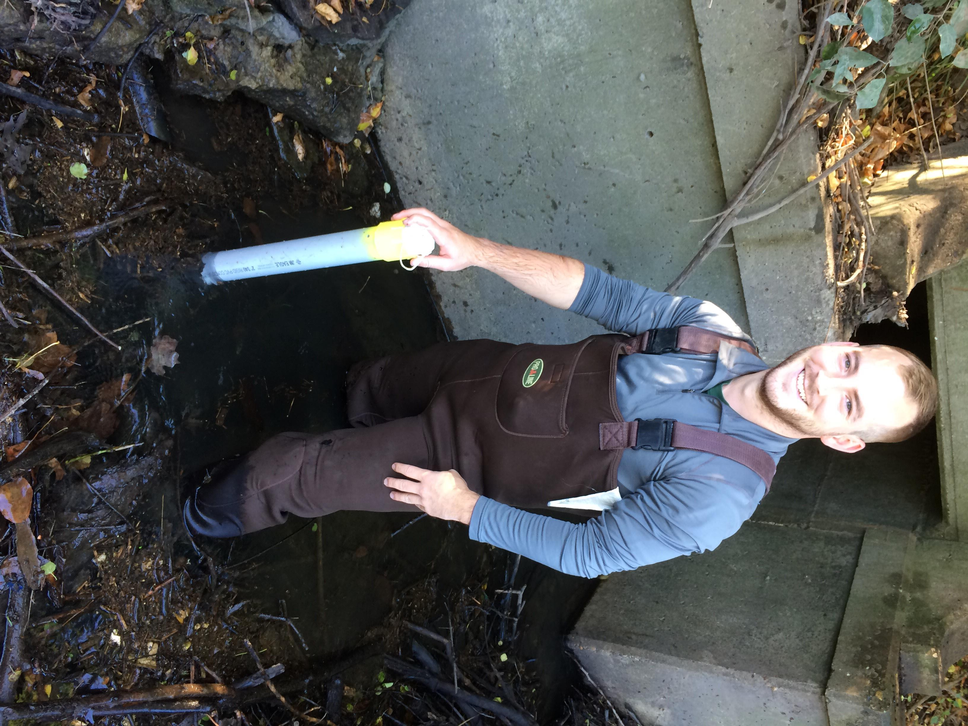
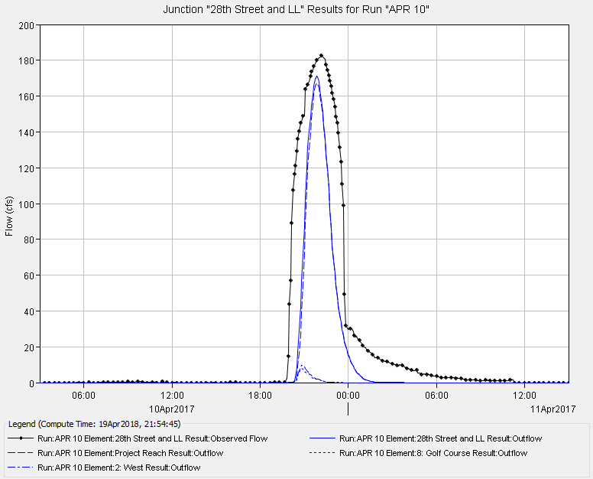
Model Validation
Introduction
Design
HEC-RAS
Costs
HEC-HMS
Additional
Slide 8/22

Slide 11
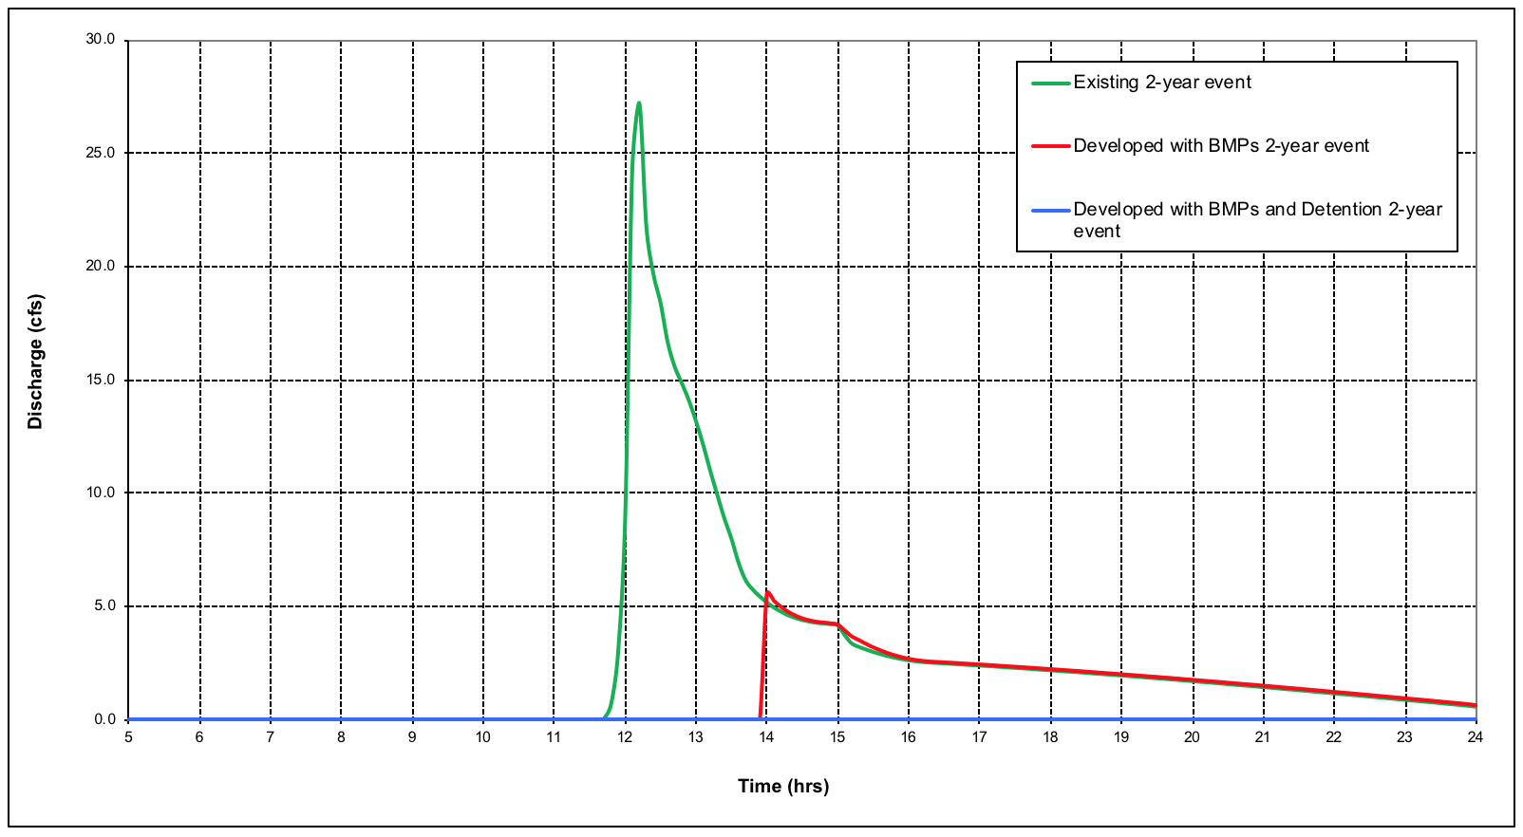
HEC-HMS Rain Garden Results
Introduction
Design
HEC-RAS
Costs
HEC-HMS
Additional
Slide 9/22

Slide 12
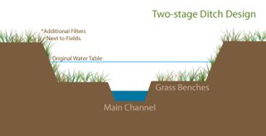
Two Stage Ditch
Improves drainage functions and ecological function
Better flow during low periods
Increase sediment filtration
Can improve water quality
Introduction
Design
HEC-RAS
Costs
HEC-HMS
Additional
Slide 10/22

Slide 13
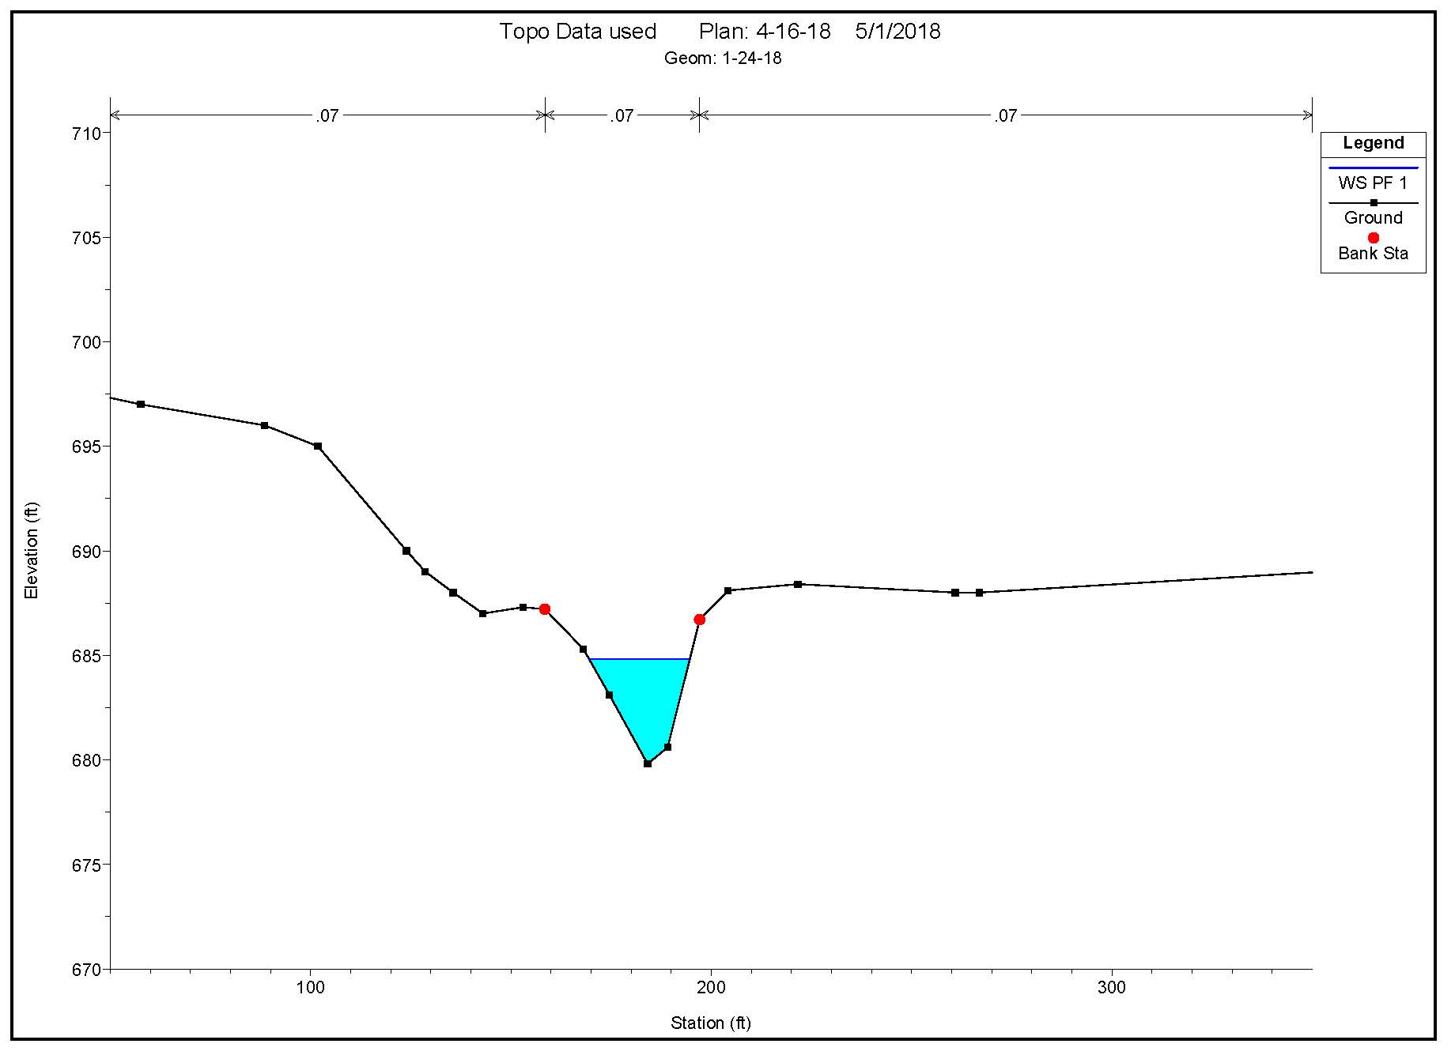
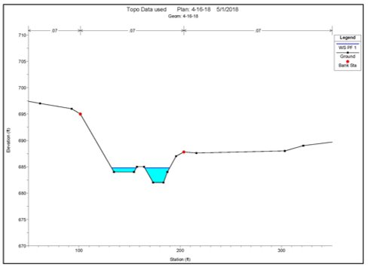
HEC-RAS Cross- Sections
Introduction
Design
HEC-RAS
Costs
HEC-HMS
Additional
Slide 11/22

Slide 14
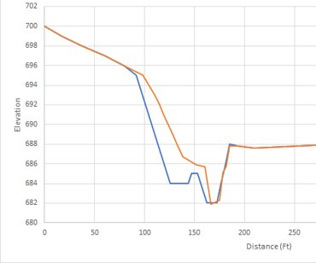

Slide 15
HEC-RAS Proposed Solution
Introduction
Design
HEC-RAS
Costs
HEC-HMS
Additional
Slide 12/22

Slide 16
HEC-RAS Results
Introduction
Design
HEC-RAS
Costs
HEC-HMS
Additional
Slide 13/22

Slide 17
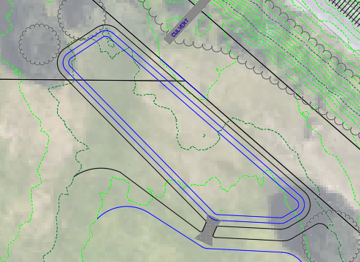
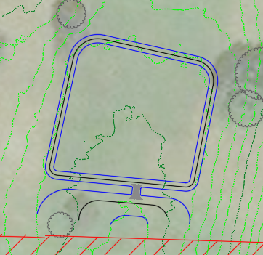
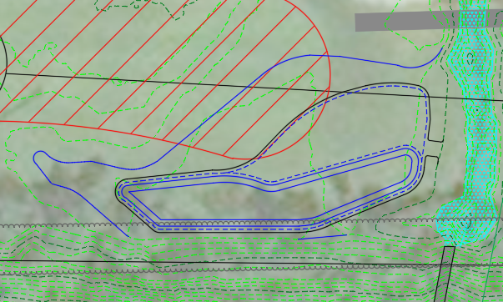
AutoCAD Modeling/Survey
North
Mid
South
Introduction
Design
HEC-RAS
Costs
HEC-HMS
Additional
Slide 14/22

Slide 18
Cost Estimates
Introduction
Design
HEC-RAS
Costs
HEC-HMS
Additional
Slide 15/22

Slide 19
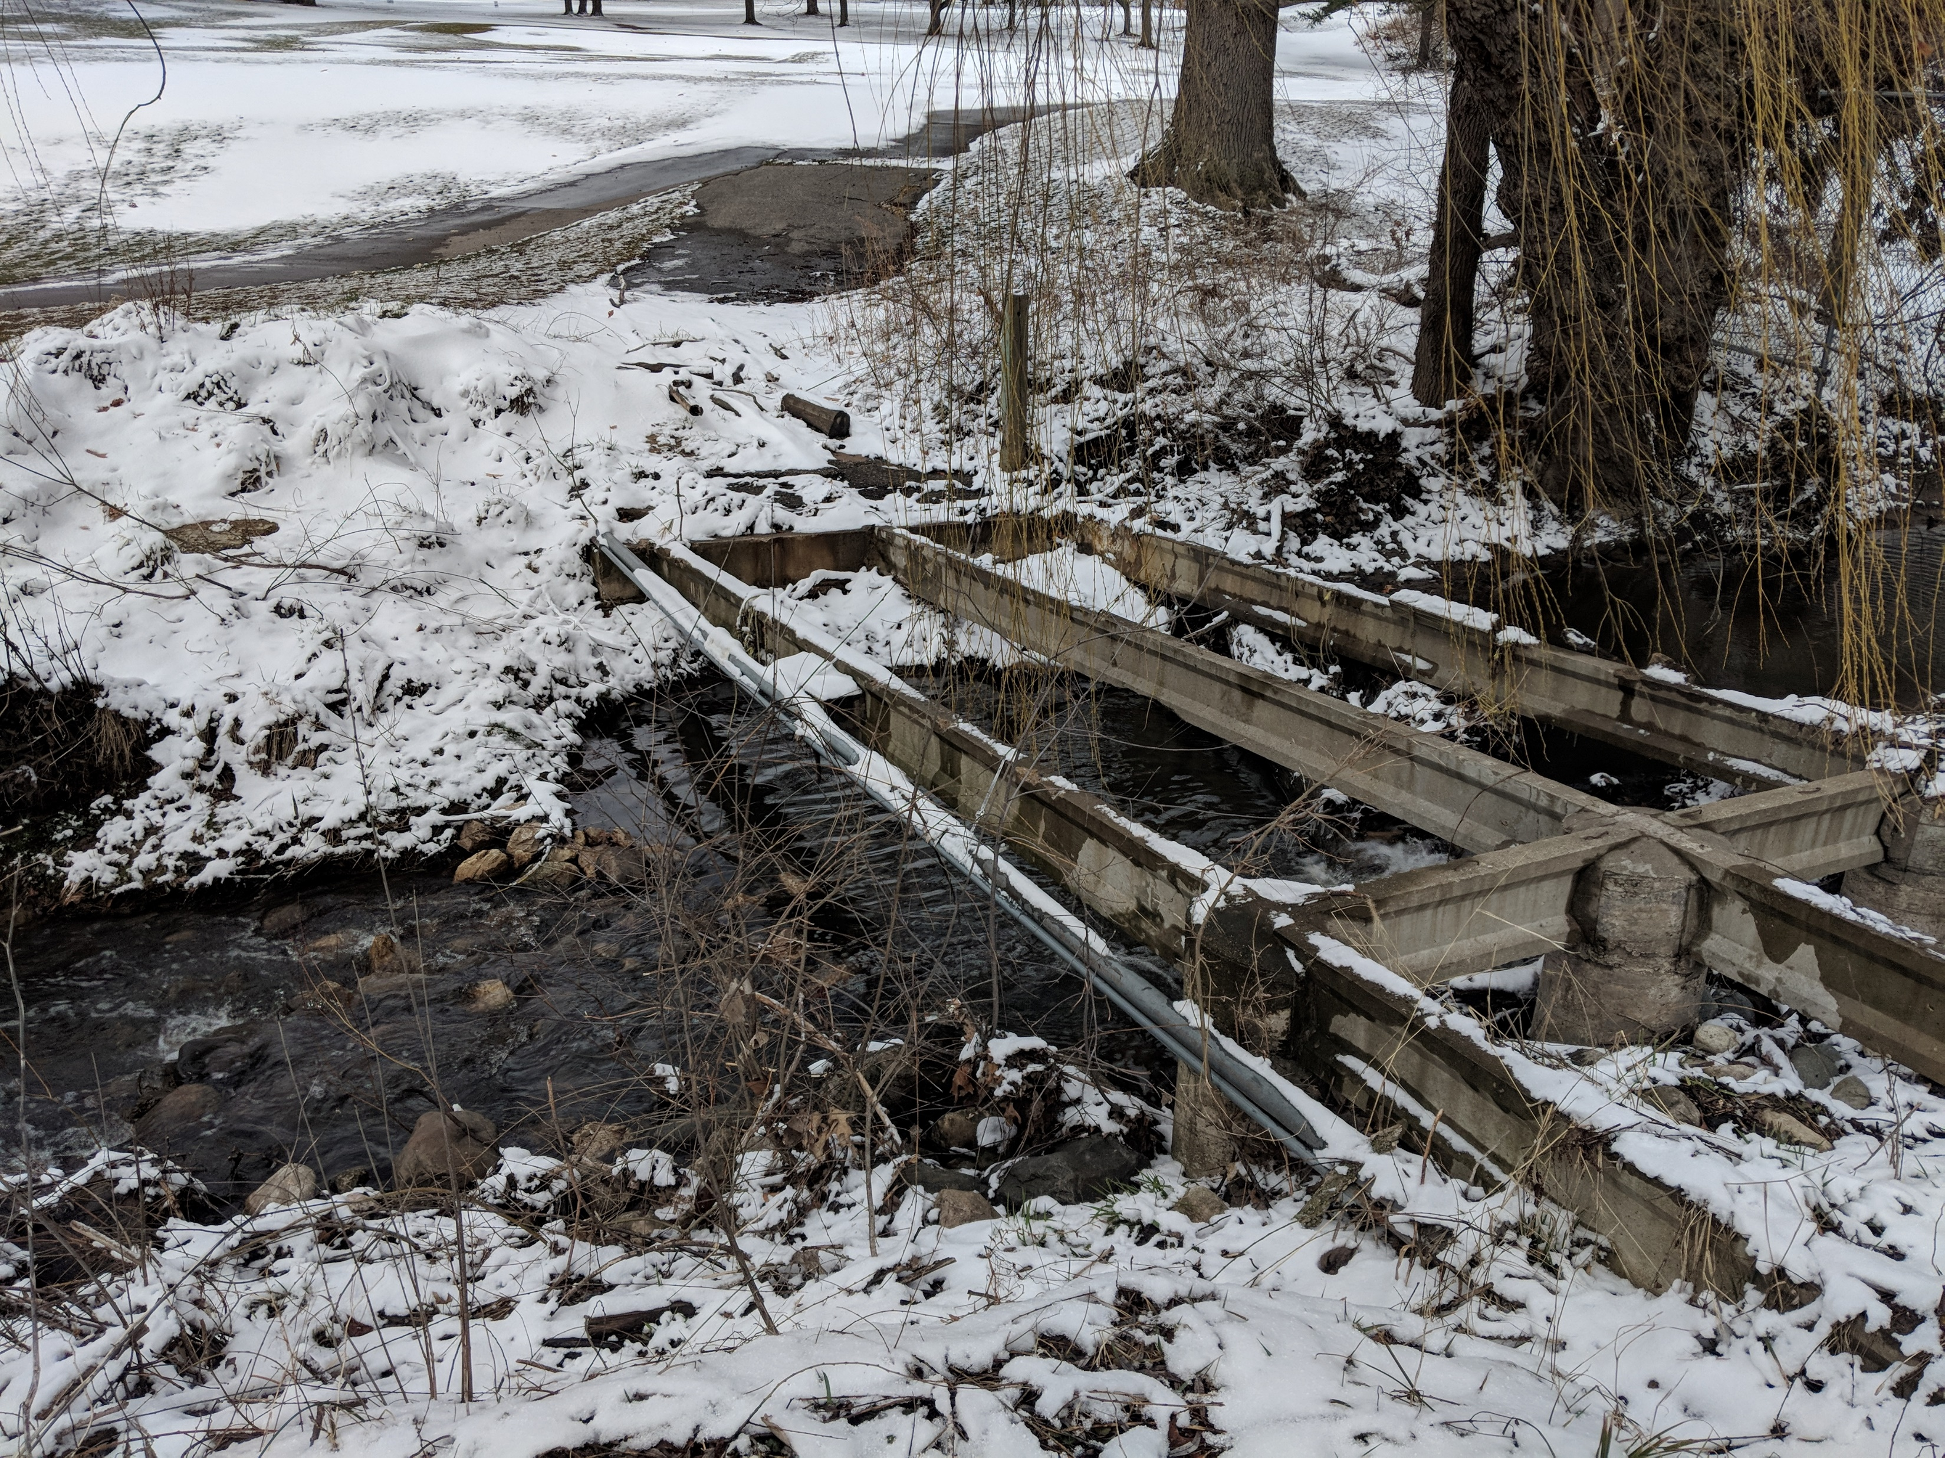
Recommendations
Outside scope of project
Remove old bridge
Add trash grate to culvert
Modify chain linked fence
Introduction
Design
HEC-RAS
Costs
HEC-HMS
Additional
Slide 16/22

Slide 20
Slide 17/22

Slide 21
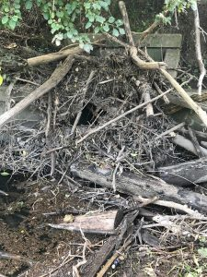
Recommendations
Outside scope of project
Remove old bridge
Add trash grate to culvert
Modify chain linked fence
Introduction
Design
HEC-RAS
Costs
HEC-HMS
Additional
Slide 18/22

Slide 22
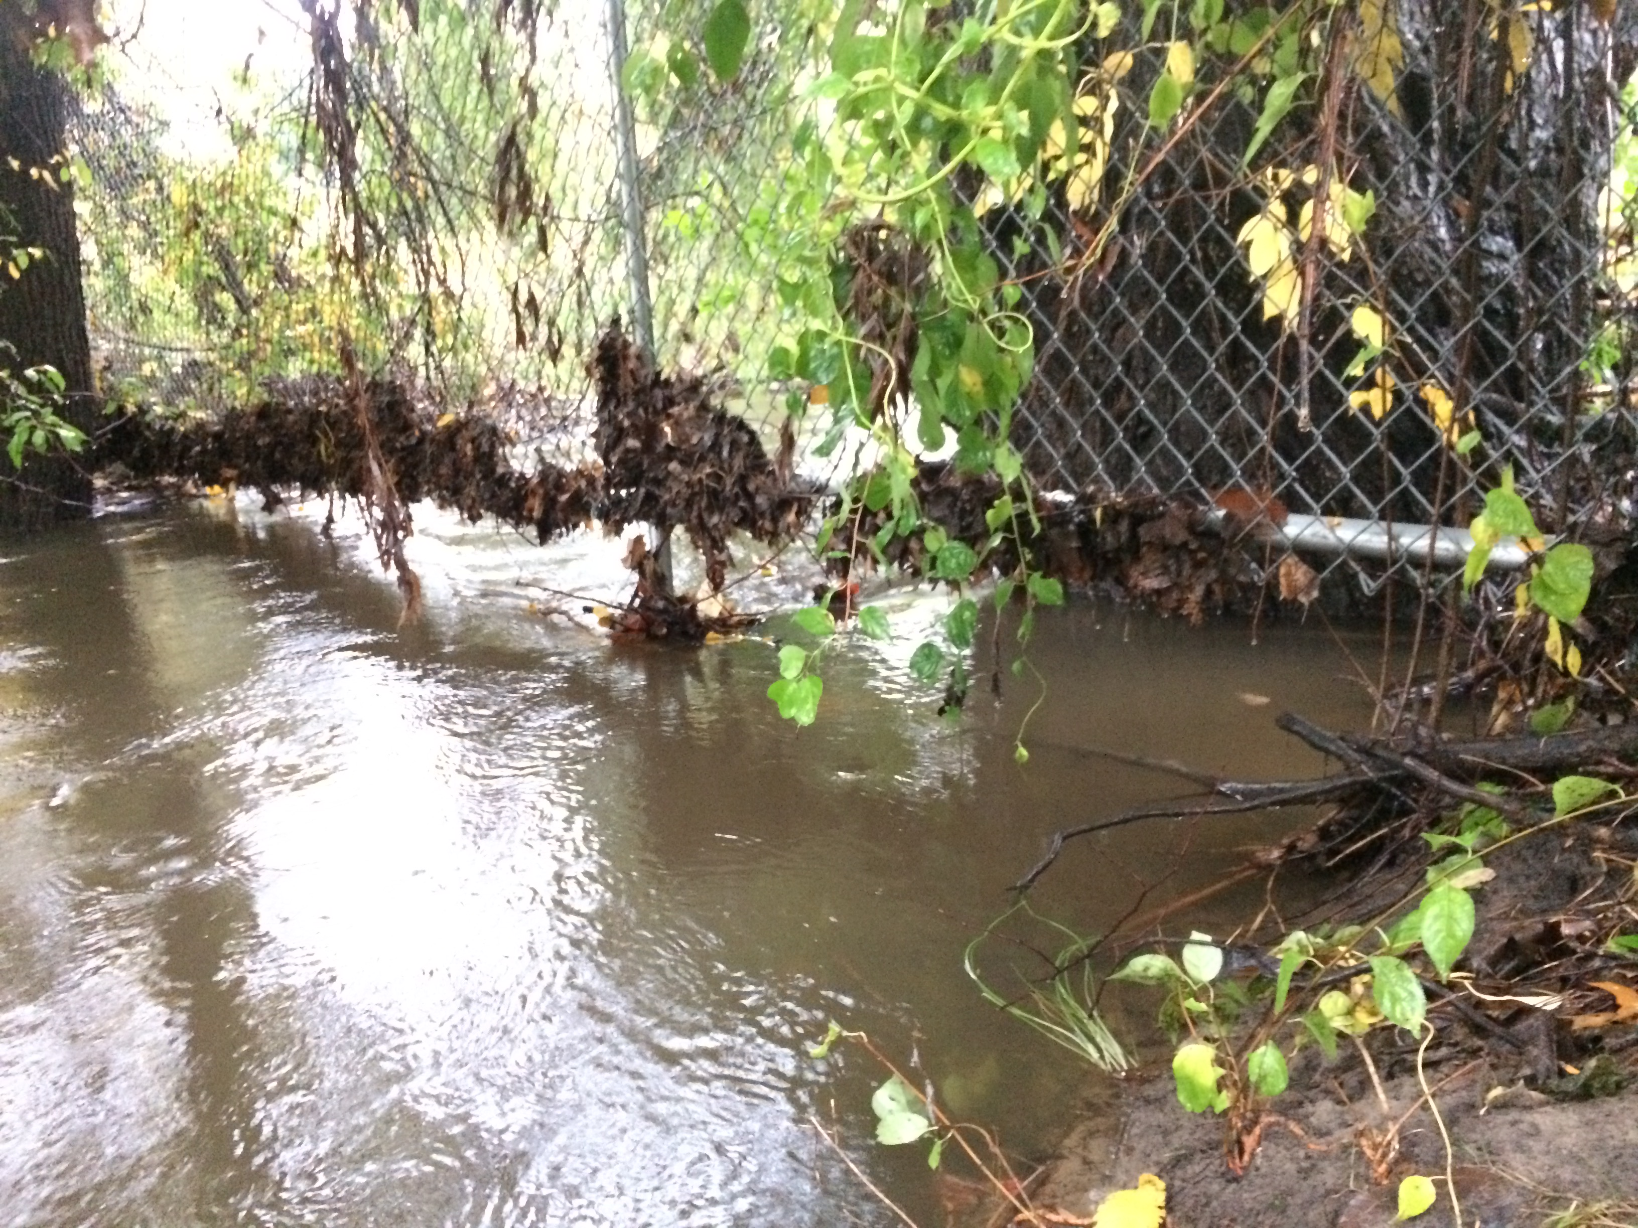
Recommendations
Outside scope of project
Remove old bridge
Add trash grate to culvert
Modify chain linked fence
Introduction
Design
HEC-RAS
Costs
HEC-HMS
Additional
Slide 19/22

Slide 23
Conclusion
Goals:
Reduce stormwater runoff from the golf course
Restore native vegetation habitats
Create a stable flood bench for Indian Creek
Introduction
Design
HEC-RAS
Costs
HEC-HMS
Additional
Slide 20/22

Slide 24
Acknowledgments
Professor Wildschut
Professor De Rooy
Slide 21/22

Slide 25
Questions?
Slide 22/22

