Slide 1
hot-JAC
Temi Ogunnoiki, Chinelo Ezenwelu, Shurjo Maitra

Slide 2
Problem we are trying to solve
Constructing and testing a Heated jacket/hoodie with temperature control using android ecosystem.
Secondary feature: inbuilt bone conduction headphones with bluetooth capability
Tertiary features: smart pockets, portable charging, inflatable neck, etc (if time and design permit)

Slide 3
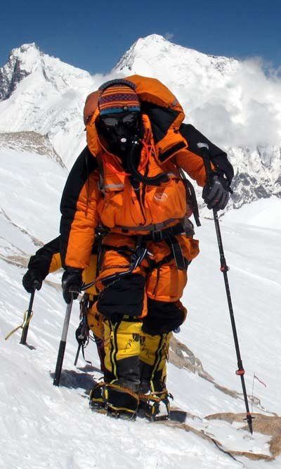
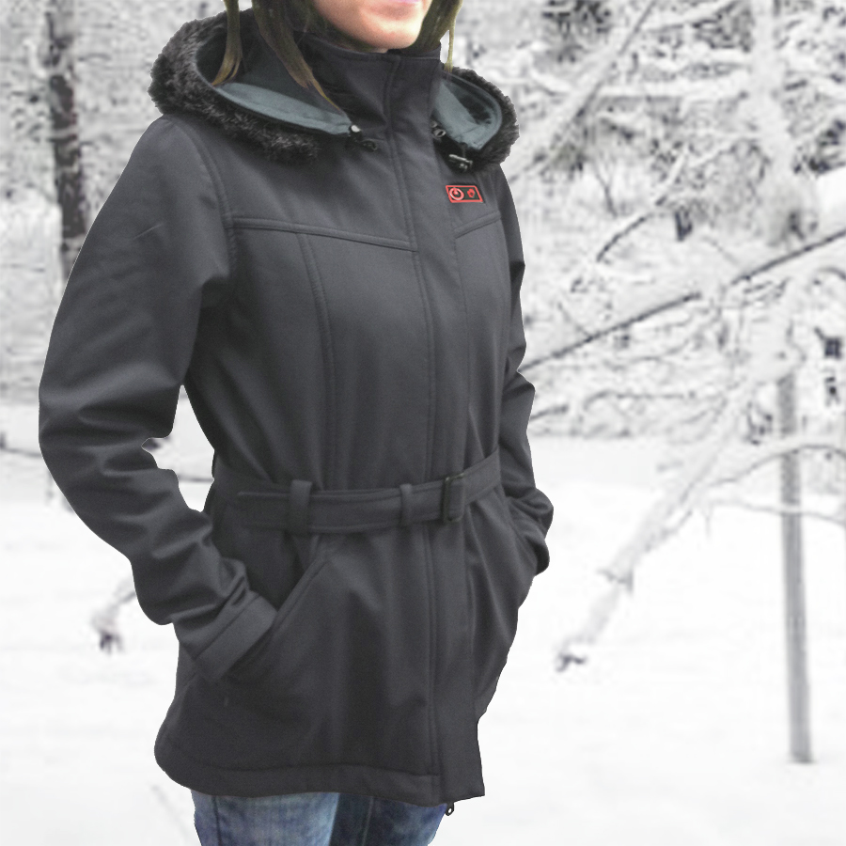
Importance of the problem
Who wants to wear layers?
Extreme winter sport standpoint
Stylish?
Emergencies
Adjustability

Slide 4
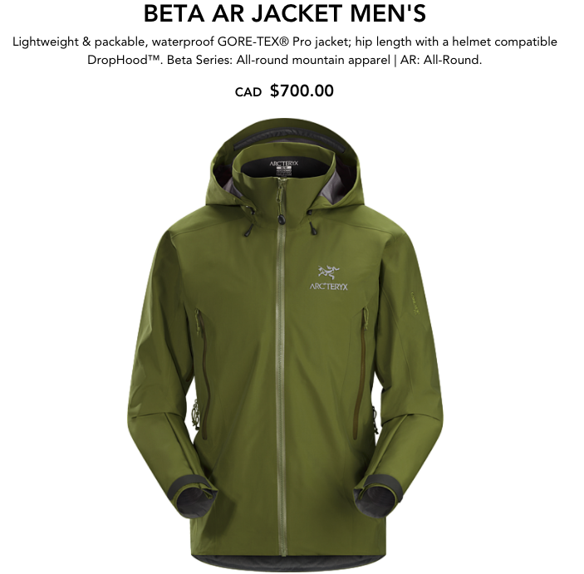
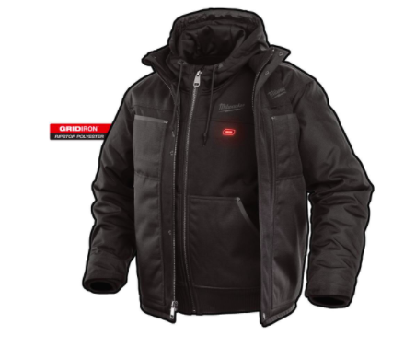
Market and Customer analysis
Anyone in colder climates
Down and Gore-tex jackets are already quite expensive >$300
Heated jackets are too bulky or too expensive at the moment >$200

Slide 5
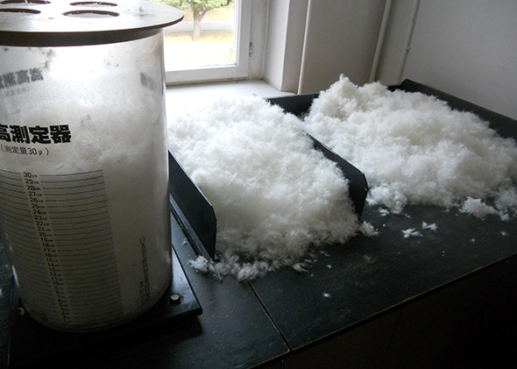
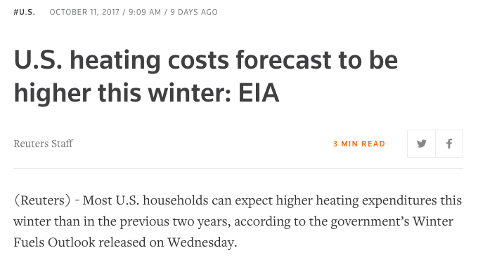
Christian faith
Help save manufacturing of clothing material
More energy efficient (even at home)
If economically viable will help reach people who cannot afford heat

Slide 6
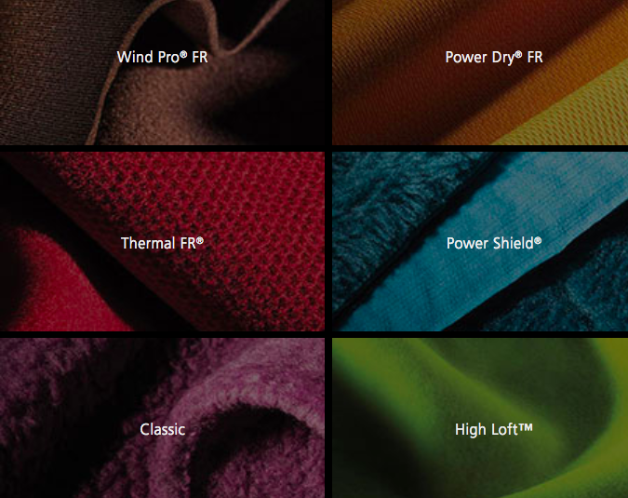
Alternative Solutions
New materials, in addition to down fill and Gore-tex
Better insulation and breathability

Slide 7
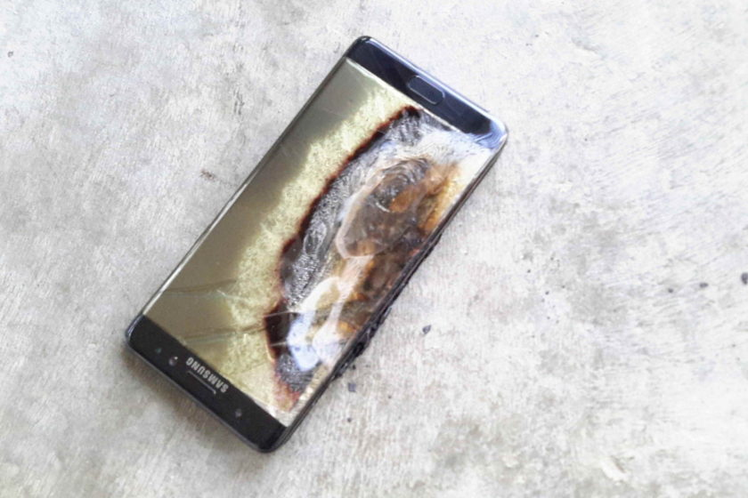
Important Design norms
Trust
Integrity
Care

Slide 8
Predicted Major Obstacles
Designing and implementing a the heating element
Providing sufficient safety and testing to make a hazard free prototype
Interfacing between controller and software to provide sufficient control
Power vs. Heat vs. Weight tradeoff
Bone conduction prototyping

Slide 9
Conclusion
What could we add/take out?
Viability?
Questions?

Slide 10
Image References
http://polartec.com/products
https://www.gore-tex.com/technology/what-is-gore-tex
https://www.androidauthority.com/samsung-galaxy-note-7-recall-714419/
http://balcikheatingelements.com/
http://breaking911.com/governor-cuomo-signs-executive-order-to-protect-homeless-individuals-during-inclement-winter-weather/
https://arcteryx.com/is/en/shop/mens/beta-ar-jacket
https://commons.wikimedia.org/wiki/File:Almaty_winter_Street.jpg
http://www.mountainguides.com/cho-oyu-gear.shtml
https://www.activheat.com/Womens-Hooded-Heated-Jacket-s/537.htm

