Slide 1
Team 5
Temi Ogunnoiki, Shurjo Maitra & Chinelo Ezenwelu

Slide 2
Outline
Meet The Team
Summary of Project
Marketing Analysis
Design Norms
Design Decisions
Lessons Learned
Future Steps
Acknowledgements
Questions

Slide 3
Team Members
Chinelo Ezenwelu
Shurjo Maitra
Temi Ogunnoiki

Slide 4
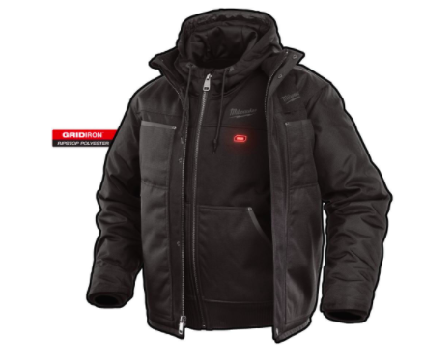
Summary of Project
Problem:
Long cold dreadful winter day, wearing uncomfortable bulky clothes to barely stare warm
Solution:
Heating Jacket with bone conduction for everyone from all social and financial backgrounds to combat the long cold days with delight.

Slide 5
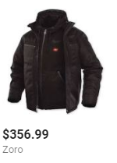
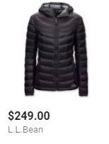
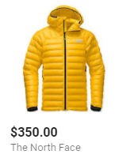
Marketing Analysis
average market price for heating jacket
Our design is using simple electrical devices and material to reduce the cost of material and the price of the final product
At a reduced price the product fulfils the design norm of care and justice by increasing accessibility to all demographics
https://www.thenorthface.com/shop/mens-summit-l3-down-hoodie-nf0a37p6?from=subCat&variationId=739&cm_mmc=Google-_-Shopping-_-Men+s+Tops-_-NF0A37P6739XL1&utm_medium=cpc&utm_source=Google&utm_campaign=Shopping&utm_term=NF0A37P6739XL1&gclid=Cj0KCQjw_ODWBRCTARIsAE2_EvWeBSObrSPVJidiPla33a1E175laEUcnJozNhaEzoQEUg9yVLUyJCUaAoFkEALw_wcB#hero=0

Slide 6
Design Norms
Trust
Care
Justice
Notes:
Care using cheaper materials with good quality
Trust with safety
Justice our design is for everyone and not for only those with cash

Slide 7
Design Decisions
Heating Pads
HC-05 Bluetooth Module
Arduino Uno microcontroller
Gore-tex Material
Cotton and Wool material
Android application
Choices were validated with research and testing
Notes:
Design abilities clearly evident. Team clearly showed that they met the project goals by making appropriate design decisions (i.e. selecting components, sizes, materials, etc). Clear evidence team appropriately considered all relevant constraints.

Slide 8
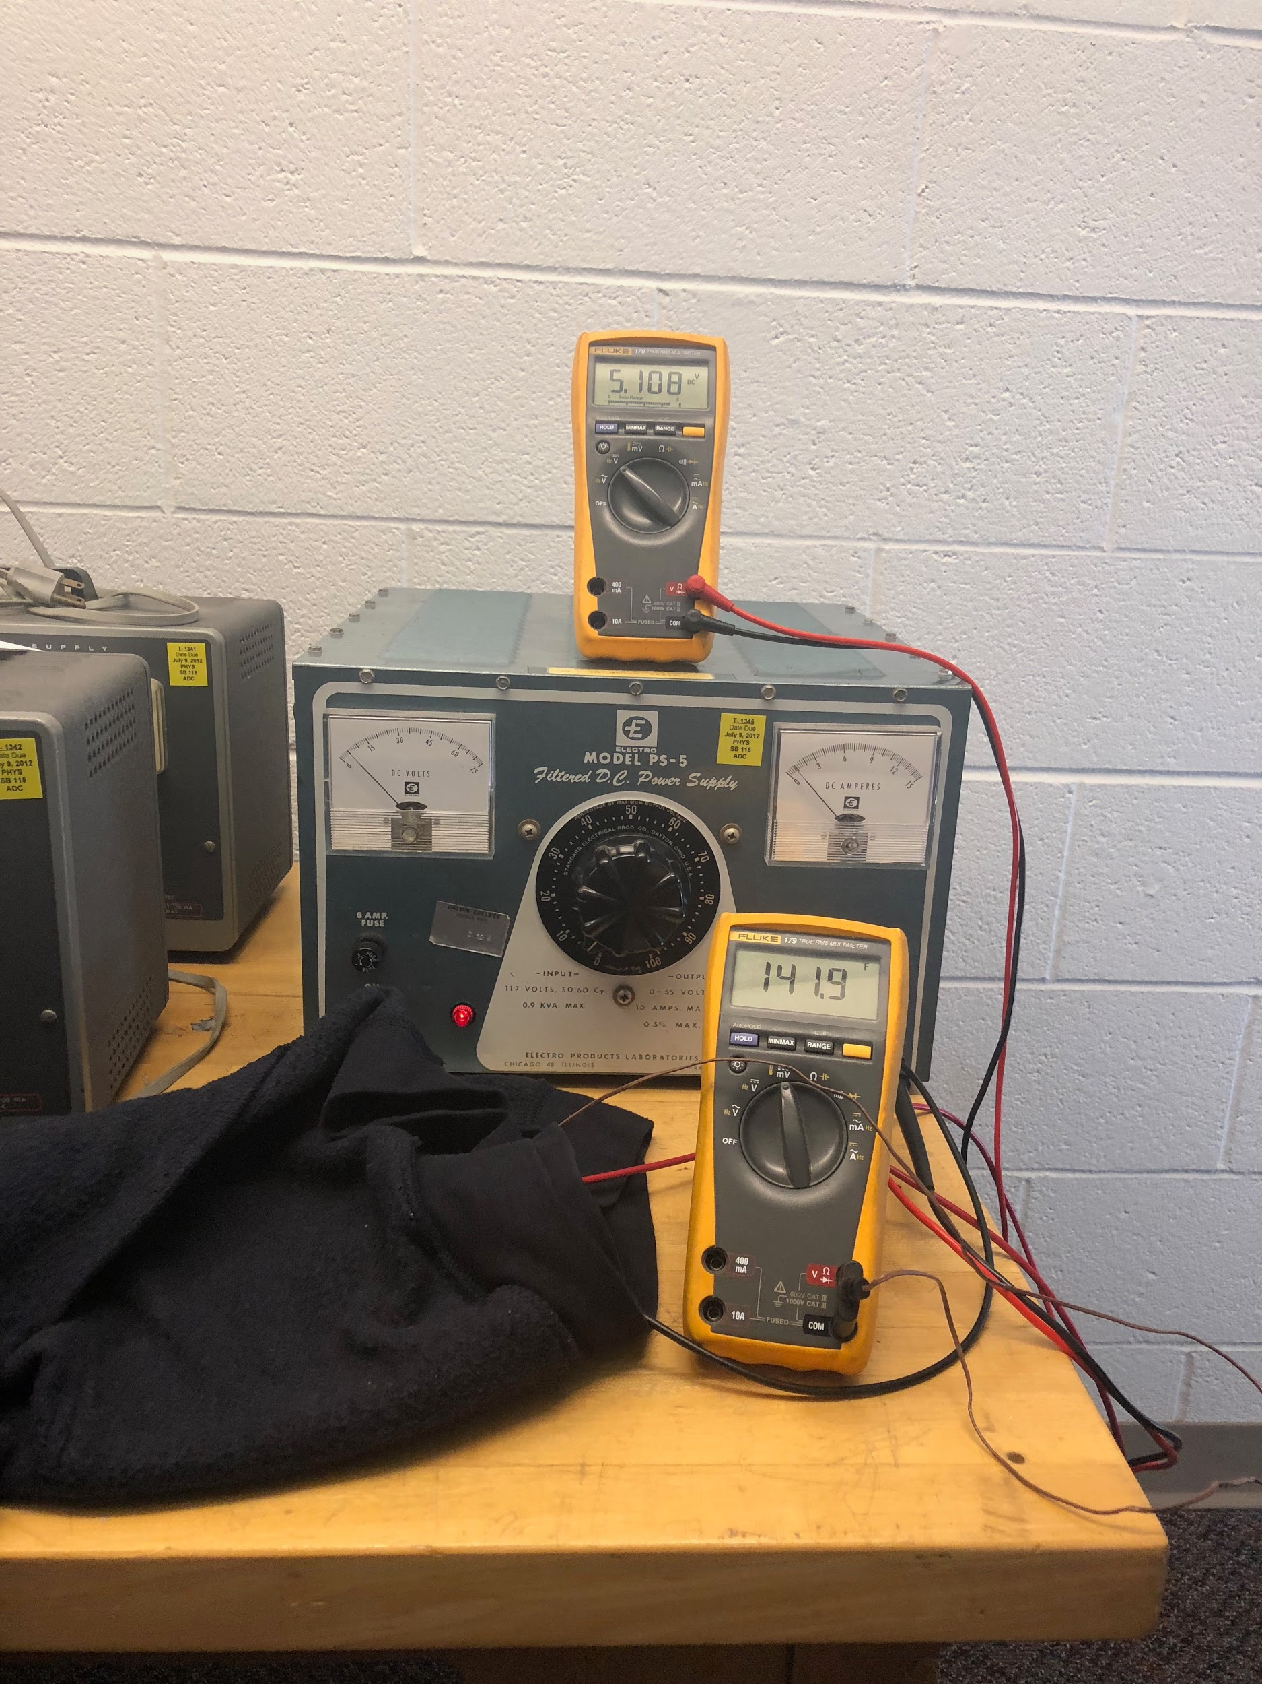
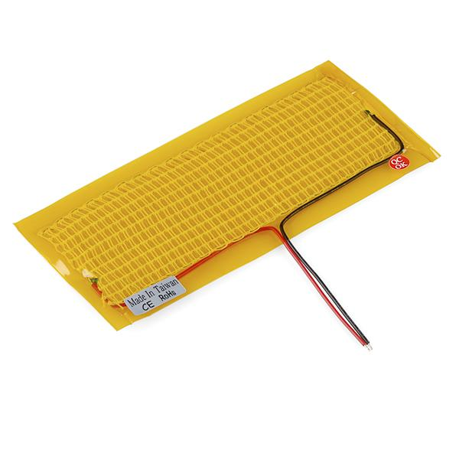
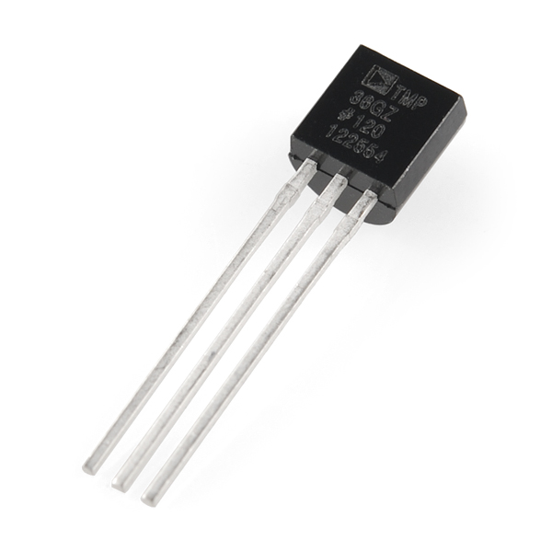
Heating Pad and Temperature Sensor
Sparkfun 5x15cm heating pads.
Specifications: min 5V, 1A, produces as little as 90F heat and as high as 145F at a reasonably fast rate.
TMP-36 sensor, very cheap, but works perfectly with arduino.
Sources: https://www.sparkfun.com/products/11289

Slide 9
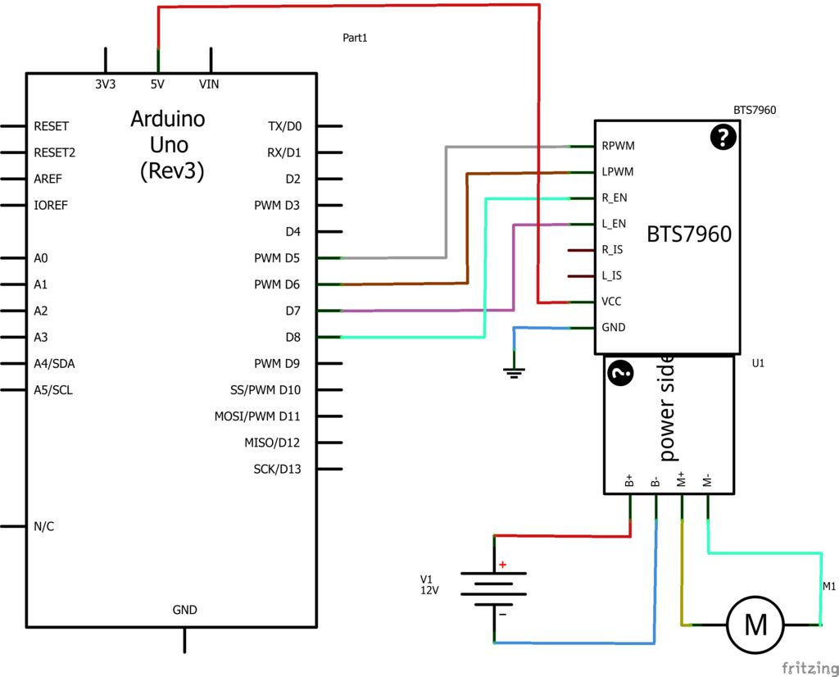
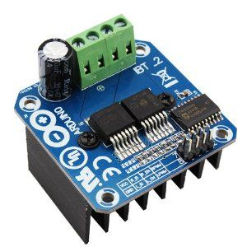
H-Bridge - BTS7960
Used for Motor driving control
Undervoltage Shut Down
Overtemperature Protection
Current Limitation
https://cdn.instructables.com/FRV/794B/HUL8W14L/FRV794BHUL8W14L.LARGE.jpg

Slide 10
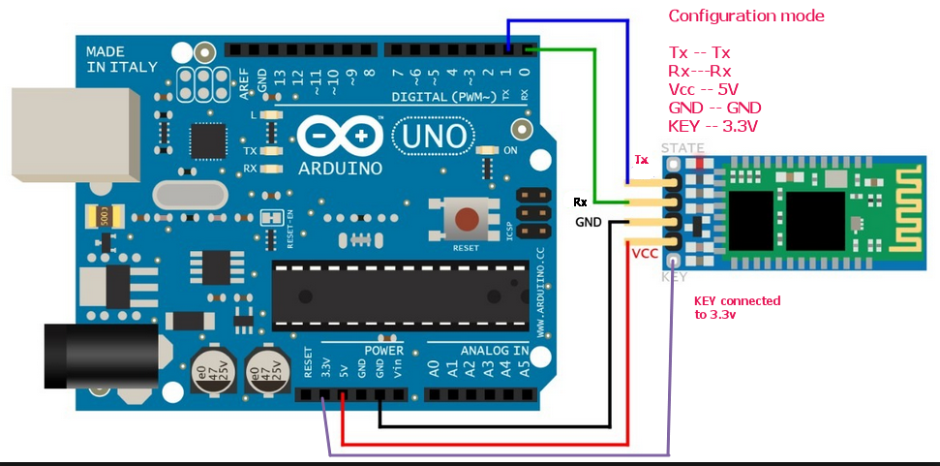
HC-05 Bluetooth Module and Arduino
Designed for serial connection setup
Can work as both master and slave
Very cheap and widely used.

Slide 11
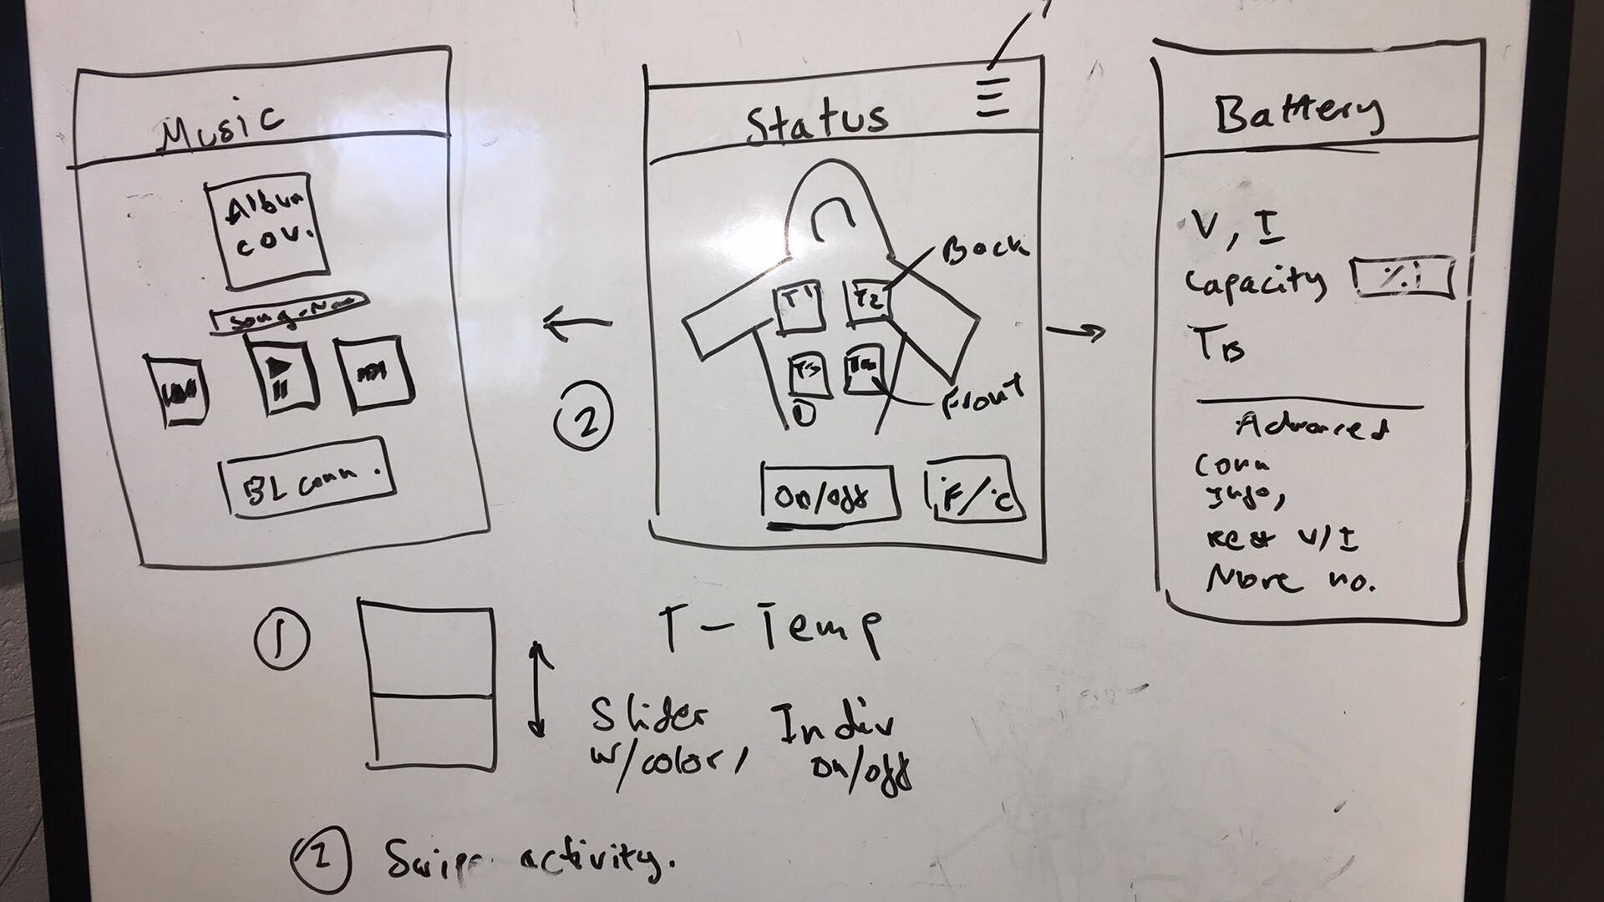
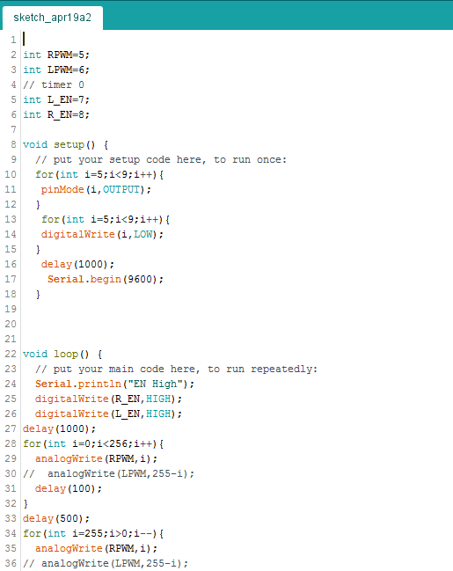
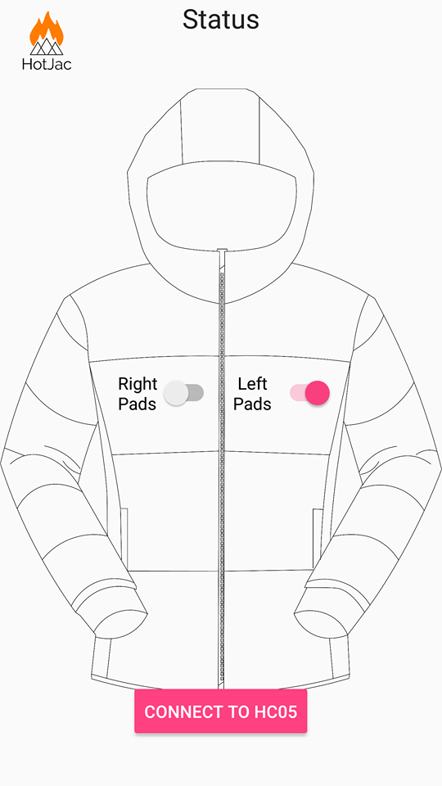
Software Design: Android Studio and Arduino IDE

Slide 12
Lessons Learned
Communication
More Testing
Set achievable goals
Stick to deadlines and timelines

Slide 13
Future Steps
A more sophisticated design
More Testing

Slide 14
Conclusion and Acknowledgement
Prof. Michmerhuizen
Mr. Eric Walstra
Bob Dekraker
Chuck Holwerda
Prof. Yoon Kim

Slide 15
Questions

