Slide 1
Production of Sesame Oil
Group 20
Golden Oil

Slide 2




Emma Huynh
Preston Ji
Charlotte Ntim
Maame Sarpong
Team Members
Project Summary
General
Design
Detailed Design
Cost
Analysis
Holistic
Concerns
Future
Work

Slide 3
Outline
Team members
Project summary
General design
Detailed design
Cost analysis
Holistic concerns
Future work

Slide 4
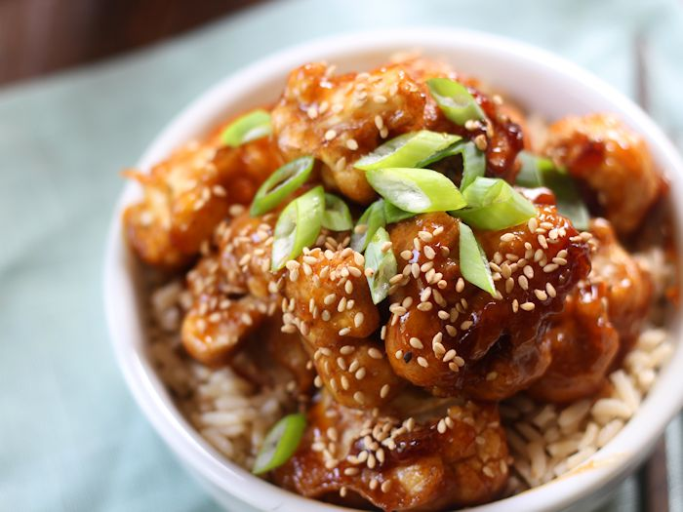
Golden Oil Project
Produce sesame oil from sesame seed
Produce via mechanical pressing followed
by solvent (hexane) extraction
Project scale: 10,750 tons/year, which is 1% of worldwide sesame oil production
Team Members
Project Summary
General
Design
Detailed Design
Cost
Analysis
Holistic
Concerns
Future
Work

Slide 5
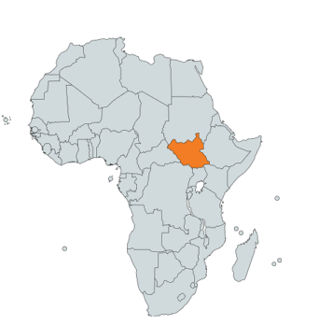

Inspiration
Team Members
Project Summary
General
Design
Detailed Design
Cost
Analysis
Holistic
Concerns
Future
Work

Slide 6
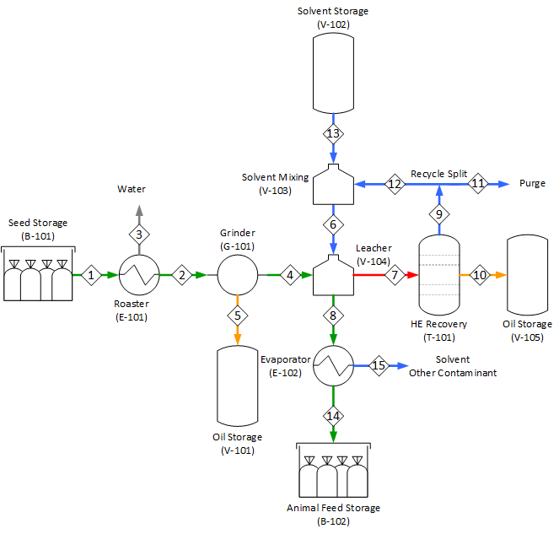
General Design
Roast and grind sesame seed into cake
Collect oil
Apply hexane
Separate liquid and solid
Separate hexane and oil
Recycle hexane
Collect oil
Team Members
Project Summary
General
Design

Slide 7


Slide 8
Detailed Design
Leacher (V-104)
Hexane-oil separation (T-101)
Team Members
Project Summary
General
Design
Detailed Design

Slide 9
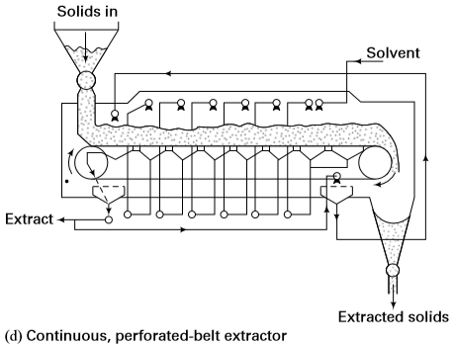
Leacher
Objective: remove 49~50% of sesame oil
Solution: Continuous, perforation belt leacher
Team Members
Project Summary
General
Design
Detailed Design
Notes:
The sesame pulp enters the tank on a conveyer belt and showers of hexane are sprayed on the pulp. This gives an easier separation of the solid phase from the liquid phase

Slide 10
Leacher
Solvent : Seed ratio: 1.25:1
Operating condition: 60℃ and 100 kPa
Two methods are considered:
Graphical method
Mathematical method
Team Members
Project Summary
General
Design
Detailed Design
Cost
Analysis
Holistic
Concerns
Future
Work

Slide 11
Detailed Design
Graphical method
Two stages needed
Assume:
Residence time
No change in density and viscosity
Perfect dissolution of oil in solvent
Use soybean oil data for the solid retained in the solution vs. the concentration of oil
Team Members
Project Summary
General
Design
Detailed Design
Cost
Analysis
Holistic
Concerns
Future
Work

Slide 12
Graphical method

Slide 13
Detailed Design
Porous sesame seed
Internal diffusion
External diffusion
Mathematical model
- Internal diffusion is negligible
- External diffusion limiting
- Diffusivity: D_{AB} = 1.44*10⁻⁹ m²/s
- Mass transfer coefficient: kc =2.28*10⁻³ m/s
External surface
Team Members
Project Summary
General
Design
Detailed Design
Notes:
Diffusivity tells about the mobility characteristic of a the component

Slide 14
Optimization for Leaching
Plans for optimization:
Amount of hexane vs. number of stages
Try different the Solvent: Feed ratio
Team Members
Project Summary
General
Design
Detailed Design
Cost
Analysis
Holistic
Concerns
Future
Work

Slide 15
Hexane-Oil Separation
Objective: remove hexane from oil down to 20 parts per million (ppm)
Problem 1:
Modeling of sesame oil
Complex mixture of various fatty acids attached to glycerol
Solution:use top 4 fatty acids, hypothetical components, Clausius-Clapeyron
Team Members
Project Summary
General
Design
Detailed Design
Cost
Analysis
Holistic
Concerns
Future
Work

Slide 16
Hexane-Oil Separation
Objective: remove hexane from oil down to 20 ppm
Problem 2:
Distill the mixture: oil does not boil → evaporation instead of distillation
Insufficient material property to converge (Unisim)
Solution: multi-stage flash
Team Members
Project Summary
General
Design
Detailed Design
Cost
Analysis
Holistic
Concerns
Future
Work

Slide 17
Hexane-Oil Separation
Objective: remove hexane from oil down to 20 ppm
Problem 3:
End of the flash drums: 1 wt% hexane, not enough
→ use stripping gas (nitrogen)
Solution: multi-stage flash + stripping column
Team Members
Project Summary
General
Design
Detailed Design
Cost
Analysis
Holistic
Concerns
Future
Work

Slide 18
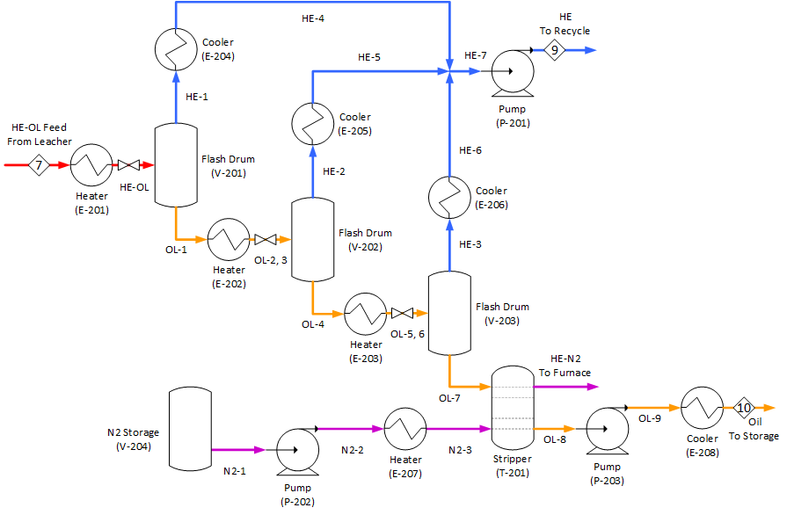
Flash
4. Condense vapor
5. Recycle hexane
1. Heat the liquid
2. Vaporize some hexane
3. Separate liquid and vapor
Repeat

Slide 20
Flash
Conditions:
1st drum: 90 ℃, 70 kPa
2nd drum: 130 ℃, 20 kPa
3nd drum: 130 ℃, 20 kpa ← can be omitted
Results:
Inlet: ~86% hexane in oil
Outlet: 1.7% hexane in oil
Negligible (~ 0.01%) oil in hexane
Team Members
Project Summary
General
Design
Detailed Design
Cost
Analysis
Holistic
Concerns
Future
Work

Slide 21
Stripper
3. Burn off-gas
4. Cool the oil
1. Vaporize nitrogen
2. Bubble through oil

Slide 22
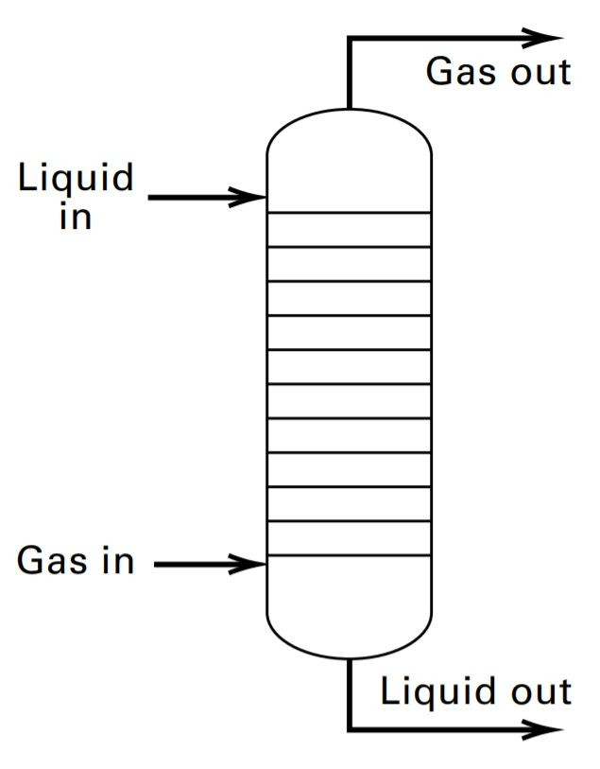
Stripper
Stripping Gas:
Nitrogen - inert
Methane - flammable
Steam - oxidant
Conditions: ← to be finalized
130 ℃, 20~30 kPa
Team Members
Project Summary
General
Design
Detailed Design
Cost
Analysis
Holistic
Concerns
Future
Work

Slide 24
Cost Analysis
1st year cost ~ $ 25,767,000 (Capital cost to be annualized)
Item | Cost, USD
Capital cost | $5,630,000
Utility | $507,000/yr
Labor | $3,650,000/yr
Maintenance | $3,100,000/yr
Material | $12,880,000/yr
Team Members
Project Summary
General
Design
Detailed Design
Cost
Analysis
Holistic
Concerns
Future
Work
Notes:
The second method is the labor-related-operations method ^{[43]}. This method evaluates the type and arrangement of the equipment, the multiplicity of the units, and the control of each process. For a preliminary estimate of the number of operators required per shift, the process is divided into the following sections with each section requiring at least 2 operators at a time

Slide 25
Cost Analysis
From general design (PPFS):
Oil price: $2,670/t
Market oil price: $2,870/t
BEP is 7% lower than market price → feasible in the US
Criteria:
15% rate of return
20 year study period (plant life)
Team Members
Project Summary
General
Design
Detailed Design
Cost
Analysis
Holistic
Concerns
Future
Work

Slide 26
Further Considerations
Waste: CO2, N2, water
By-product: animal feed
Hazard: fire
Chemicals: relatively harmless
Reasonably safe and environmentally friendly
Team Members
Project Summary
General
Design
Detailed Design
Cost
Analysis
Holistic
Concerns
Future
Work

Slide 27
Further Considerations
South Sudan
Unstable economy → high inflation rate
→ unstable currency exchange rate
Poor infrastructure → high transportation cost
Low urbanization → high utility cost
Risky investment, likely unprofitable
Team Members
Project Summary
General
Design
Detailed Design
Cost
Analysis
Holistic
Concerns
Future
Work

Slide 28
Further Considerations
Cultural and Social Impacts
Promote industrial agriculture
Centralization of land → landless flowing into the cities
Dissolution of traditional society
Use caution to proceed
Team Members
Project Summary
General
Design
Detailed Design
Cost
Analysis
Holistic
Concerns
Future
Work

Slide 29
Further Considerations
Strategic Importance
Selling the oil is not the focus
Create technical employment
Training ground for future development
Maybe worthwhile even if unprofitable
Team Members
Project Summary
General
Design
Detailed Design
Cost
Analysis
Holistic
Concerns
Future
Work

Slide 30
Acknowledgement
Professors
Professor Chad Tatko (Organic Chemist)
Jennifer VanAntwerp (Chemical Engineer)
Jeremy VanAntwerp (Chemical Engineer)
Wayne Wentzheimer (Chemical Engineer)
Dr. Phil Bronsema (Industrial Chemist)
Zeeland Farm Services Inc. (Soybean Oil Company)
Team 18 (Mechanical Team)

Slide 31


