Slide 1
Production of Sesame Oil
Group 20
Golden Oil

Slide 2




Emma Huynh
Preston Ji
Charlotte Ntim
Maame Sarpong
Team Members
Project Summary
General
Design
Detailed Design
Cost
Analysis
Holistic
Concerns
Future
Work

Slide 3
Outline
A. Team members
B. Project summary
C. General design
D. Detailed design
E. Cost analysis
F. Holistic concerns
G. Future work

Slide 4

Golden Oil Project
Produce sesame oil from sesame seed
Produce via mechanical pressing followed
by solvent (hexane) extraction
Project scale: 10,750 tons/year, which is 1% of worldwide sesame oil production
Team Members
Project Summary
General
Design
Detailed Design
Cost
Analysis
Holistic
Concerns
Future
Work

Slide 5
General Design
Boundary of project:
One harvest per year
Industrial agriculture: seeds are already processed
Ignore further oil refinery
US references and data
Solvent selection: hexane → widely used in industry
Relatively low cost High volatility
High oil solubility Low toxicity
Team Members
Project Summary
General
Design
Detailed Design
Cost
Analysis
Holistic
Concerns
Future
Work

Slide 6
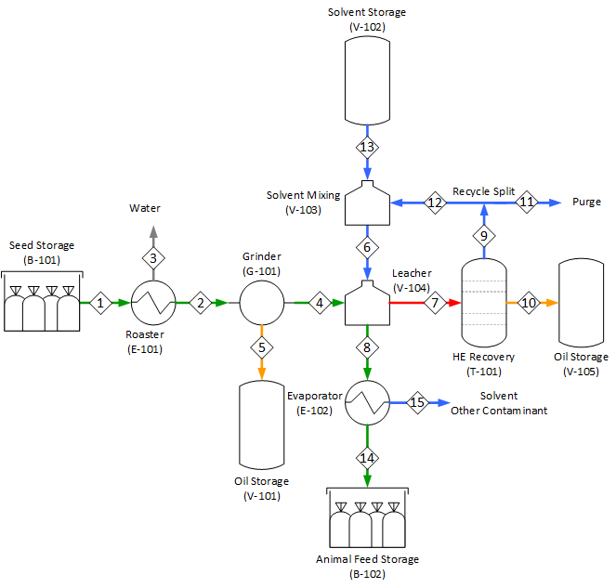
General Design
Roast and grind sesame seed into cake
Collect oil
Apply hexane
Separate liquid and solid
Separate hexane and oil
Recycle hexane
Collect oil
Team Members
Project Summary
General
Design

Slide 7
Detailed Design
Leacher (V-104)
Hexane-oil separation (T-101)
Team Members
Project Summary
General
Design
Detailed Design

Slide 8
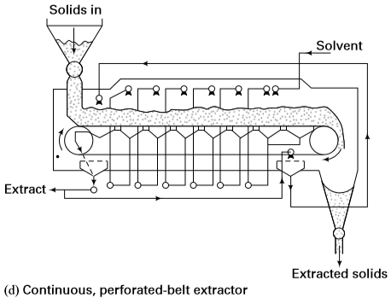
Leacher
Objective: remove 49~50% of sesame oil
Solution: Continuous, perforation belt leacher
Team Members
Project Summary
General
Design
Detailed Design
Notes:
The sesame pulp enters the tank on a conveyer belt and showers of hexane are sprayed on the pulp. This gives an easier separation of the solid phase from the liquid phase

Slide 9
Leacher
Solvent : Seed ratio: 1.25:1
Operating condition: 60℃ and 100 kPa
Two methods are considered:
Graphical method
Mathematical method
Team Members
Project Summary
General
Design
Detailed Design
Cost
Analysis
Holistic
Concerns
Future
Work

Slide 10
Detailed Design
Graphical method
Two stages needed
Assume:
Residence time
No change in density and viscosity
Perfect dissolution of oil in solvent
Use soybean oil data for the solid retained in the solution vs. the concentration of oil
Team Members
Project Summary
General
Design
Detailed Design
Cost
Analysis
Holistic
Concerns
Future
Work

Slide 11
Graphical method

Slide 12
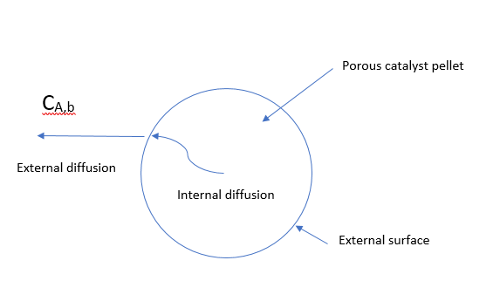
Detailed Design
Mathematical model
- Internal diffusion is negligible
- External diffusion limiting
- Diffusivity: D_{AB} = 1.44*10⁻⁹ m²/s
- Mass transfer coefficient: kc =2.28*10⁻³ m/s
Team Members
Project Summary
General
Design
Detailed Design
Notes:
Diffusivity tells about the mobility characteristic of a the component

Slide 13
Optimization for Leaching
Plans for optimization:
Amount of hexane vs. number of stages
Try different the Solvent: Feed ratio
Team Members
Project Summary
General
Design
Detailed Design
Cost
Analysis
Holistic
Concerns
Future
Work

Slide 14
Hexane-Oil Separation
Objective: remove hexane from oil down to 20 ppm
Problem 1:
Modeling of sesame oil
Complex mixture of various fatty acids attached to glycerol
Solution:
Option 1: use glyceryl trilinoleate → most conservative but lacking properties
Option 2: use top 4 fatty acids, hypothetical components, Clausius-Clapeyron
Team Members
Project Summary
General
Design
Detailed Design
Cost
Analysis
Holistic
Concerns
Future
Work

Slide 15
Hexane-Oil Separation
Objective: remove hexane from oil down to 20 ppm
Problem 2:
Distill the mixture: oil does not boil → evaporation instead of distillation
Insufficient material property to converge (Unisim)
Solution: multi-stage flash
Team Members
Project Summary
General
Design
Detailed Design
Cost
Analysis
Holistic
Concerns
Future
Work

Slide 16
Hexane-Oil Separation
Objective: remove hexane from oil down to 20 ppm
Problem 3:
End of the flash drums: 1 wt% hexane, not enough
→ use stripping gas (nitrogen)
Solution: multi-stage flash + stripping column
Team Members
Project Summary
General
Design
Detailed Design
Cost
Analysis
Holistic
Concerns
Future
Work

Slide 17
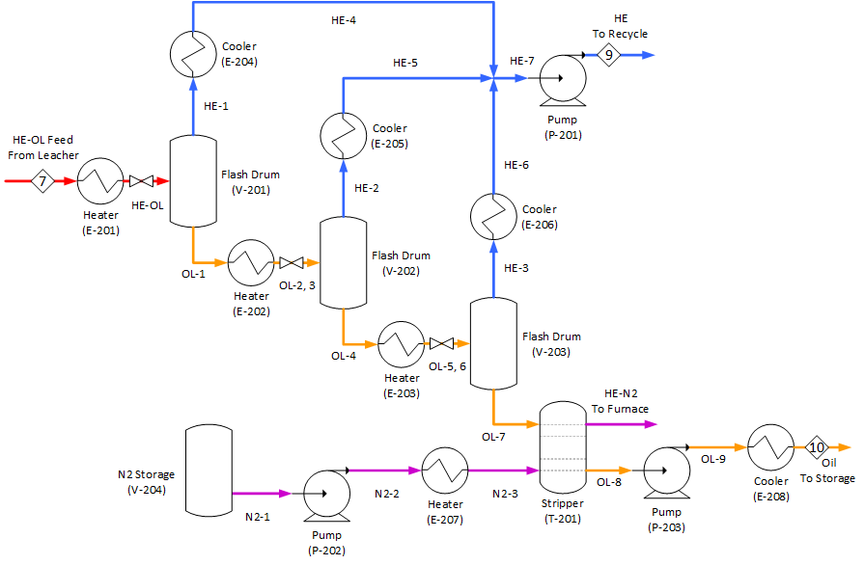

Slide 18
Flash
4. Condense vapor
5. Recycle hexane
1. Heat the liquid
2. Vaporize some hexane
3. Separate liquid and vapor
Repeat

Slide 19
Flash
Conditions: ← to be finalized
1st drum: 90 ℃, 70 kPa
2nd drum: 130 ℃, 20 kPa
3nd drum: 130 ℃, 20 kpa ← can be omitted
Results:
Inlet: 90% hexane in oil
Outlet: 1.7% hexane in oil
Negligible (~ 0.01%) oil in hexane
Team Members
Project Summary
General
Design
Detailed Design
Cost
Analysis
Holistic
Concerns
Future
Work

Slide 20
Flash
Number of stages: may not need 3 (optimization)
Heat exchanger first, valve next
Liquid gives better heat transfer
Heat exchanger pressure drop
Assumed values (20, 10, 5 kPa)
Team Members
Project Summary
General
Design
Detailed Design
Cost
Analysis
Holistic
Concerns
Future
Work

Slide 21
Stripper
3. Burn off-gas
4. Cool the oil
1. Vaporize nitrogen
2. Bubble through oil

Slide 22
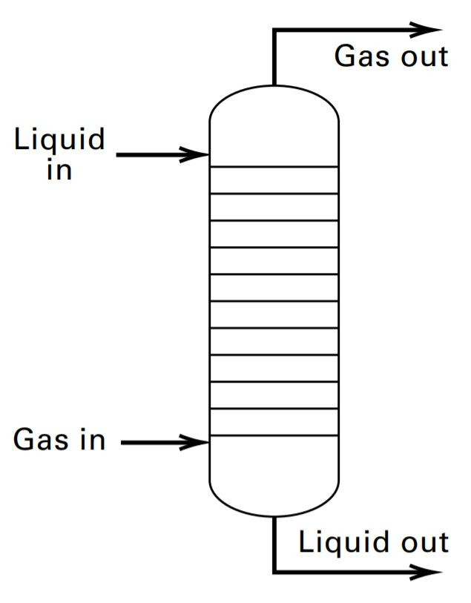
Stripper
Stripping Gas:
Nitrogen - inert
Methane - flammable
Steam - oxidant
Conditions: ← to be finalized
130 ℃, 20~30 kPa
Team Members
Project Summary
General
Design
Detailed Design
Cost
Analysis
Holistic
Concerns
Future
Work

Slide 23
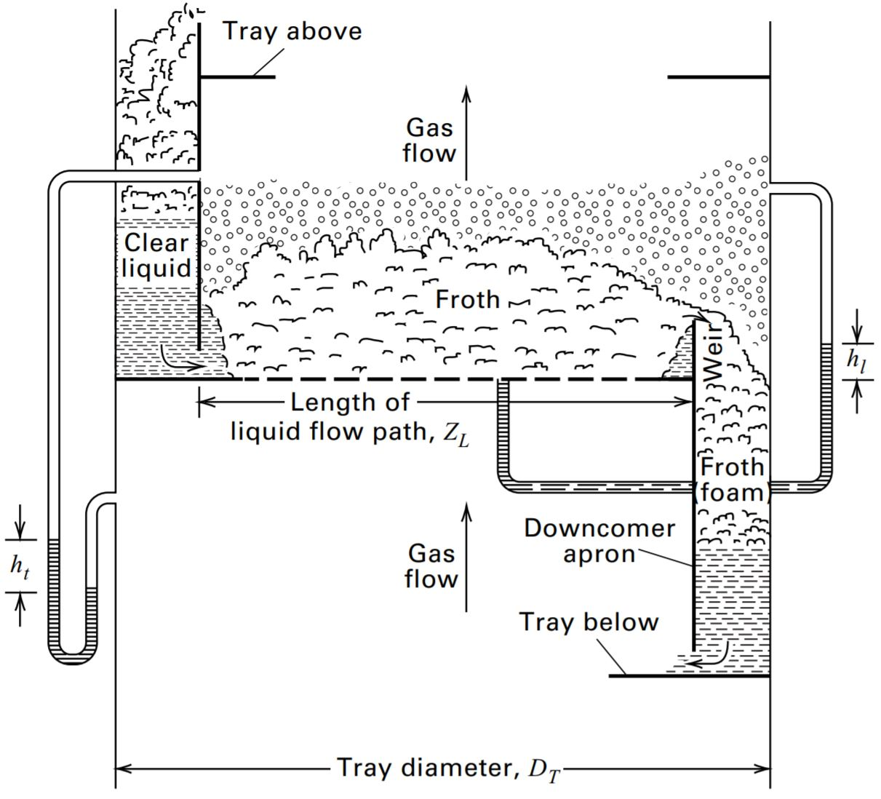
Stripper
Trayed tower
Sieve trays
5 stages
Assume 10 kPa pressure drop
Trade off:
Amount of N2 and number of stages

Slide 24
Hexane-Oil Separation
Optimization scheme
Flash section first → upstream, more expensive
Stripping section next
Independent variables (manipulate):
T, P, # of drums → low hexane oil → amount of N2, # of stages
Dependent variables (compare):
Cost: annualized capital cost + operating cost
Hexane in oil, oil in hexane, hexane recovery
Team Members
Project Summary
General
Design
Detailed Design
Cost
Analysis
Holistic
Concerns
Future
Work

Slide 26
Hexane-Oil Separation
Material of construction:
Oil: stainless steel → food application
Hexane only: carbon steel → hexane is highly non-polar
Steam: stainless steel → phase change is corrosive
High T + W/O2: stainless steel → kinetics
Process/cooling W: carbon steel → regular pipes + inhibitor
Liquid N2: stainless steel → less brittle at very low T
N2 gas: carbon steel → N2 is inert
Seed: carbon steel → simple storage, low humidity
Team Members
Project Summary
General
Design
Detailed Design
Cost
Analysis
Holistic
Concerns
Future
Work

Slide 27
Other Systems (not shown on PFD)
Transport:
Conveyors
Pumps + motors
Clarifiers
Utility:
Steam boiler
Cooling tower
Fuel storage
Team Members
Project Summary
General
Design
Detailed Design
Cost
Analysis
Holistic
Concerns
Future
Work

Slide 28
Cost Analysis
Capital cost: module costing method
Equipment type → key size variable → purchase cost
→ scale up for material, instrumentation, plant construction, etc
→ inflation → total capital cost → annualize
Team Members
Project Summary
General
Design
Detailed Design
Cost
Analysis
Holistic
Concerns
Future
Work

Slide 29
Cost Analysis
Operating cost
Materials cost and revenue (amount x average market price)
Utility cost (amount x price of steam, cw, N2, fuel)
Maintenance cost (capital cost x cost factors)
Labor cost (count heads x average salary)
Team Members
Project Summary
General
Design
Detailed Design
Cost
Analysis
Holistic
Concerns
Future
Work

Slide 30
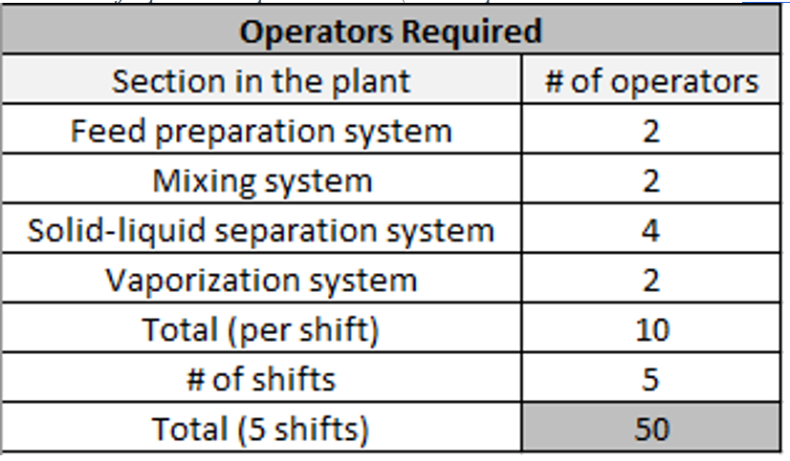
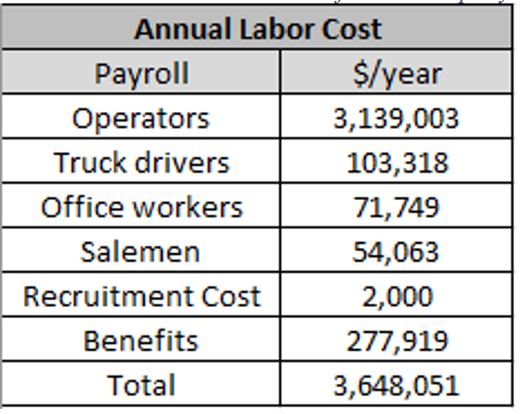
Cost Analysis
Team Members
Project Summary
General
Design
Detailed Design
Cost
Analysis
Holistic
Concerns
Future
Work
Notes:
The second method is the labor-related-operations method ^{[43]}. This method evaluates the type and arrangement of the equipment, the multiplicity of the units, and the control of each process. For a preliminary estimate of the number of operators required per shift, the process is divided into the following sections with each section requiring at least 2 operators at a time

Slide 31
Cost Analysis
From general design (PPFS):
Breakeven oil price: $2,670/t
Market oil price: $2,870/t
BEP is 7% lower than market price → feasible in the US
Criteria:
15% rate of return
20 year study period (plant life)
Team Members
Project Summary
General
Design
Detailed Design
Cost
Analysis
Holistic
Concerns
Future
Work

Slide 32
Further Considerations
Waste: CO2, N2, water
By-product: animal feed
Hazard: fire
Chemicals: relatively harmless
Reasonably safe and environmentally friendly
Team Members
Project Summary
General
Design
Detailed Design
Cost
Analysis
Holistic
Concerns
Future
Work

Slide 33
Further Considerations
South Sudan
Unstable economy → high inflation rate
→ unstable currency exchange rate
Poor infrastructure → high transportation cost
Low urbanization → high utility cost
Risky investment, likely unprofitable
Team Members
Project Summary
General
Design
Detailed Design
Cost
Analysis
Holistic
Concerns
Future
Work

Slide 34
Further Considerations
National Determination
South Sudan has petroleum resources
→ self-sufficient in fuel
Crude hexane must be hydrogenated for food applications
→ reliant on foreign technology
Uncertain outcome
Team Members
Project Summary
General
Design
Detailed Design
Cost
Analysis
Holistic
Concerns
Future
Work

Slide 35
Further Considerations
Cultural and Social Impacts
Promote industrial agriculture
Centralization of land → landless flowing into the cities
Dissolution of traditional society
Use caution to proceed
Team Members
Project Summary
General
Design
Detailed Design
Cost
Analysis
Holistic
Concerns
Future
Work

Slide 36
Further Considerations
Strategic Importance
Selling the oil is not the focus
Create technical employment
Training ground for future development
Maybe worthwhile even if unprofitable
Team Members
Project Summary
General
Design
Detailed Design
Cost
Analysis
Holistic
Concerns
Future
Work

Slide 37
Future Work
Check and refine assumptions
Finish optimizing equipment
Update cost estimate
Team Members
Project Summary
General
Design
Detailed Design
Cost
Analysis
Holistic
Concerns
Future
Work

Slide 38
Acknowledgement
Professors
Professor Chad Tatko (Organic Chemist)
Jennifer VanAntwerp (Chemical Engineer)
Jeremy VanAntwerp (Chemical Engineer)
Wayne Wentzheimer (Chemical Engineer)
Dr. Phil Bronsema (Industrial Chemist)
Zeeland Farm Services Inc. (Soybean Oil Company)
Team 18 (Mechanical Team)

